Slide 1
The correlation between content novelty and scientific impact
Wuhan University
Shiyun Wang (Presenter), Jin Mao and Yaxue Ma
September 30, 2021

Slide 2
1 Introduction
One major factor of research evaluation in contemporary science is citation count, which might underestimate the value of these studies in the early years.
The present paper offers new measures of novelty by exploiting knowledge content of papers, and explores the correlation between novelty and citation impact.

Slide 3
2 Methods
Dataset: 634,738 journal articles in PubMed.
Knowledge representation: knowledge entities obtained from PubTator Central system ¹ for each article.
Content novelty indicators:
(a) The proportion of new knowledge entities in a paper p compared to its references:
$${ent}_{p}= \frac{n_{pi}}{n_{p}}$$
(b) The proportion of new pairwise combination of knowledge entities in paper 𝑝 compared to its references:
$${com}_{p}= \frac{r_{pi}}{r_{p}}$$
¹ https://www.ncbi.nlm.nih.gov/research/pubtator/

Slide 4
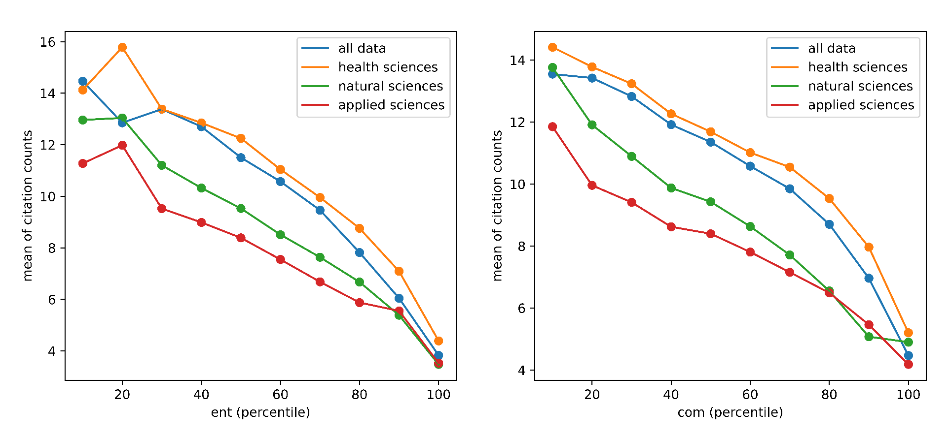
3 Results
We divided the papers into ten groups in terms of the ranking of novelty from low to high.
For each group of papers, we calculated the average number of citations each paper received over a 3-year period after the publication year.
Citations decrease significantly as the rise of novelty.
Figure 1: Average citation counts of papers in different novelty groups.

Slide 5
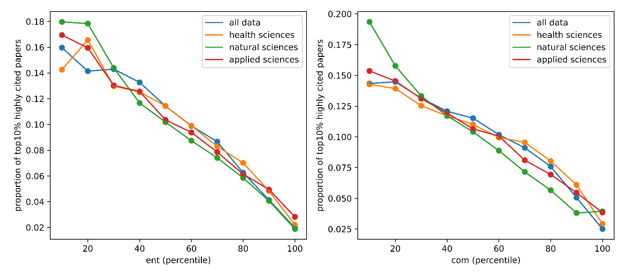
3 Results
The proportion of top10% highly cited papers declines as novelty increases.
Figure 2: Proportion of top10% highly cited papers in different novelty groups..

Slide 6
3 Results
Table 1. The Pearson correlation coefficient between content novelty and scientific impact.
It shows that content novelty of papers has significantly negative correlation with scientific impact.
Content novelty | Citation impact
 | 1-year | 3-year | 5-year | 10-year
ent | -0.114 | -0.130 | -0.126 | -0.100
com | -0.087 | -0.101 | -0.098 | -0.078
Note: The p-values were all smaller than 0.001.

Slide 7
4 Major Conclusion
The content novelty is negatively correlated with the citation impact, which indicates that the widely used citation count based measures may be biased against novel research, and thus may fail to recognize novel research in science.

Slide 8
THANKS
Contact
Shiyun Wang
Email: wangsy2@whu.edu.cn
Jin Mao
Email: maojin@whu.edu.cn
Yaxue Ma
Email: myx_vicky@163.com

