Slide 1
Analyzing Research Diversity of Scholars Based on Multi-dimensional Calculation of Entities
Cite：
Chuhan Wang, Tongyang Zhang, Yi Bu, and Jian Xu. 2022. Analyzing Research Diversity of Scholars Based on Multi-dimensional Calculation of Entities. In EEKE 2022, Cologne, Germany and Online, June 20 – 24, 2022, 5 pages.
Chuhan Wang, Tongyang Zhang, Yi Bu, and Jian Xu （Corresponding Author）
School of Information Management, Sun Yat-sen University
Presenter: Tongyang Zhang
School of Information Management, Sun Yat-sen University

Slide 2
1、Introduction
Notes:
研究背景和相关研究合并

Slide 3
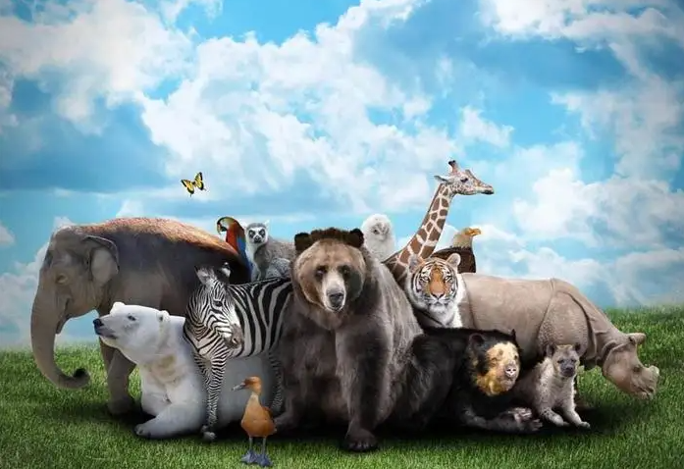
01
Introduction—Origin
Diversity in Biology
Originally defined as an index to measure the variety of animal species in biology [1], diversity has now been widely applied to capture multiculturalism in politics, diverse customers in business, multiple transmit channels in technology, etc. The increasing wide range of contents that research studies not only enrich the original system of knowledge, but also reflect the dynamic research characteristics of scholars.
Notes:
Originally defined as an index to measure the variety of animal species in biology [1], diversity has now been widely applied to capture multiculturalism in politics, diverse customers in business, multiple transmit channels in technology, etc. The increasing wide range of contents that research studies not only enrich the original system of knowledge, but also reflect the dynamic research characteristics of scholars.

Slide 4
02
Introduction—Related Work on Research Diversity
In sufficient Detailed Knowledge-level Studies on the Diversity of Research Contents
Paper-level Bibliometric Studies
(Need to offer intricate feature analysis and performance assessment of scholars)
(Capturing Interdisciplinarity
Among Fields)
Through the reasonably combination of different knowledge-level indicators, research diversity of scholars can be grasped more comprehensively
Traditional single-dimension index
(e.g., topic, discipline. Short of systematically comprehensive view angle, which impedes the full-featured diversity analysis of research)

Slide 5
03
Introduction—Our Work
Variety:
Number of Distinct Entities
Taking account into primary attributes of diversity in biology--variety, evenness, and disparity [2]
Calculate different combinations of diversity attributes, respectively
Explore the feasibility of different diversity calculation methods through using the allotaxonograph for comparing diversity rankings of scholars across different dimension combinations
Evenness: Balance of Distribution
Diversity Attributes
Disparity: Degree of Difference

Slide 6
04
Introduction—Objective
Through applying multiple diversity indexes used in biology to measure research diversity reflected in bio-entities, precise and comprehensive understanding can be drawn regarding various aspects of research diversity.
The applicability of different multi-dimensional calculation methods discussed provide a reference for method selection, ultimately leading to enriching the current system for evaluating scientific scholars and promoting the development of scientific progress.

Slide 7
2. Methodology

Slide 8
05
Methodology—Data Collection
All experimental data are obtained from PubMed Knowledge Graph (PKG) [3], a dataset extracting biomedical entities from all PubMed article abstracts and disambiguating author names.
The study adopts extracted entities on the types of Gene/Protein and Drug/Chemical, which are used as proxies as research contents, to measure research diversity of scholars.
We identify authors studying gene/drugs based on the author, entity and literature data from PKG in 1988-2017.
PKG

Slide 9
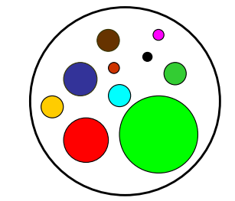
06
Methodology— One-dimensional Diversity
The variety of research content is represented by the number of distinct bio-entities (N) covered in all articles of an author as shown in Formular 1:
${ Div}_{N}=N$ (1)
When the number of distinct entities increases, the diversity of the research content is also improved.
Variety:
Number of Distinct Entities

Slide 10
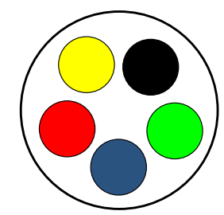
07
Methodology— One-dimensional Diversity
Evenness in this study reflects the degree of balance in the distribution of various research content proportion $p_{i}$:
${ Div}_{S}=(−\sum_{i}{p_{i}}\ln{p_{i}})/\ln{N}$ (2)
where $p_{i }$presents the proportion that the quantity of the entity $i$ takes up in all entities. Given a certain number of varieties, the more evenness the entity variety, and thus the higher equality degree of the research content distribution.
Evenness:
Balance of Distribution

Slide 11
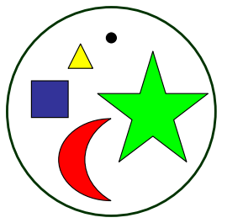
08
Methodology— One-dimensional Diversity
Disparity refers to the distance between research contents, which is indicated by the cosine distance $d_{ij}$ between any two entity vectors $x_{i}$and $y_{j}$:
${ d}_{ij}=1−\cos{θ}$ (3)
$cosθ=\frac{X·Y}{\left\|X\right\|·\left\|Y\right\|}=\frac{\sum_{i=1}^{n}{x_{i}y_{j}}}{\sqrt{\sum_{i=1}^{n}{x_{i}}}·\sqrt{\sum_{j=1}^{n}{y_{j}}}}$ (4)
where $x_{i}$/$y_{i}$ respectively represents the $i_{th}$/ $j_{th}$ vector in the corresponding vector group X and Y, and $n$ is the size of the vector dimension. In Formular 3, as the $\cos{θ}$ gets closer to 1, the further between two entities.
Disparity:
Degree of Difference

Slide 12
09
Methodology— Two-dimensional Diversity
The combination of variety and evenness expresses the concentrated level of research content. We use the diversity index Gini-Simpson [5] to quantitatively measure research diversity here:
${\begin{aligned} \\ Div\end{aligned}}_{GS}=1−\sum_{i=1}^{N}{p_{i}^{2}}$ (5)
Variety+Evenness

Slide 13
10
Methodology— Two-dimensional Diversity
The combination of variety and disparity represents the uniqueness level of research content. We use the Euclidean metric to measure the value difference between two vectors:
${ D}_{ij}\left(X,Y\right)=\sqrt{\sum_{i=1}^{N}{{\left(x_{i}−y_{j}\right)}^{2}}}$ (6)
Variety + Disparity

Slide 14
11
Methodology— Three-dimensional Diversity
Based on the calculation model of Rao-Strirling (RS) diversity [6], we integrate the three primary dimensions into a single expression:
${Div}_{∆}=\sum_{ij(i≠j)}{{(d_{ij})}^{α1}∙{(p_{i}∙p_{j})}^{β1}}$（α1=1，β1=1） (7)
where $d_{ij}$ denotes the cosine distance between entity $i$ and $j$. According to the RS formular definition, we can better measure the overall research diversity when setting the values of α1 and β1 to 1.
Variety + Disparity + Evenness

Slide 15
12
Methodology— Comparing Methods
The rank-turbulence divergence, a tunable instrument for comparing any two ranked lists, is used to quantitatively compare calculation methods of research diversity in different dimensional structures [7]. Given that a scholar τ has a rank $r_{(τ,1)}$ in the calculation method $R_{1}$ and $r_{(τ,2)}$ in the calculation method $R_{2}$, the divergence between $R_{1}$ and $R_{2}$ is calculated as follows:
$\begin{aligned}& D_{α}^{R}\left(R_{1}∥R_{2}\right)=\sum_{τ∈R_{1,2;α}}{ }δD_{α,τ}^{R}\left(R_{1}∥R_{2}\right) \\ &=\frac{1}{𝓝_{1,2;α}}\frac{α+1}{α}\sum_{τ∈R_{1,2;α}}{ }{\left|\frac{1}{{\left[r_{τ,1}\right]}^{α}}−\frac{1}{{\left[r_{τ,2}\right]}^{α}}\right|}^{1/(α+1)}\end{aligned}$ (8)
$\begin{aligned}𝓝_{1,2;α}&=\frac{α+1}{α}\sum_{τ∈R_{1}}{ }{\left|\frac{1}{{\left[r_{τ,1}\right]}^{α}}−\frac{1}{{\left[N_{1}+\frac{1}{2}N_{2}\right]}^{α}}\right|}^{1/(α+1)} \\ &+\frac{α+1}{α}\sum_{τ∈R_{1}}{ }{\left|\frac{1}{{\left[N_{2}+\frac{1}{2}N_{1}\right]}^{α}}−\frac{1}{{\left[r_{τ,2}\right]}^{α}}\right|}^{1/(α+1)}\end{aligned}$ (9)
where $N_{1}$and $N_{2}$ are the number of distinct scholars in each ranked list of calculation, α ($0≤α≤$∞) is a parameter to adjust the weights of the highly/lowly ranked scholars on the compound semantic system. The higher the divergence, the greater the ranking results between two calculation methods is.

Slide 16
3. Preliminary Results

Slide 17
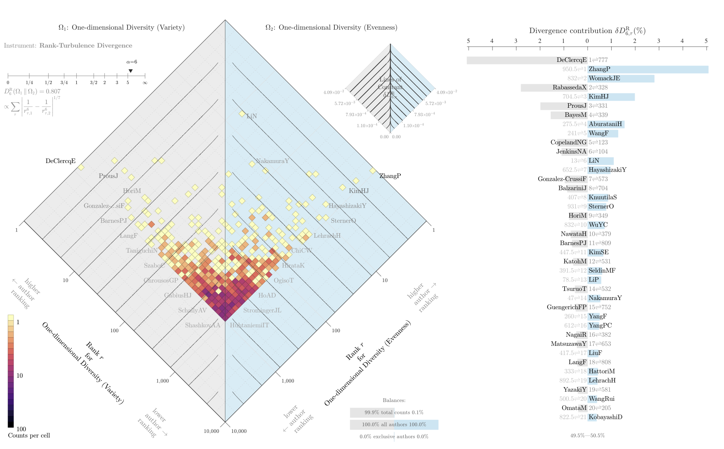
13
Comparison of the One-dimensional Diversity Results
The overall distribution pattern of the squares is dispersive, which means there are obvious research diversity differences in the two dimensions.
From squares far away from the central axis, we can find scholars whose studied entities are of high variety (e.g., De Clercq E.) and low evenness or low variety and high evenness(e.g., Zhang P.)
Figure 1: Allotaxonograph Comparing Ranked Lists of Scholars in Variety and Evenness of Research.

Slide 18
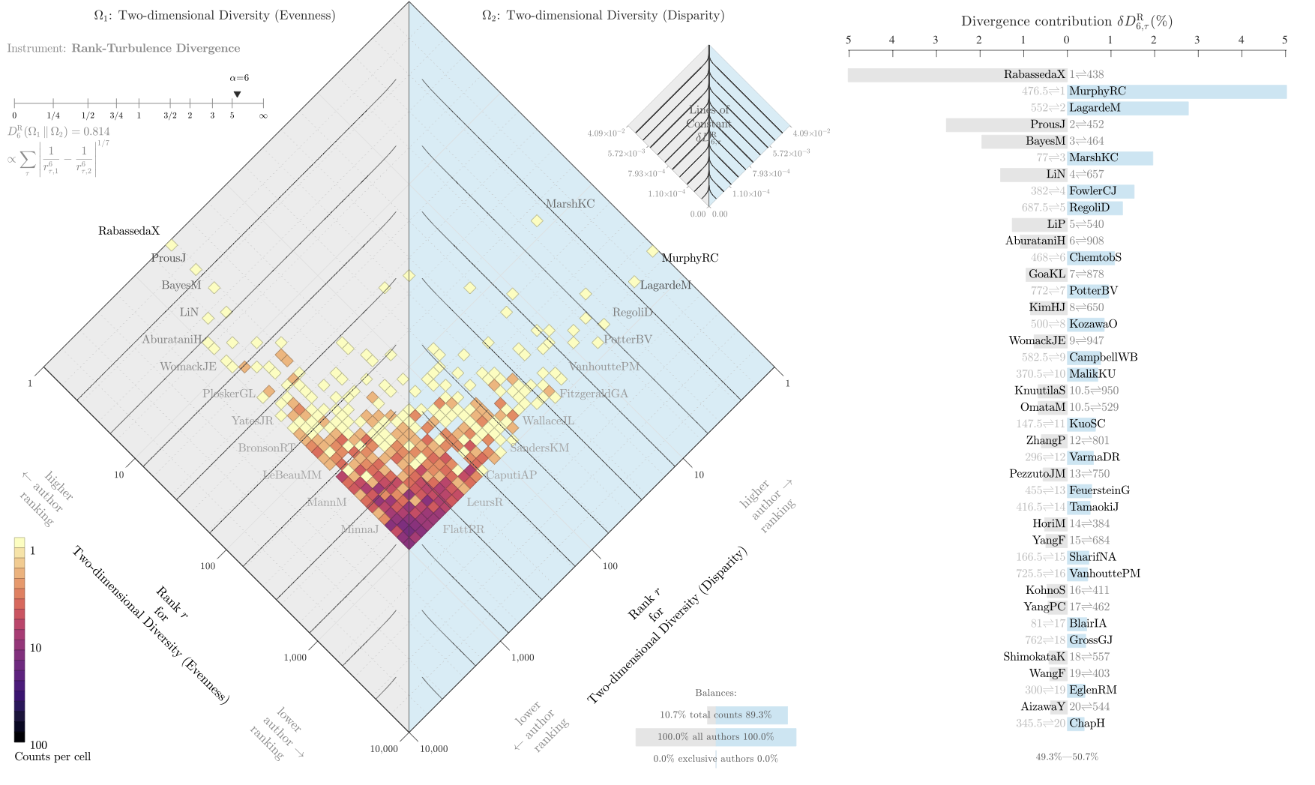
14
Comparison of the Two-dimensional Diversity Results
The overall distribution pattern of the squares is dispersive, which means there are obvious research diversity differences in the two dimension structures.
From squares far away from the central axis, we can find scholars whose studied entities are of high evenness and low disparity or low evenness and high disparity.
Affected by the relatively small quantity of entities, Zhang P., who ranks the first in evenness of the one-dimensional diversity, is reduced to rank 12th in the evenness/variety diversity.
Figure 2: Allotaxonograph Comparing Ranked Lists of Scholars in Evenness/Variety and Disparity/Variety of Research.
Notes:
We can find reasons for their divergence in the right graph.

Slide 19
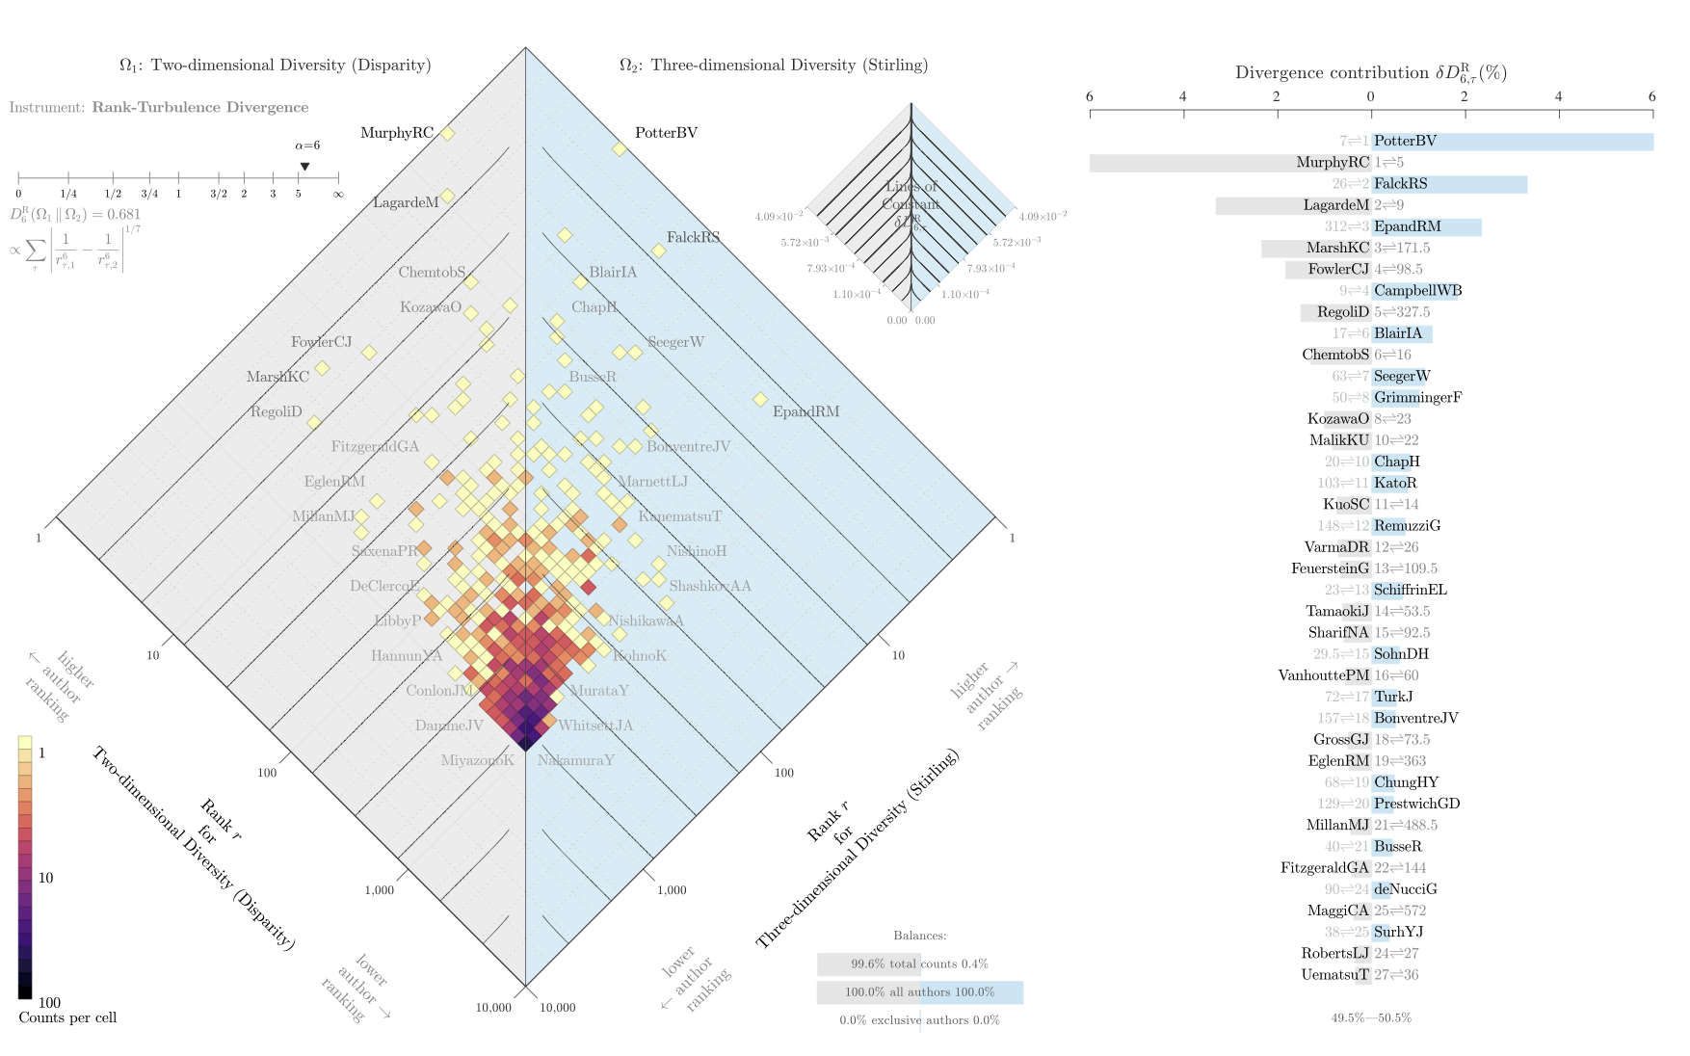
Comparison of the Two-dimensional and
Three-dimensional Diversity Results
15
The distribution of squares shows a converging pattern as a whole.
Some squares representing high-ranking scholars are not distributed near the central axis and the point of converging mainly concentrate in the middle of axis, which reflect in part results of the two diversity calculation methods vary.
Scholars concentrating in the middle of central axis (e.g., Chap H., Blair IA., Busse R.) have similar levels of variety, evenness and disparity in research diversity.
Figure 3: Allotaxonograph Comparing Ranked Lists of Scholars in Disparity/Variety and Disparity/Variety /Evenness (Stirling)

Slide 20
4、Conclusion

Slide 21
16
Conclusion
Diversity Attributes
Comparison of Methods
This study analyzes the research characteristics of scholars by using entities as a proxy.
It highlights three critical metrics, including variety, evenness and divergence, for assessing the diversity of research content.
Different combinations of these metrics form evaluating systems in three dimensional structures.
Results of them show differences.
The one-dimensional diversity is suitable when the anticipated need is a relatively simple and easy schema that reflects diversity in a direct way. It can also be used to deeply analyze one point of diversity characteristics of an author.
The two-dimensional help put different emphasis on the importance of evenness/variety or disparity/variety, other than a singular focus, which gives us alternative solutions of diversity measurement and multiple perspectives in higher dimensions. It avoids limitations in the one-sidedness of the one-dimensional diversity to some extent.
the three-dimensional diversity provides a comprehensive view of research diversity properties. The weights of different properties can be controlled to achieve the requirement for its flexible adjustment. It requires more complex calculations and data amount.

Slide 22
18
References
[1] Fisher A., Corbet S. A., Williams C. B, 1943. The relation between the number of species and the number of individuals in a random sample of an animal population, The Journal of Animal Ecology, 12 (1) :42-58.
[2] Ismael Rafols, Martin Meyer, 2010. Diversity and network coherence as indicators of interdisciplinarity: case studies in bionanoscience. Scientometrics, 82 (2): 263–287. DOI: 10.1007/s11192-009-0041-y.
[3] Jian Xu, Sunkyu Kim, Min Song, et al., 2020. Building a PubMed knowledge graph, Scientific Data, 7(1): 1-15. DOI:10.1038/s41597-020-0543-2.
[4] Pielou, E.C., 1966. Shannon’s formula as a measure of specific diversity: Its use and misuse. American Naturalist, 100 (914): 463-465.
[5] Simpson, E. H., 1997. Measurement of diversity. Journal of Cardiothoracic and Vascular Anesthesia, 11 (6): 812-812. DOI: 10.1136/thx.27.2.261.
[6] Andy Stirling. 2007. A general framework for analyzing diversity in science, technology and society. Journal of The Royal Society Interface, 4 (15): 707-719.
[7] Peter S., Dodds, J. R., Minot, M. V., Arnold, et al., 2020. Allotaxonometry and rank-turbulence divergence: a universal instrument for comparing complex systems. arXiv:2002.09770. Retrieved from https://arxiv.org/abs/2002.09770.

Slide 23
Thanks！
Chuhan Wang, Tongyang Zhang, Yi Bu, and Jian Xu （Corresponding Author）
School of Information Management, Sun Yat-sen University
Email: issxj@mail.sysu.edu.cn

