Slide 1
2SCE-4SL A 2-Stage Causality Extraction Framework for Scientific Literature
3rd Workshop on Extraction and Evaluation of Knowledge Entities from Scientific Documents.
Yujie Zhang¹, Rujiang Bai^{1*}, Ling Kong², Xiaoyue Wang¹
1.Institute of Information Management, Shandong University of Technology, Zibo
2.School of Information Management, Nanjing Agricultural University, Nanjing

Slide 2
Table of contents
01
02
Motivation
Method
03
04
Experiment
Future Work
Describe the motivation and challenges.
Describe the methodology of 2SCE-4SL
Describe the data, evaluation and experiment
Describe the limitations and future work

Slide 3
Motivation ：
1.Mining knowledge elements from literature, such as entities, concepts, and terms, is of great significance for promoting knowledge transmission and scientific innovation.
2.Discovering causality in scientific literature plays an important role in academic recommendation, knowledge discovery, intelligent reasoning, event abduction, causal inference, future scenario generation and other knowledge-driven downstream tasks.

Slide 4
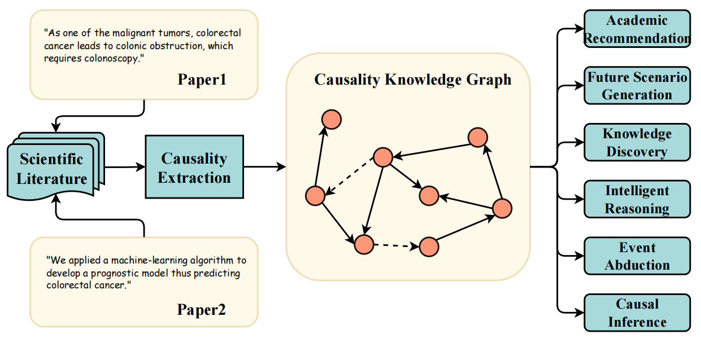
Figure 1: Application scenarios of causality extraction for scientific literature. Causal triplets can be extracted from scientific papers to construct knowledge graph about causality (e.g., Event Logic Graph), which can facilitate academic recommendation, future scenario generation, knowledge discovery, intelligent reasoning, event abduction, causal inference and other downstream tasks.
For example, two sentences shown in Fig1, "<colorectal cancer, leads to, colonic obstruction>, <prognostic model, thus, predicting colorectal cancer>" can be obtained by extracting causal pairs in the papers.
These causal triplets can be constructed as knowledge graphs about causality thereby improving the performance of automatic question answering systems; And also can predict potential connections between nodes by link prediction on the network, thereby facilitating knowledge discovery and future scenario generation.

Slide 5
The challenges of causality
extraction in scientific literature ：
1.Most of the current study focuses on common sense causality, while few research on causality extraction from scientific literature;
2.Due to long length, intricate linguistic characteristics and lack of domain-specific knowledge in scientific literature, causality extraction is still challenging;
3.Due to lack of large quantities of readily available annotation data, the performance of supervised causality extraction of scientific literature needs to be improved.

Slide 6
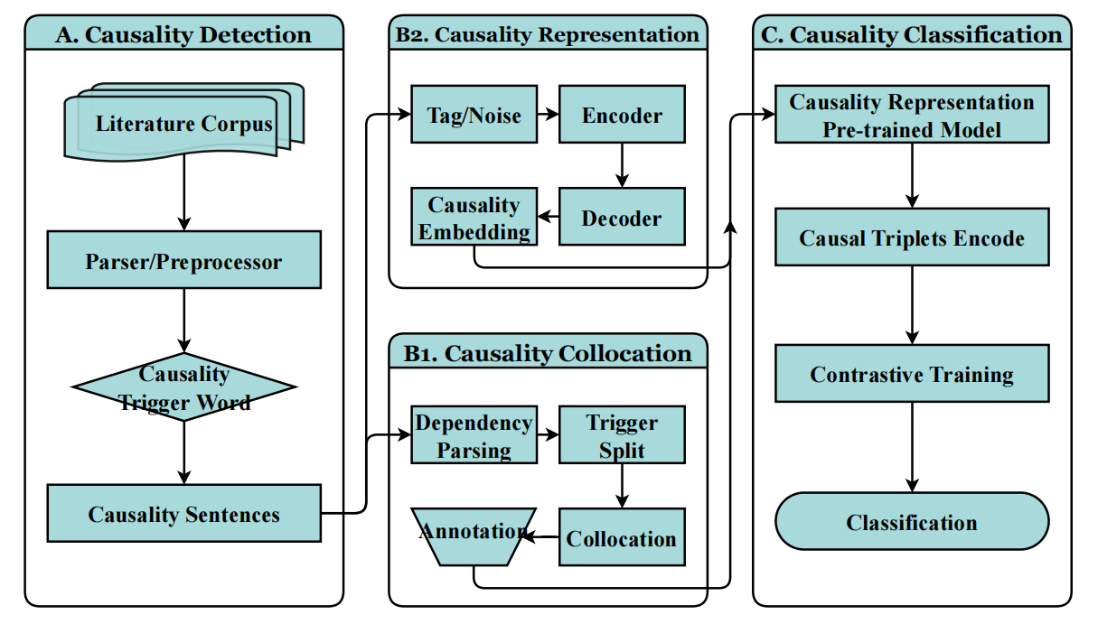
2SCE-4SL :
2-Stage Causality Extraction for Scientific Literature
Causality extraction in this paper is limited to explicit causality.
We preliminarily define the structure of causality, which is represented by the triple form of (c, v, e), where c means cause, e represents effect, and v represents causal trigger word. For example, <the malignant tumors, leads to, colonic obstruction>.
This triplet structure of causality is intelligible and could facilitate direct application easily in many downstream tasks shown in Fig1.
Stage 2
Stage 1
Figure 2: Framework of 2SCE-4SL. It consists of four parts: causality detection(A), causality collocation(B1, stage 1), causality representation(B2, stage 2), and causality classification(C).

Slide 7
The brief idea ：
1. Input scientific literature, causal sentences are detected in Part A.
2. Collocating candidate causal triplets (with noise) from causal sentences received in Part A based on pattern-matching. (Part B1, stage1)
3. Learning causal dependency and contextual knowledge of causal sentences based on DAE architecture. (Part B2, stage2)
4. Finding positive causal triplets based on text classification idea combine stage1 and stage2. (Part C)
Stage 2
Stage 1
Figure 2: Framework of 2SCE-4SL. It consists of four parts: causality detection(A), causality collocation(B1, stage 1), causality representation(B2, stage 2), and causality classification(C).

Slide 8
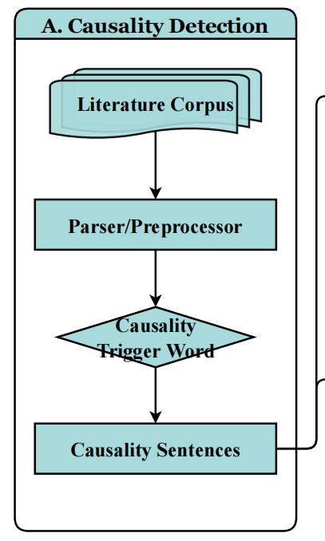
A.Causality detection
The purpose of this part is to identify sentences that express explicit causality in the literature.
Here, we divide the causality detection of scientific literature into three steps:
- Firstly, preprocessing the literature corpus;
- Then, defining trigger words that express causality;
- Finally, the sentences containing causal trigger words are identified.
In the selection of causal trigger words, we referred to the previous work, defining 81 causal cues such as "lead to, result in, because".
e.g. ........an increase in intestinal permeability would result in translocation of bacteria from the gut lumen......

Slide 9
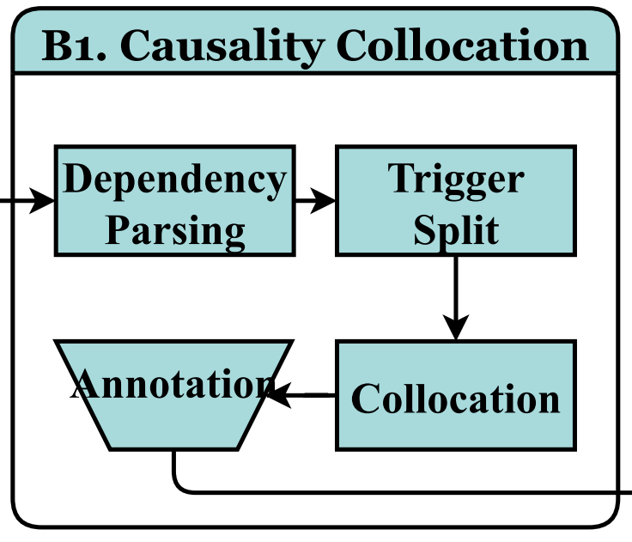
B1.Causality collocation (stage 1)
As the first stage of 2SCE-4SL, causality collocation aims to identify candidate causal triplets from causal sentences. We construct a large number of candidate causal pairs with entities collocation in this section, and then identify the true causal pairs in subsequent part.
To collocate candidate causal triplets, we use pattern-matching method to parser causal sentences.

Slide 10
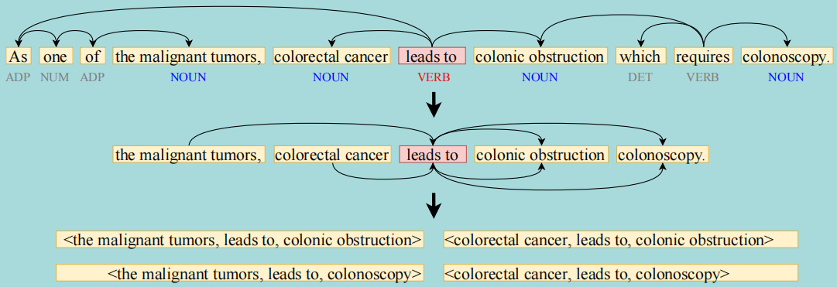
B1.Causality collocation (stage 1)
The causal trigger word v_{i} is identified from the causal sentence. Then, v_{i} is used as the boundary to identify the entities c_{i} and e_{i} on both sides. For any ∀c_{i} and e_{i} (c_{i} ≠ e_{i}), ergodic combination is carried out and Cartesian product is calculated to construct the triplets set C, which can be expressed as follows:
Figure 3: Example of causality collocation. Input a sentence, "As one of the malignant tumors, colorectal cancer leads to colonic obstruction, which requires colonoscopy.", using ScispaCy to perform dependency parsing, and identify the entities. Taking the trigger word "leads to" as the boundary, causal triplets "<the malignant tumors, leads to, colonic obstruction>, <colorectal cancer, leads to, colonic obstruction>, <the malignant tumors, leads to, colonoscopy>, <colorectal cancer, leads to, colonoscopy>" can be parsed from sentence.

Slide 11
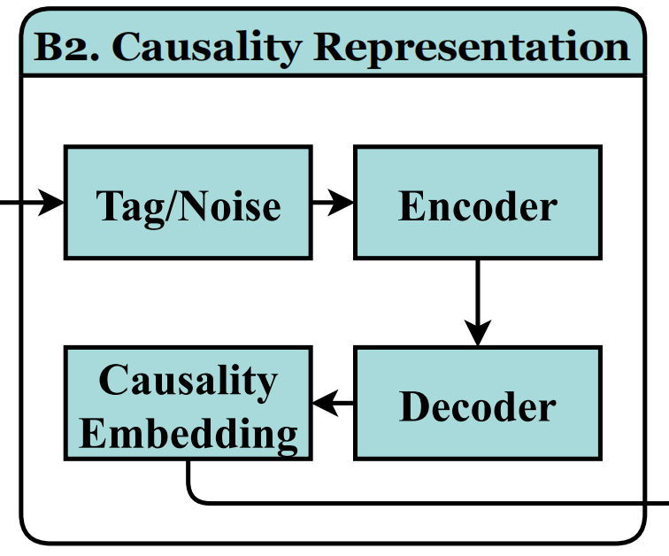
B2.Causality representation (stage 2)
We can find that the expressions of causal sentences have specific linguistic characteristics. The entities on the same side of the trigger word v_{i} are continuous sequence structures, while the entities on the other side of v_{i} are not only discrete in continuity, but also farther apart in vector coordinates. In addition, scientific literature generally contains professional knowledge compared with common sense.
As the second stage of 2SCE-4SL, causality representation aims to feature representation of causal sentences in part A, so as to learn causal dependency of sentences and contextual knowledge of the specific domain.

Slide 12
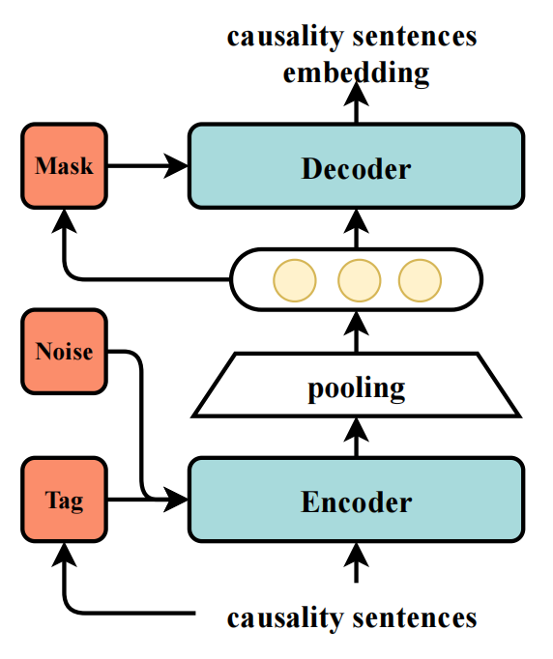
Figure 4: Architecture of causality representation.The architecture is an AutoEncoder based on Transformer model, which is composed of an Encoder and a Decoder.The Encoder tags the trigger word of a causal sentence when input, and then randomly adds disturbance information (deletion, addition, exchange, etc.), randomly masks some words before the Decoder. The training object is to recover the embedding representation of the original causal sentence from the noise data and learn semantic structural information.
To address these challenges, we constructed an encoder-decoder architecture network based on Transformer, which can be regarded as an AutoEncoder for learning causal structure. Inputting causal sentence, the position information of v_{i} is tagged in Encoder based on Denoising AutoEncoder(DAE)[36], then in Decoder, randomly add some noise to the sentence, and encode the fixed length vector, as well as randomly mask the words around v_{i}.
The goal of training is to recover the embeddeding representation of the original causal sentence from the noise data and learn its semantic structural information.

Slide 13
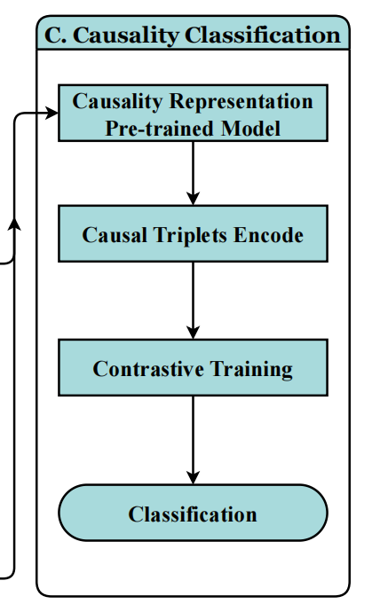
C. Causality classification
Candidate causal triplets collocated in Stage 1 contain lots of noise. “<colorectal cancer, lead to, colonoscopy>”, for example, does not express causality in the document.
The goal of part C aims to filter these noisy triplets. The positive causal pairs will be identified from noisy causal triplets based on fine-tuning model. We will solve this problem with a classification idea.
Given an arbitrary causal triplet (c, v, e), if label is 1, indicating true
causality, otherwise false causality.

Slide 14
Data ：
We chose S2ORC as our experiment data, which is a common English corpus for NLP and text mining research of scientific papers developed by Allen Institute for AI. We took Computer Science(CS) and Medicine(Med) as examples to extract causality. Randomly sampled some papers and selected the title, abstract and full-text as extraction objects respectively. CS and Med each collected 100,000 papers for a total of 200,000 papers.
For the training dataset, we parser candidate causal triplets in stage1, and annotate positive and negative samples. If true causal pair, marked as 1, otherwise marked as 0. In the titles, abstracts and full-texts of the two disciplines, 400 samples are marked respectively, and 2400 causal pairs are annotated in total.

Slide 15
Evaluation ：
Measure the quality and validity of causality representation:
- Whether the architecture captures causal dependency of sentences;
- Whether the architecture learns the semantic information of causal sentences.
Contrast experiments and ablation experiments:
- Whether there are differences in causality extraction among different disciplines (CS, Med);
- Whether different amounts of training data affect the results;
- The effect of whether causality representation (stage 2) on the results;
- Whether there are differences in the performance results of different document lengths (title, abstract, full-text).

Slide 16
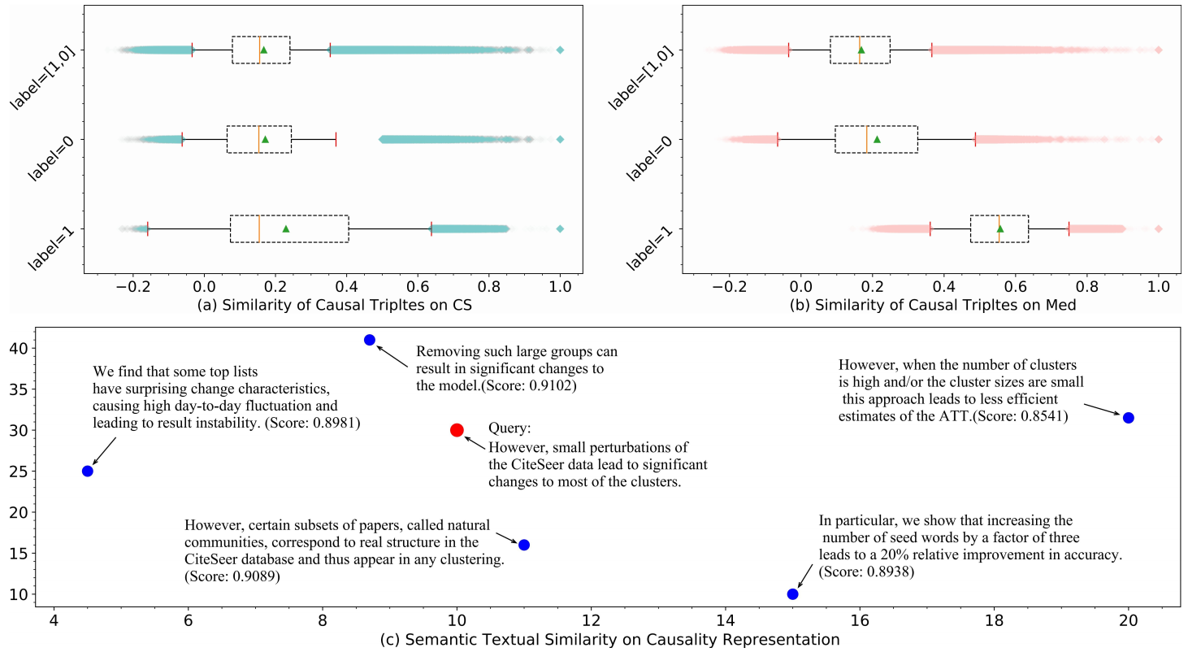
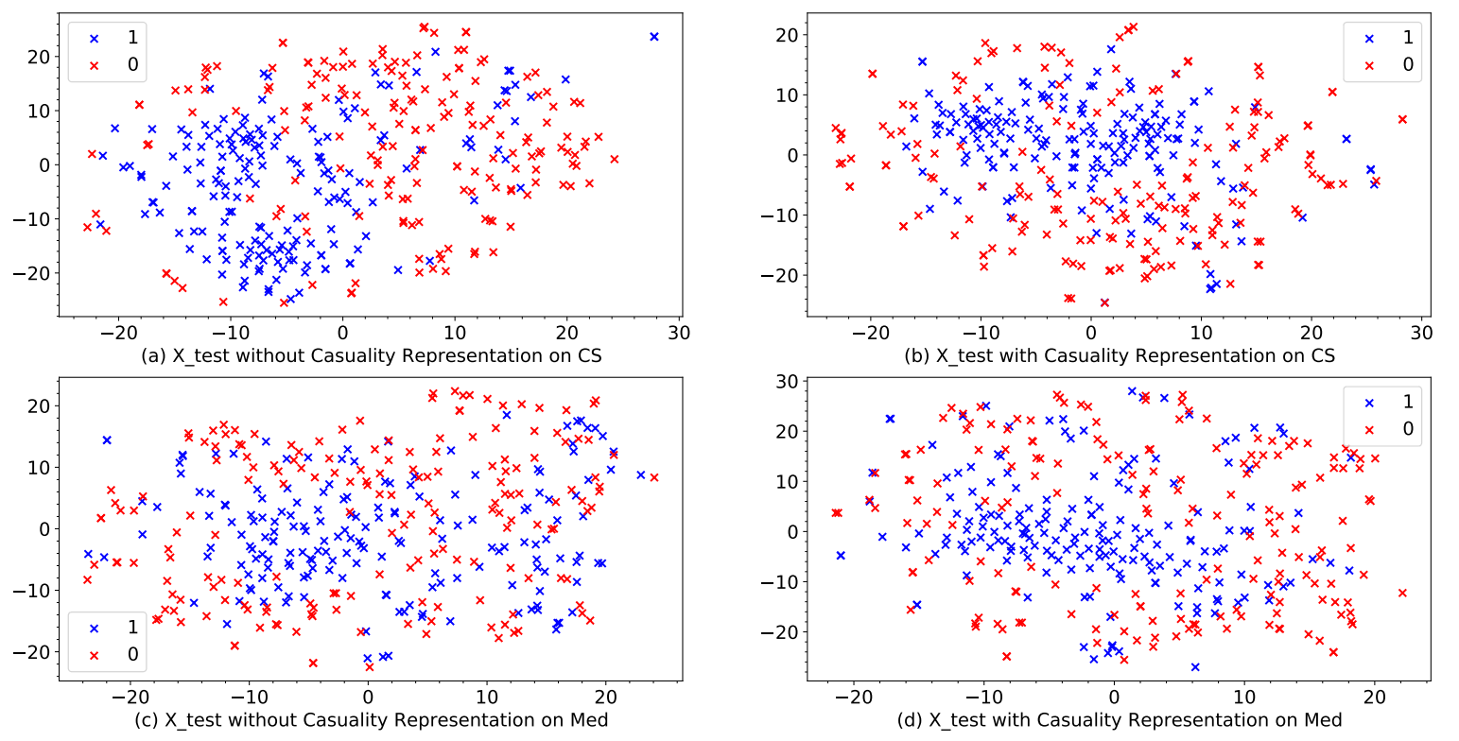
Figure 6: Evaluation for the causal dependency and semantic information.(a) and (b) are the sample similarity of CS and Med respectively. When both labels are 1, they have higher similarity, indicating that causal dependency of sentences can be captured. (c) is semantic search for causality representation. Input a paragraph to query the closest result, 5 returned records indicate that semantic information of causal sentences can be captured.
Figure 7: Ablation experiment for causality representation.The labels of test data after causality representation have better separability and clearer boundaries, especially CS, while the boundaries between labels without causal representation are fuzzy.
Causality representation on scientific literature

Slide 17
Causality classification on scientific literature
(1) Comparison of different data volumes
Results are shown in table 3.
We can find that the increase of training data will improve the precision and F1 of the model accordingly.

Slide 18
Causality classification on scientific literature
(2) Ablation experiment: whether causality representation
The results are shown in table 4.
It can be found that increasing causality representation at stage 2 significantly improved the results.

Slide 19
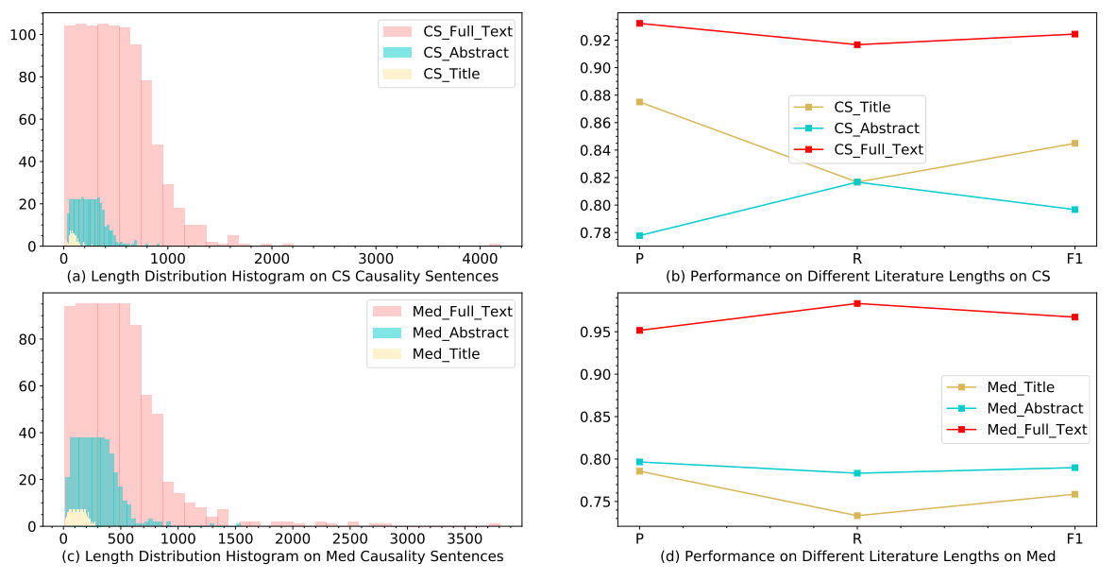
Causality classification on scientific literature
(3) Comparison of different document lengths
We compare the influence of different document lengths on classification metrics. It can be found in table5, on CS, the best performance is in the full text, followed by the title. On Med, full text is the best, followed by abstract, the average precision of the two disciplines is 0.9420.
Relationship between document length distribution and classification performance is shown in Fig8. The longer the length, the better the classification performance. For example, CS, the full-text causal sentence has a longer distribution, with P,R and F1 exceeding 0.9.

Slide 20
Limitations and future work ：
2SCE-4SL extracts only explicit causality and does not include implicit causality. Due to the limitation of causal trigger words, those implicit causalities (i.e. without trigger words but expressing causality) are difficult to be identified.
The second stage of 2SCE-4SL is represented in sentences rather than paragraphs, which means that those long-distance causality are difficult to identify.
In the future, we will solve these problems and conduct applications to more downstream tasks.

Slide 21
Question & Answering
3rd Workshop on Extraction and Evaluation of Knowledge Entities from Scientific Documents.
Yujie Zhang
1725zyj@gmail.com
Institute of Information Management
Shandong University of Technology

