Slide 1
EVALUATION OF EMBEDDING MODELS FOR AUTOMATIC EXTRACTION AND CLASSIFICATION OF ACKNOWLEDGED ENTITIES IN SCIENTIFIC DOCUMENTS
NINA SMIRNOVA*^{1,}, PHILIPP MAYR¹
¹ GESIS – LEIBNIZ INSTITUTE FOR THE SOCIAL SCIENCES, COLOGNE, GERMANY
* PRESENTING AUTHOR: NINASMIRNOVA@WEB.DE

Slide 2
Focus of the study
evaluate the performance of different embedding models for the task of automatic extraction and classification of acknowledged entities from the acknowledgment text in scientific papers.
Acknowledgments in scientific papers are short texts where the author express gratitude towards different types of support received during the research process.

Slide 3
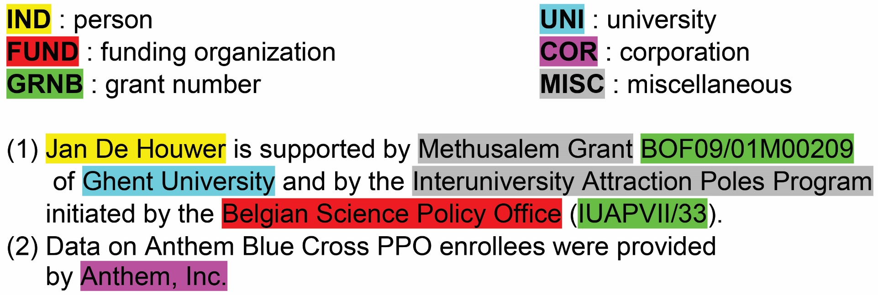
Entity Types

Slide 4
FLAIR
an NLP framework
open-sourced & built on PyTorch
has shown better accuracy for NER tasks using pre-trained datasets in comparison with other open source NLP tools
is easily customizable

Slide 5
Research Questions
RQ1: Which of the Flair default NER models is more suitable for the defined task of the extraction and classification of acknowledged entities from scientific acknowledgements?
RQ2: How does the training corpus size impact the training accuracy for different NER models?

Slide 6
Why developing a new NER tool?
previous works on automatic acknowledgment analysis were mostly concerned with the extraction of funding organizations and grant numbers or classification of acknowledgement texts.
large bibliographic databases such as Web of Science (WoS) and Scopus selectively index only funding information, i.e., names of funding organizations and grant identification numbers.

Slide 7
Problems with WoS funding information indexing

Slide 8
Data
2 differently-sized training corpora:
49 sentences (corpus No. 1)
654 sentences (corpus No. 2)
Records from:
Four different scientific disciplines (sociology, economics, oceanography, computer science)
published from 2014 to 2019 in English
WoS records types “article” and “review”

Slide 9
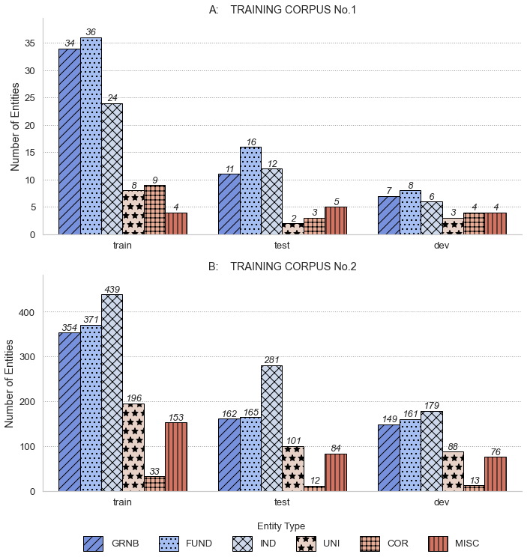
The distribution of acknowledged entities of each type in the training corpora

Slide 10
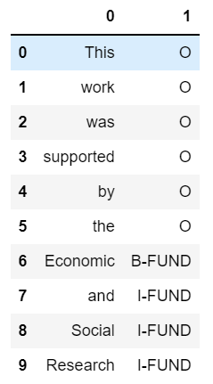
Annotation
semi-automated approach
the Flair format - the IOB2-format (Inside–Outside–Beginning) for tag annotation

Slide 11
FLAIR NER Models
Named Entity Recognition (NER) Model with Flair Embeddings
Stacked Embeddings: contextual string embeddings + GloVe
Named Entity Recognition (NER) Model with Transformers (FLERT)
RoBERTa
Zero-shot or Few-shot Named Entity Recognition (NER) with Task-aware representation of sentences (TARS)

Slide 12
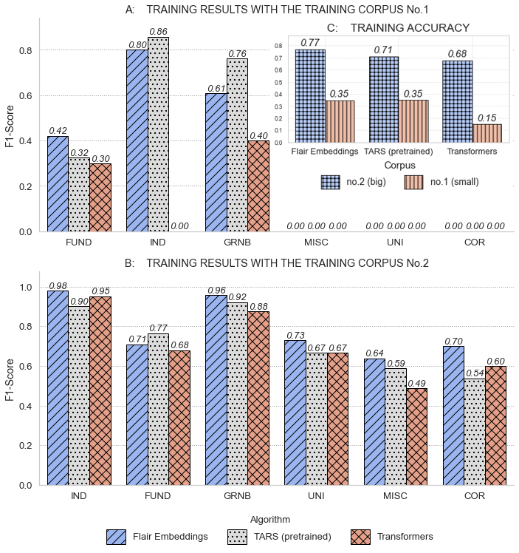
Default Training Results
Best Model:
Flair Embeddings
0.77
Zero-short TARS
FUND | 0.23
GRNB | 0.33
IND | 0.86
UNI | 0
COR | 0
MISC | 0

Slide 13
Additional Training
Altered corpus
3 Entity Types
5 Entity Types
Altered algorithm
RoBERTa+ Flair Embeddings

Slide 14
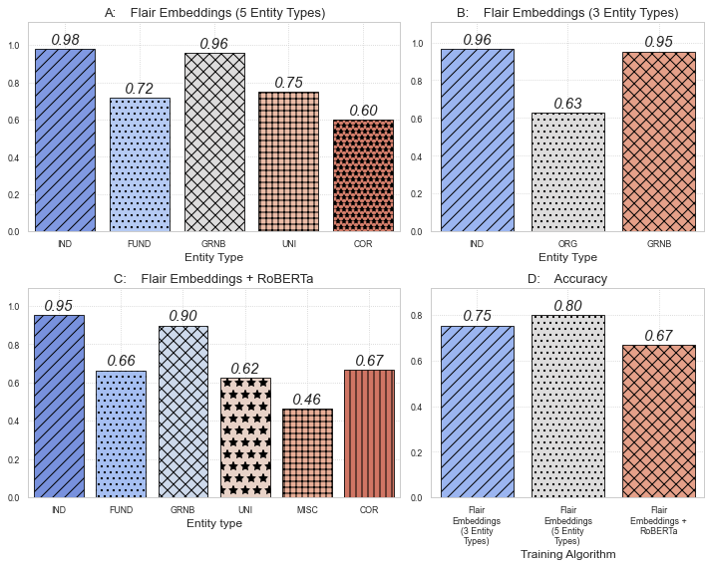
Additional Training Results

Slide 15
DEMO

Slide 16
Future Work
expanding the training corpus
try other models such as SciBert

Slide 17
Thank you for your attention!

