Slide 1
The Impact of Interdisciplinarity and Entity Characteristics on the Clinical Translation Intensity of COVID-19 Papers
Joint Workshop of the 4th Extraction and Evaluation of Knowledge Entities from Scientific Documents (EEKE2023)
and the 3rd AI + Informetrics (AII2023)
Shuang Chen
School of Health Management
China Medical University
shuangchen1212@163.com
Chunli Liu*
Library, China Medical University
liuchunliliangxu@163.com
Corresponding author

Slide 2
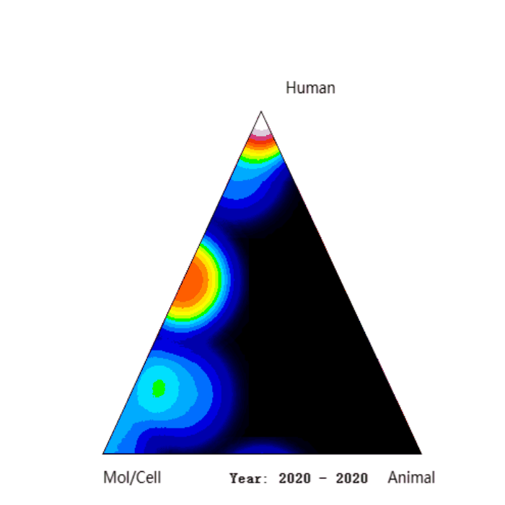
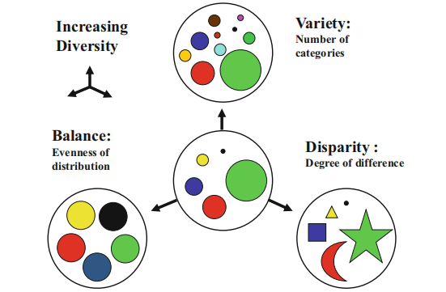
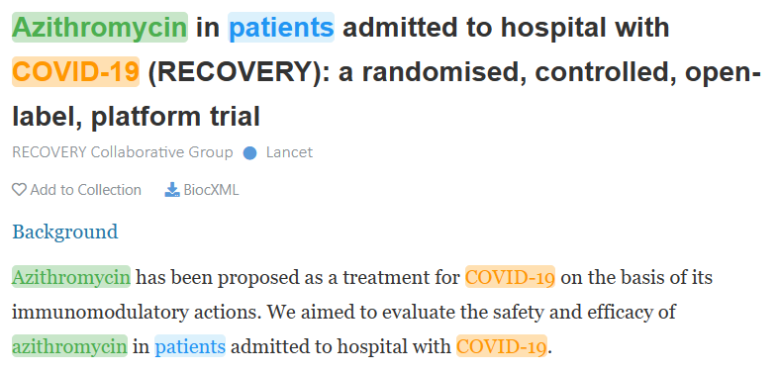
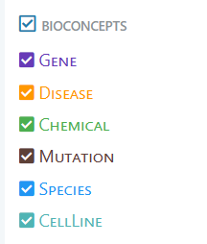
1 Introduction
1 Introduction
Biomedical research has academic impact & clinical impact
The exploration of scientific impact evaluation has been very rich, but the identification and measurement of clinical impact
is still relatively weak.
Clinical translation Interdisciplinary research Biological entity features
Source:iCite
Source: Pubtator
objectives
1) to measure the clinical translation intensity of COVID-19 articles published in 2021.
2) to test the impact of interdisciplinary level and the characteristics of biological entity on the intensity of clinical translation of COVID-19 papers.

Slide 3
2 Related works
The measurement of clinical translation intensity of biomedical papers
“Biomedical Triangle method”
Whether the paper is cited in clinical trials or clinical guidelines
Biomedical entities
Interdisciplinary features of COVID-19 papers
Liu's research confirmed that the global pandemic was a "catalyst" for scientific innovation, with the degree of novelty in papers and the proportion of first-time collaborations increasing after the outbreak of COVID-19 .
Zhang et al. investigated the interdisciplinary of COVID-19 papers published in 2020, the first year after the outbreak of COVID-19 .
Entity characteristics in biomedical papers
Li X. developed four indicators (Popularity, Promising, Prestige and collaboration) and analyzed the relationship between the characteristics of biomedical entities and the way drugs are reused.
Li X. also published two papers in which the clinical translation potential of scientific papers was predicted based on the entity characteristics of scientific papers .

Slide 4
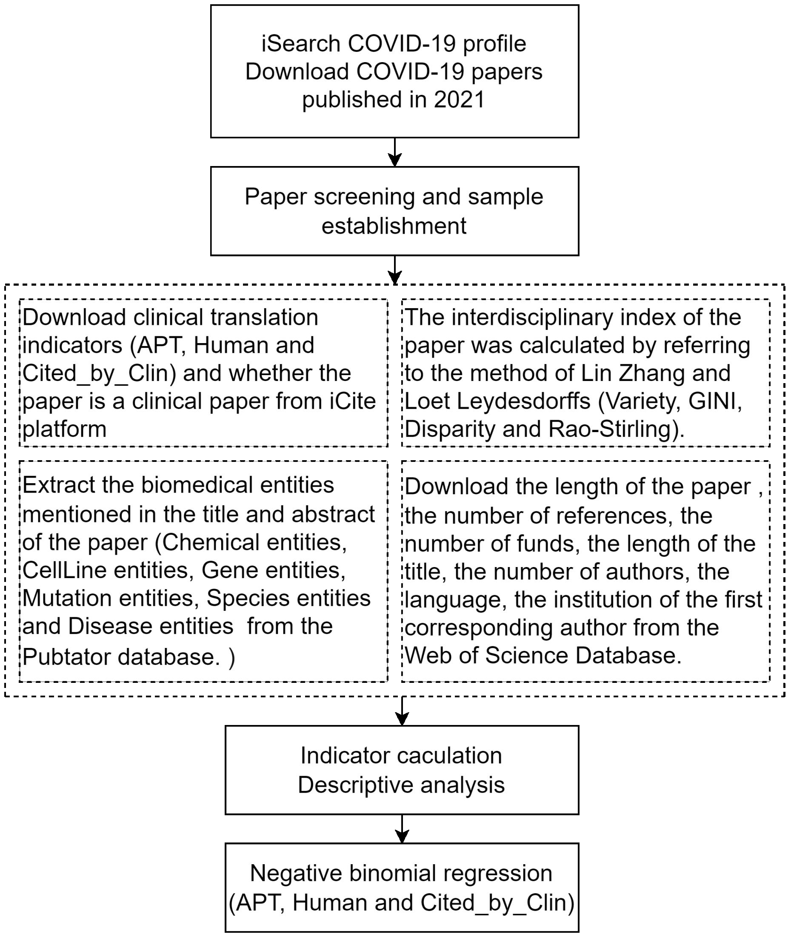
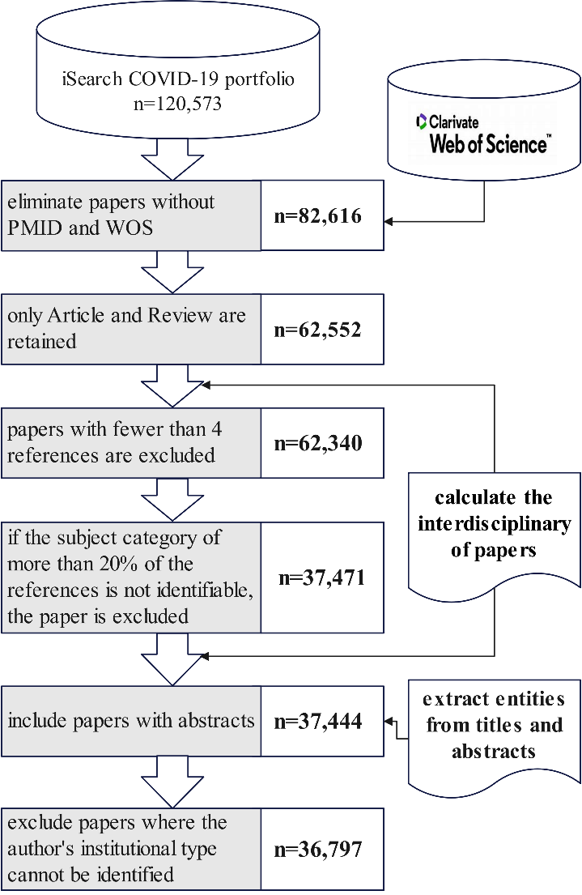
3 Methods
Research flow chart
Inclusion and exclusion criteria

Slide 5
3 Methods——variables
dependent variables
Control variables
Three dependent variables | Implications
APT | The probability of a paper being cited in clinical guidelines, clinical trials, etc., after publication.
Human | The ratio of MeSH terms of Human category to the sum of MeSH term categories of Human, Animal and Mol/Cell in the paper.
Cited_by_Clin | The number of times the paper has been cited in clinical papers such as clinical trials, clinical guidelines, etc
Control variables | Description
Length of paper | The number of pages in the paper.
Number of references | The number of references in the paper.
Number of funds | The number of funds mentioned in the paper.
Length of Title | The number of words in the title.
Number of authors | The number of authors in the paper.
Clinical paper | Whether this paper is a clinical trial, clinical guidelines, and other clinical papers, 1= Yes; 0= No.
English Language | Whether the paper is written in English, 1= Yes; 0= No.
Institution type | 0=Company; 1=Foundation; 2=Government; 3=Hospital; 4=Research institution; 5=Universityor College.
independent variables
Interdisciplinary indicators | Connotations
RAO-Stirling | Reflecting the number of disciplines represented, their distribution, and differences, the indicator ranges from 0 to 1.
GINI | The degree of uniformity in the distribution of different disciplines
Variety | The ratio of the number of subjects involved in the study to the total number of subjects.
Disparity | A measure of distance between different disciplines.
Variables of entity characteristics | Definitions
CellLine | The number of CellLine entities with different "Entity IDs" mentioned in a paper.
Chemical | The number of Chemical entities with different "Entity IDs" mentioned in a paper.
Disease | The number of Disease entities with different "Entity IDs" mentioned in a paper.
Gene | The number of Gene entities with different "Entity IDs" mentioned in a paper.
Mutation | The number of Mutation entities with different "Entity IDs" mentioned in a paper.
Species | The number of Species entities with different "Entity IDs" mentioned in a paper.

Slide 6
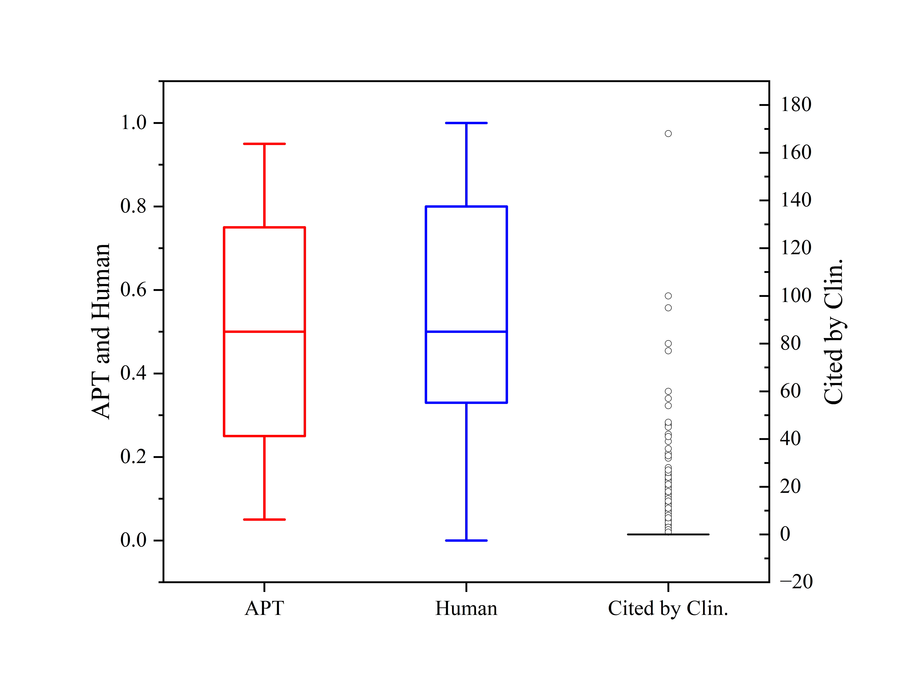
4 Results——Summary of APT, Human and Cited_by_Clin
variables | Mean | SD | Median | Min | Max
APT | 0.461 | 0.309 | 0.5 | 0.05 | 0.95
Cited_by_Clin | 0.495 | 2.123 | 0 | 0 | 168
Human | 0.581 | 0.298 | 0.5 | 0 | 1
RAO-STIRLING | 0.832 | 0.077 | 0.851 | 0 | 0.959
GINI | 0.000 | 0 | 0 | 0 | 0.003
VARIETY | 0.001 | 0 | 0 | 0 | 0.005
DISPARITY | 0.909 | 0.042 | 0.919 | 0 | 0.991
CellLine | 0.060 | 0.288 | 0 | 0 | 6
Chemical | 0.652 | 1.376 | 0 | 0 | 22
Disease | 3.536 | 2.668 | 3 | 0 | 41
Gene | 0.638 | 1.502 | 0 | 0 | 27
Mutation | 0.044 | 0.469 | 0 | 0 | 25
Species | 1.558 | 1.141 | 1 | 0 | 19
Table 5 Descriptive analysis of dependent and independent variables
Figure 4: Box plot of APT, Human and Cited_by_Clin

Slide 7
4 Results——Negative Binomial Regression
APT | Coef. | St.Err. | p-value
RAO-STIRLING | .084 | .207 | .687
VARIETY | -17.907 | 98.617 | .856
GINI | 30.889 | 146.358 | .833
DISPARITY | -.052 | .318 | .87
Number of CellLine entities | -.025 | .029 | .395
Number of Chemical entities | -.038 | .006 | 0
Number of Disease entities | .029 | .003 | 0
Number of Gene entities | -.017 | .006 | .004
Number of Mutation entities | -.031 | .02 | .12
Number of Species entities | -.077 | .008 | 0
Length of paper | .007 | .002 | 0
Number of references | -.0004349 | .000214 | .042
Number of funds | .015 | .005 | .002
Length of Title | .005 | .002 | .004
Number of authors | .0003123 | .000092 | .001
Clinical Article | .228 | .029 | 0
English Language | .917 | .131 | 0
Type of institution
Company (REF) | 0 | . | .
Foundation | .101 | .111 | .363
Government | .162 | .107 | .132
Hospital | .029 | .067 | .668
Research institution | -.091 | .069 | .192
University | -.037 | .065 | .57
Constant | -1.799 | .241 | 0
Positive
Number of Disease entities
Negative
Number of Chemical entities
Number of Gene entities
Number of Species entities
Table 6 Negative binomial regression for APT

Slide 8
4 Results——Negative Binomial Regression
Human | Coef. | St.Err. | p-value
RAO-STIRLING | .034 | .18 | .852
VARIETY | -89.1 | 89.152 | .318
GINI | 114.387 | 131.733 | .385
DISPARITY | -.004 | .276 | .988
Number of CellLine entities | -.246 | .034 | 0
Number of Chemical entities | -.052 | .006 | 0
Number of Disease entities | .03 | .002 | 0
Number of Gene entities | -.041 | .006 | 0
Number of Mutation entities | -.054 | .02 | .009
Number of Species entities | -.122 | .007 | 0
Length of paper | -.005 | .002 | .007
Number of references | -.002 | .0002245 | 0
Number of funds | -.031 | .005 | 0
Length of Title | .009 | .001 | 0
Number of authors | .0001628 | .0001227 | .184
Clinical Article | .184 | .026 | 0
English Language | -.019 | .07 | .788
Type of institution
Company (REF) | 0 | . | .
Foundation | .169 | .102 | .098
Government | .168 | .102 | .099
Hospital | .174 | .064 | .006
Research institution | .021 | .067 | .749
University | .102 | .063 | .103
Constant | -.493 | .191 | .01
Positive
Number of Disease entities
Negative
Number of CellLine entities
Number of Chemical entities
Number of Gene entities
Number of Mutation entities
Number of Species entities
Table 7 Negative binomial regression for Human

Slide 9
4 Results——Negative Binomial Regression
Cited_by_Clin | Coef. | St.Err. | p-value
RAO-STIRLING | -.096 | .353 | .786
VARIETY | -28.332 | 167.529 | .866
GINI | 91.928 | 249.526 | .713
DISPARITY | -.252 | .536 | .638
Number of CellLine entities | .264 | .045 | 0
Number of Chemical entities | -.04 | .01 | 0
Number of Disease entities | .066 | .005 | 0
Number of Gene entities | -.026 | .009 | .005
Number of Mutation entities | -.15 | .04 | 0
Number of Species entities | -.1 | .014 | 0
Length of paper | .006 | .003 | .028
Number of references | .001 | .0003638 | .074
Number of funds | .072 | .008 | 0
Length of Title | -.001 | .003 | .655
Number of authors | .039 | .002 | 0
Clinical Article | 1.095 | .048 | 0
English Language | 1.89 | .257 | 0
Type of institution
Company (REF) | 0 | . | .
Foundation | -.425 | .193 | .027
Government | .544 | .171 | .002
Hospital | -.128 | .106 | .227
Research institution | -.306 | .11 | .005
University | -.454 | .103 | 0
Constant | -2.824 | .425 | 0
Positive
Number of CellLine entities
Number of Disease entities
Negative
Number of Chemical entities
Number of Gene entities
Number of Mutation entities
Number of Species entities
Table 8 Negative binomial regression for Cited_by_Clin

Slide 10
4 Conclusions
APT is measured from the perspective of the potential of a paper to be cited by clinical guidelines or clinical trials after publication.
Human is measured from the perspective of the proportion of MeSH terms in a paper that are biased toward human beings.
Cited_by_Clin is measured from the perspective of the actual number of citations of a paper by clinical guidelines or clinical trials.
Interdisciplinary research requires more time and perseverance to overcome challenges.
The number of chemical entities, gene entities and species entities had significant negative effects on APT.
The number of CellLine entities, chemical entities, gene entities, species entities and mutation entities had significant negative effects on Human.
The number of chemical entities, gene entities, mutation entities and species entities had significant negative effects on clinical citation.The CellLine entities has a positive relationship with clinical citation.
The number of disease entities had a positive impact on APT, Human, and clinical citations.

Slide 11
4 Conclusions
COVID-19 papers published in 2021
22.43% of the papers were cited in clinical trials or clinical guidelines.
47.42% of the papers are biased towards human research in MeSH terminology.
46.1% of papers have the potential to be cited in clinical studies after publication.
interdisciplinary features, biomedical entity features & clinical translation strength

Slide 12
Thanks for Your Attention！
Joint Workshop of the 4th Extraction and Evaluation of Knowledge Entities from Scientific Documents (EEKE2023)
and the 3rd AI + Informetrics (AII2023)
Shuang Chen
School of Health Management
China Medical University
shuangchen1212@163.com
Chunli Liu*
Library of China Medical University
liuchunliliangxu@163.com
Corresponding author

