Slide 1
AII-EEKE2025
Interdisciplinarity and Scientific Output Quality in AI-for-Science
——Implications from a Literature Analysis of AI4S
Weiyu Duan¹ , Ying Guo^{2*} , and Jiaqi Wei³
Presenter: Weiyu Duan | duanweiyu@ucas.ac.cn
Notes:
Good morning everyone.
It was an honor to participate in this workshop
My name is Weiyu Duan and today I will present our study “Interdisciplinarity and Scientific Output Quality in AI-for-Science (AI4S): Implications from a Literature Analysis of AI4S

Slide 2
AII-EEKE2025
01
02
Research framework and hypotheses
Introduction
03
Data and method
04
Empirical analysis
05
Discussion and conclusion
Notes:
first let me introduce our research background and why we foucs this research question

Slide 3
Research Background
AI for Science:
Interdisciplinarity
Research Gap
However, despite the increasing prevalence of AI-enabled methodologies across disciplines, it is not clear what kind of interdisciplinary knowledge recombination model can promote the quality of AI4S research in terms of “knowledge” and “team” dimensions, and its mechanism remain largely unexplored.
AI has emerged as a transformative technology, widely anticipated to enhance the quality of scientific outputs across diverse disciplines.
The quality of AI4S research is not only defined by the novelty of the methods used, but by the extent to which the research engages with the existing scientific knowledge.
Research Question: What role did interdisciplinarity play in promoting the quality of AI4S at both the knowledge base level and research team level?
Notes:
AI has emerged as a transformative technology, widely anticipated to enhance the quality of scientific outputs across diverse disciplines.
As a nascent research paradigm that hinges on cross-disciplinary knowledge recombination, the quality of AI4S research is not only defined by the novelty of the methods used, but by the extent to which the research engages with the existing scientific knowledge.
The quality of researches requires not only the recombination of heterogeneous domain knowledge embodied in the research itself, but also the re-assembly of expertise within the collaborating team.
However, despite the increasing prevalence of AI-enabled methodologies across disciplines, it is not clear what kind of interdisciplinary knowledge recombination model can promote the quality of AI4S research in terms of “knowledge” and “team” dimensions, and its mechanism remain largely unexplored.
To address this research gap, this study aims to investigate the interdisciplinarity’s effect on scientific output quality in AI4S research. In particular, we propose these questions: What role did interdisciplinarity play in promoting the quality of AI4S at both the knowledge base level and research team level?

Slide 4
AII-EEKE2025
01
02
Research framework and hypotheses
Introduction
03
Data and method
04
Empirical analysis
05
Discussion and conclusion
Notes:
second，i will discrbe the

Slide 5
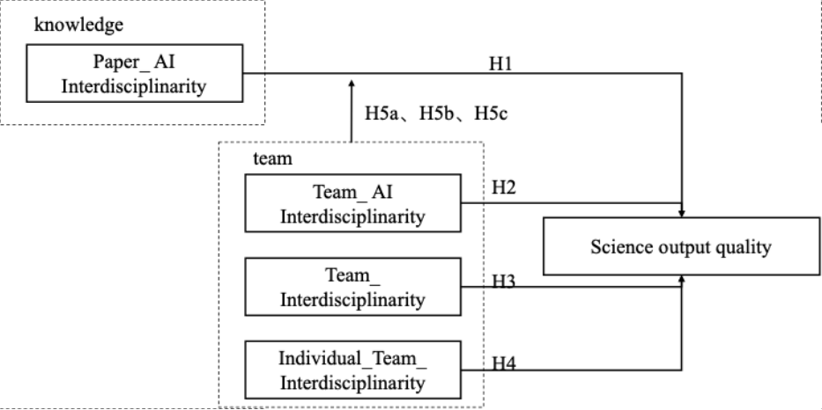
Conceptual Framework
This study seeks to elucidate the factors that contribute to the production of high-quality research in the field of AI4S by examining the relationships among “knowledge” and “team” dimensions.
Based on the knowledge-based view and the knowledge recombination perspective, this study analyzes 6,643 AI4S publication data identified through an advanced Large Language Model (LLM) methodology.
Fig.1 The conceptual framework
Notes:
This study uses the knowledge-based view and the knowledge recombination perspective to analyse 6,643 AI4S publications identified through an advanced Large Language Model (LLM) methodology.

Slide 6
Hypotheses—Knowledge-level
The methodological depth of AI integration critically determines research outcomes. Methodologically grounded integration—where domain expertise and AI techniques undergo reciprocal refinement—systematically generates novel, replicable discoveries (Uzzi et al., 2013).
H1: Paper AI interdisciplinarity positively affects scientific output quality.
The strength of a research team's artificial intelligence (AI) knowledge background, which reflects the extent of members' previous AI research and specialization in the AI field, significantly enhances the team's capability to effectively apply AI theories and methods to interdisciplinary research problems, thereby producing higher-quality research outputs. Therefore, teams well-versed in AI are not only proficient in recognizing opportunities for AI application but also in integrating AI methods into research practices, ultimately driving more substantial scientific advances.
H2: Team AI interdisciplinarity positively affects scientific output quality.
Notes:
The depth of the methodology used for AI integration is critical in determining research outcomes. Methodologically sound integration, where domain expertise and AI techniques are mutually refined, systematically generates novel and replicable discoveries. This leads us to our first hypothesis: Paper AI interdisciplinarity positively affects scientific output quality.
Our second hypothesis shifts focus to the team behind the research: H2: Team AI Interdisciplinarity positively affects scientific output quality. here, we‘re examining the AI knowledge background of the research team. We blieve that The strength of a research team's artificial intelligence (AI) knowledge background, which reflects the extent of members' previous AI research and specialization in the AI field, significantly enhances the team's capability to effectively apply AI theories and methods to interdisciplinary research problems, thereby producing higher-quality research outputs.

Slide 7
Hypotheses—Team -level
AI4S research requires integrating artificial intelligence techniques with various scientific disciplines (e.g., biology, physics, environmental sciences). Interdisciplinary teams can effectively combine specialized AI knowledge—such as machine learning models and data-driven algorithms—with domain-specific scientific expertise, resulting in more robust, innovative, and practically valuable solutions (Wuchty et al., 2007;).
H3: Team interdisciplinarity positively affects scientific output quality.
Team Interdisciplinarity in individual level is defined as a situation in which a single researcher has expertise in all the different disciplines present in the team (Haeussler and Sauermann, 2020). The presence of a scientist with a multifaceted profile bridges the gap between the different backgrounds of other team members. The higher the degree of disciplinary crossover at the individual level, the more likely the researcher is to independently complete key aspects from algorithm development to scientific problem solving, reduce communication costs within and outside the team, and increase the ability to reorganise knowledge.
H4: Team Interdisciplinarity in individual level positively affects scientific output quality.
Notes:
Moving to the team level, we now examine hypotheses about the impact of team composition and individual expertise on scientific output.
H three: Team Interdisciplinarity positively affects scientific output quality.
This hypothesis focuses on the overall diversity of disciplines present across the entire team. The core idea is that bringing together varied expertise fosters innovation.
H four: Team Interdisciplinarity at the Individual Level positively affects scientific output quality.
As defined previous study，individual-level team interdisciplinarity exists when a single researcher has mastery of all the different disciplines present on the team. The presence of a scientist with a multifaceted profile bridges the gap between the different backgrounds of other team members. The higher the degree of disciplinary crossover at the individual level, the more likely the researcher is to independently complete key aspects from algorithm development to scientific problem solving, reduce communication costs within and outside the team, and increase the ability to recombination knowledge.

Slide 8
Hypotheses-Interaction effects
When the team's AI expertise is high, the AI expertise at the paper level will be more fully translated into high-quality research results. If the team's AI expertise is low, even if the paper tries to use advanced AI methods, the effect on the quality of the results may be weakened by problems of algorithm selection, parameter tuning and insufficient explanation.
H5a: Team AI interdisciplinarity positively moderates moderates the relationships between paper AI interdisciplinarity on scientific output quality.
AI interdisciplinarity at the paper-level, which integrates AI methodologies with multiple scientific disciplines, involves significant complexity due to differences in terminologies and methodologies across disciplines. When team interdisciplinarity is high, researchers are better equipped to bridge these disciplinary divides, effectively manage the inherent cognitive complexity, and coordinate diverse disciplinary insights, thereby significantly reducing communication and collaboration costs (Cummings & Kiesler, 2007; Leahey & Beckman, 2016).
H5b: Team interdisciplinarity positively moderates the relationships between paper AI interdisciplinarity on scientific output quality.
Notes:
We examine -Interaction effects between two levels
Hypothesis H5a focuses on Team AI interdisciplinarity。 When the team's AI interdisciplinarity is high, the AI interdisciplinarity at the paper level will be more fully translated into high-quality research results. If the team's AI interdisciplinarity is low, even if the paper tries to use advanced AI methods, the effect on the quality of the results may be weakened by problems of algorithm selection, parameter tuning and insufficient explanation.
Second, H5b: Team interdisciplinarity positively moderates the relationship between paper AI interdisciplinarity and scientific output quality.
AI interdisciplinarity confers substantial innovation potential by enabling distant knowledge recombination, yet it can simultaneously elevate the coordination costs of that recombination.

Slide 9
Hypotheses-Interaction between two levels
When the research task already involves a high degree of AI-driven interdisciplinarity, further interdisciplinarity at the individual level tends to result in significant overlap and redundancy in the knowledge bases of team members. Without deep, domain-specific expertise, team members are unable to contribute genuinely complementary perspectives, thereby reducing the marginal benefits of integrating interdisciplinary knowledge. An overly high level of individual interdisciplinarity may confine the team to surface-level amalgamations when integrating AI with other domains of knowledge, and is not conducive to reorganising knowledge from an AI-based approach alongside disciplinary specialization(Haeussler and Sauermann, 2020; Porter and Rafols, 2009).
H5c: Team Interdisciplinarity in individual level negatively moderates the relationships between paper AI interdisciplinarity on scientific output quality.
Notes:
in h5c we believe that，If each member understands most of the team's disciplines, the cost of interdisciplinary communication and knowledge integration is significantly reduced; AI methods can be seamlessly integrated with multidisciplinary variables and theories, resulting in the full benefit of the paper's AI expertise

Slide 10
AII-EEKE2025
01
02
Research framework and hypotheses
Introduction
03
Data and method
04
Empirical analysis
05
Discussion and conclusion
Notes:
Third, I will cover Data and Method.

Slide 11
Data Collection
Data Source
Journals and Conferences
Data Processing
√
√
√
We utilizes a comprehensive dataset from the literature on AI4Science, extracted from the works of Xie et al., 2025.
Top multidisciplinary journals (Nature, Science) and premier AI conferences (AAAI, NeurIPS, etc.).
In addition, to obtain individual-level data, we downloaded for each author the ASJC field classifications of prior articles from Scopus. This allows us to proxy for each author's expertise in up to 27 major fields.
 | No. | Dataset
AI4S publications | 6354 | Dataset 1
Historical publications by all authors of AI4S publications | 3,905,629 | Dataset 2
All references of AI4S publications | 243,544 | Dataset 3
Description of the dataset
Notes:
We utilised a comprehensive dataset on AI4Science, extracted from the work of Xie et al. (2025). including Top multidisciplinary journals (Nature, Science) and premier AI conferences (AAAI, NeurIPS, etc.).
. After cleaning, we retained 6,643 （six thousand, six hundred and forty-three）AI4S publications spanning 2014–2024（twenty fourteen to twenty twenty-four）, as well as over 3.9 million prior publications by their authors and 240（Two hundred and forty ） thousand cited references for disciplinary profiling.

Slide 12
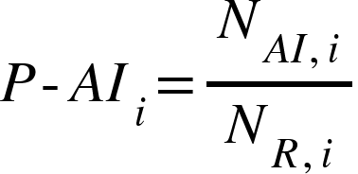
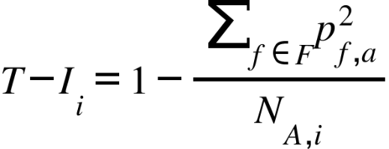
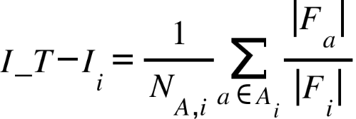
Variable Measurement
Dependent Variable:
Scientific output quality measured by the number of citations received until 2024.
Independent Variables:
Paper AI Interdisciplinarity (P-AI): The proportion of cited references related to AI within the publication
Team AI Interdisciplinarity (T-AI): Fraction of prior AI publications by each author, averaged across the team.
Team Interdisciplinarity (T-I): 1-HHI of paper’s ASJC code.
Individual Team Interdisciplinarity (I_T-I): Each member's percentage of participation in the the team’s ASJC codes.
Notes:
Moving to our empirical strategy, let‘s examine how we caculate the key Variables：
Scientific output quality is measured by the number of citations received until 2024.
Paper AI Interdisciplinarity (P-AI) is mearsured by The proportion of cited references related to AI within the publication
Team AI Interdisciplinarity (T-AI) mearsured by the Fraction of prior AI publications by each author, averaged across the team.
Team Interdisciplinarity (T-I) is mearsured 1-HHI of journals’ ASJC code.
Individual Team Interdisciplinarity (I_T-I)mearsured by the average level of each member‘s percentage of participation in the team’s ASJC codes.

Slide 13
Control Variables
Number of Authors (NA): | Teams typically produce more cited research than individuals.
Open Access Status (OAS): | Open access articles have higher accessibility and visibility.
Publication Type (PT): | Articles vs. other types of publications.
Publication Year (PY): | Earlier publications accumulate more citations.
Number of References (NR): | More references may integrate more knowledge.
Length of Title (LT): | Longer titles may enhance the visibility of research content.
Notes:
We controlled Number of Authors 、Open Access Status 、Publication Type 、Publication Year 、Number of References and Length of Title in our model。

Slide 14
Estimation Methods
Citations are count data for which the negative binomial models are natural candidates. Over-dispersion and the conditional mean of the outcome variable being much lower than its variance are the most common arguments for favouring the negative binomial over the Poisson model.
To test Hypotheses 1–4, a negative binomial model is used. We first construct Eq. (5) to test the main effect.
Second, we construct Eq. (6) to test Hypotheses 5.
Notes:
Because our dependent variable, citation counts, is overdispersed, this paper uses a negative binomial model to test hypotheses 1-5.

Slide 15
AII-EEKE2025
01
02
Research framework and hypotheses
Introduction
03
Data and method
04
Result
05
Discussion and conclusion
Notes:
“Fourth, I will present the Empirical Analysis result in our studies.

Slide 16
Results
H1-H4
Variable | Model 1 | Model 2 | Model 3
T-AI |  | 0.480*** (0.074) | 0.200ª (0.104)
P-AI |  | 1.452*** (0.070) | 0.798 (0.557)
T-I |  | 1.123*** (0.170) | 0.504 ª (0.289)
I_T-I |  | 0.863*** (0.146) | 2.166*** (0.211)
T_AI X P_AI |  |  | 0.844*** (0.220)
T_I X P-AI |  |  | 1.840** (0.624)
I_T-I X T-AI |  |  | -3.059*** (0.342)
LN(NA+1) | 0.562*** (0.023) | 0.768*** (0.037) | 0.840*** (0.038)
OAS | 0.192*** (0.046) | 0.363*** (0.048) | 0.366*** (0.048)
PT | 1.029*** (0.049) | 1.4797*** (0.0515) | 1.481*** (0.052)
PY | 0.492*** (0.006) | 0.491*** (0.006) | 0.492*** (0.006)
LN(NR+1) | 0.742*** (0.019) | 0.664*** (0.020) | 0.659*** (0.020)
LT | -0.048*** (0.004) | -0.046*** (0.004) | -0.046*** (0.004)
Observations | 6643 | 6643 | 6643
Log Likelihood | -27383.223 | -26935.616 | -26894.752
Prob > chi² | 0.000 | 0.000 | 0.000
F Statistic | 692.811 | 482.700 | 376.185
H5a-H5c
Notes:
As shown in the table:
Model 1 includes controls only.
Model 2 adds the four interdisciplinarity variables in order to test hypotheses H1–H4.
Model 3 introduces three interaction terms to test H5a–H5c.
With the exception of H5c, all of the hypotheses are supported by the results of the data analysis. This may be because coordination costs are high when activities depend on each other, requiring frequent interactions and mutual adjustment.

Slide 17
AII-EEKE2025
01
02
Research framework and hypotheses
Introduction
03
Data and method
04
Empirical analysis
05
Discussion and conclusion
Notes:
Finally, I will conclude with the Discussion and Conclusion.

Slide 18
Discussion and Conclusion
Our study provides clear insights for the broader scientific community and academic policy makers:
In order to improve the quality of research outputs using AI technology, it is not only necessary for the author team to have a background in AI research and to apply AI technology in depth in their research, but it is also necessary for the author team to have a high degree of interdisciplinarity.
However, when the articles have a high degree of AI interdisciplinarity, it is necessary for each researcher to have his/her own more specialised field competence at the individual level of the team, different from other authors, to further improve the application of AI techniques and thus the quality of research outputs.
Notes:
Our study provides clear insights for the broader scientific community and academic policy makers:
In order to improve the quality of research outputs using AI technology, it is not only necessary for the author team to have a background in AI research and to apply AI technology in depth in their research, but it is also necessary for the author team to have a high degree of interdisciplinarity.
However, when the articles have a high degree of AI interdisciplinarity, it is necessary for each researcher to have his/her own more specialised field competence at the individual level of the team, different from other authors, to further improve the application of AI techniques and thus the quality of research outputs.

Slide 19
Discussion and Conclusion
Our study provides clear insights for the broader scientific community and academic policy makers:
The bringing together of expertise and knowledge from various domains could help in the identification of blind spots and opportunities in the knowledge landscape. It seems crucial to us that institutions and a policy environment be developed that are conducive to enhancing dialogue and cross-fertilization between communities. This could be achieved, for instance, by reinforcing both horizontal (intra-field) and vertical (interfield) knowledge management.
Notes:
The bringing together of expertise and knowledge from various domains could help in the identification of blind spots and opportunities in the knowledge landscape. It seems crucial to us that institutions and a policy environment be developed that are conducive to enhancing dialogue and cross-fertilization between communities.

Slide 20
Discussion and Conclusion
Limitations and Future Work
First，our study applies the AI4S dataset as defined in the existing literature, and although it considers a sample of papers from a cross-section of disciplines, it focuses mainly on top multidisciplinary journals and premier AI conferences. In future studies， the results can be validated by further expanding the dataset of AI4S papers. In addition, the application of analysis in the measurement of the dependent variable and independent variables in this study can be further expanded.
Second, at the team level, it would be interesting to observe how scientific output quality in AI‐for‐Science changes as individuals learn to collaborate or as team composition changes through entry and exit of members.

Slide 21
AII-EEKE2025
THANK YOU!
Notes:
Thank you so much for listening! I would absolutely love to hear your comments and suggestions!

