Slide 1
Research on Technology Evolution Analysis Method from the “Problem-Solution-Effect” (PSE) Three-Dimensional Perspective
Reporter: Zhanyi Zhao
Institution:
IP Research Department,
National Science Library,
Chinese Academy of Sciences(CAS)
Team Members:
Ruiyu Yang, Jiatang Luo
Lili Zheng, Lucheng Lv, Yajuan Zhao*

Slide 2
CONTENTS
01
Research background & object
02
Related work
03
Research design
04
Research results and explanations
05
Conclusion and outlooks
06
References

Slide 3
01
Research background & object

Slide 4
Research background & object
Fourth industrial revolution is having a wide and profound impact.
Big data, robotics, AI and other digital technologies.
Scientific and technological innovation has become the main battlefield of international strategic competition.
The analysis of technological evolution can help us understand the characteristics of technological development and anticipate technological opportunities.
Schumpeter: technological innovation involves the reorganization of production factors.
Technology evolution: The process that technological production factors interaction, generation, development, maturation, and eventual extinction over time.
Using quantitative or qualitative methods to analyze the process , and to clarify the trajectory of technological innovation.
The analysis granularity and accuracy of the existing methods need to be improved.
Representitive carrier: patent citation, classification or text(technology composition, Patent portfolio).
Analysis methods: TF-IDF, LDA, SAO, mashine learning...
Visualization methods: sankey, river map...(connection: text similarity)

Slide 5
02
Related Work

Slide 6
Related Work
Evolution methods
Topic model: LDA, hLDA,DTM, Rolling LDA, Bertopic...
Advantage: automatic determination of the number of topics, dynamic topic discrimination, time series data monitoring.
Disadvantage: conduct a direct summary of patent text into key words or topic words, It is difficult to grasp the core content of the invention.
SAO and machine learning: extract entity words or technical elements, manual annotation and machine classification
Advantage: reliable with fine granularity
Disadvantage: higher labor cost, and the disclosure of inventions outside the entity is limited.
visualization methods
graph: sankey, river map with small multiple view
node: key words, topic words or one patent
connection: text similarity, entity number
software: citeSpace、Vosviewer、Stanford Parser、NetworkX、SciMAT、D3.js...
Advantage: Topics features are prominent, and key points and changes can be clearly identified.
Disadvantage: Highly subjective about number and hierarchy of topics.

Slide 7
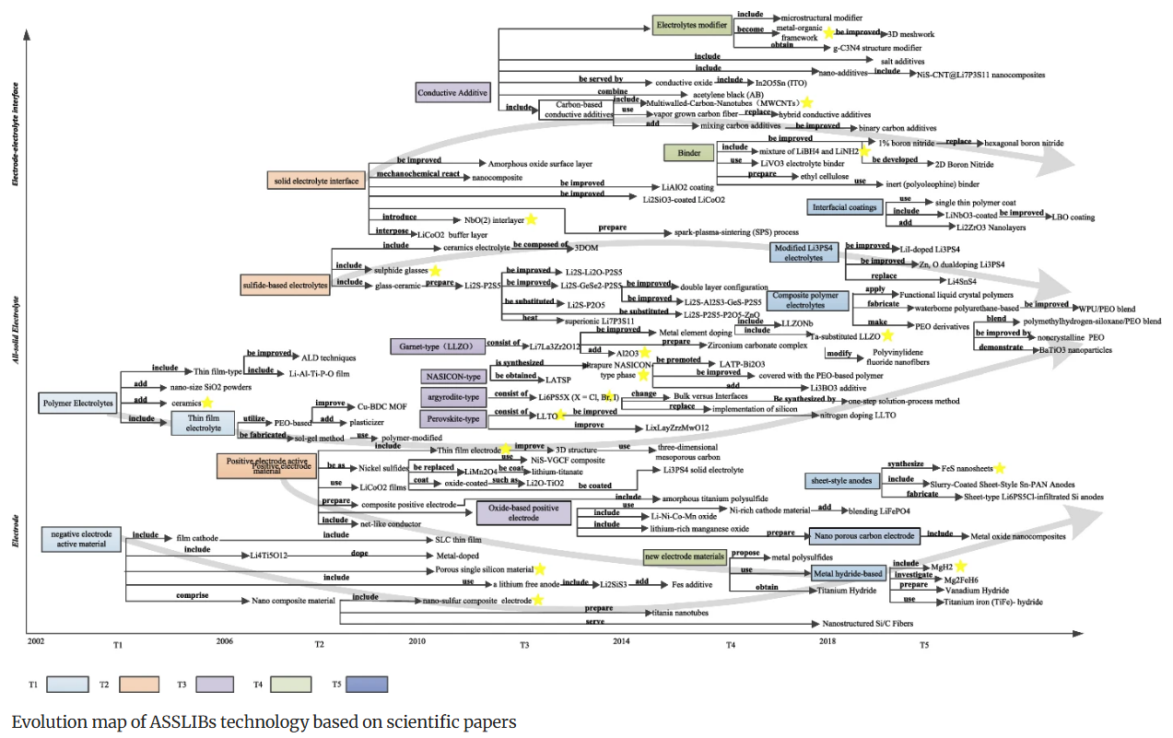
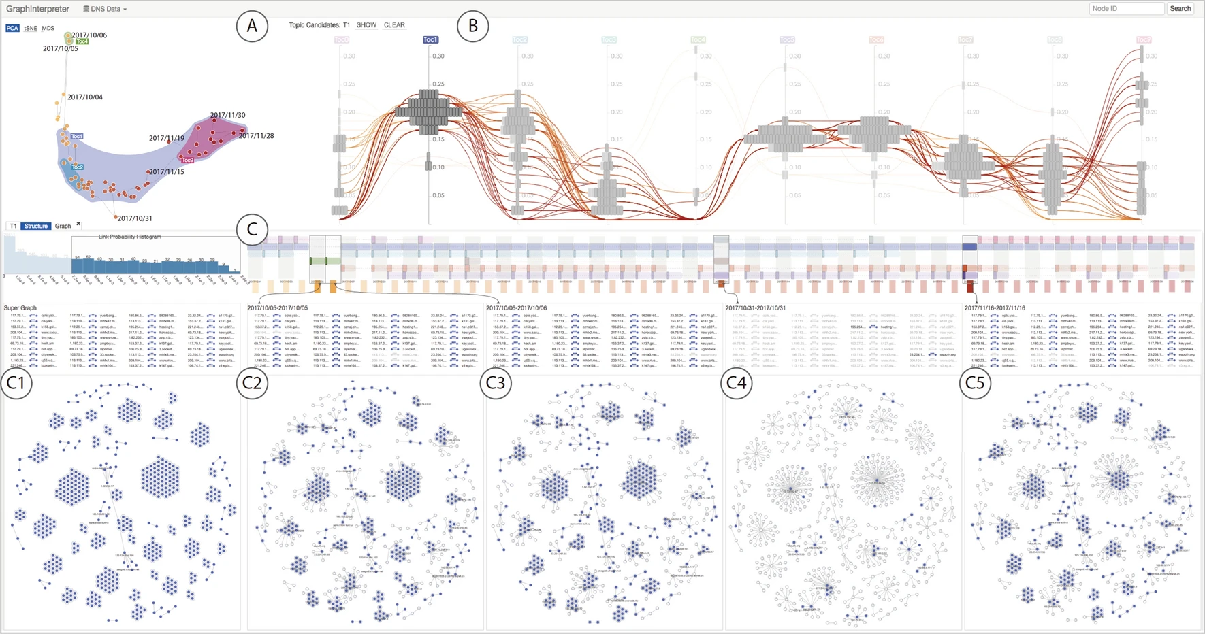
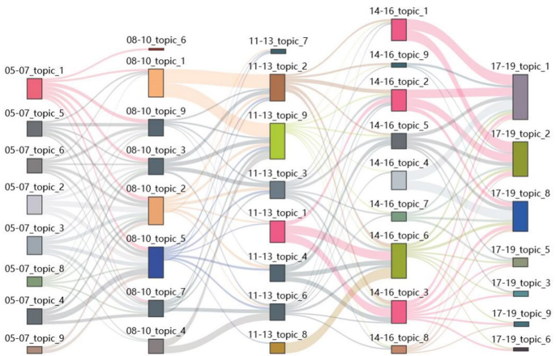
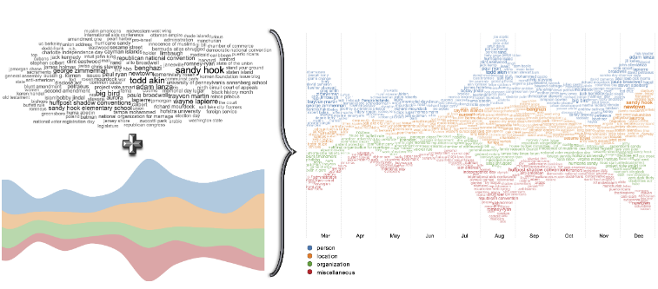
Related Work
https://doi.org/10.1007/s11192-024-04961-0
https://doi.org/10.1007/s11192-024-04961-0
https://doi.org/10.1007/s12650-024-00993-z
https://doi.org/10.2312/evs.20191178
https://doi.org/10.1007/s11192-021-03925-y

Slide 8
03
Research design

Slide 9
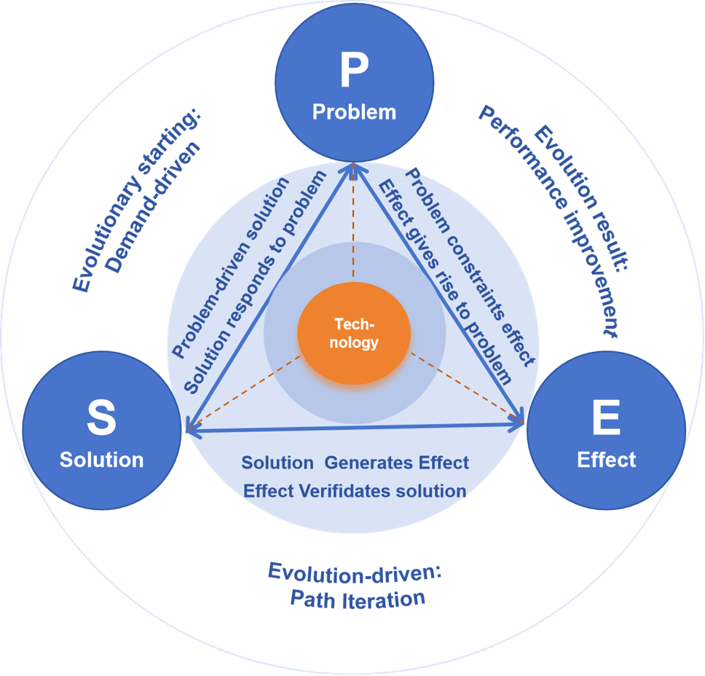
3-1 Research Framework
The Chinese Patent Examination Guidelines: a patent should clearly and objectively describe the technical problem to be solved, the technical Solution, and the beneficial Effects.
Technical Problem(P): deficiencies and inadequacies in existing technology. starting point and the demands and R&D directions.
Technical Solution(S): collection of technical means utilizing natural laws adopted to address technical problems," and these technical means are often embodied through technical features, forming the core content of patent protection. driving force and specific path of innovation.
Technical Effect(E): the beneficial outcomes compared to existing technology. verification and feedback of innovation.
Technical PSE: reveal the collaborative mechanism of technological evolution involving demand-driven, path iteration, and effect verification.
Three-dimensional PSE Perspective of Technological Evolution Analysis Framework

Slide 10
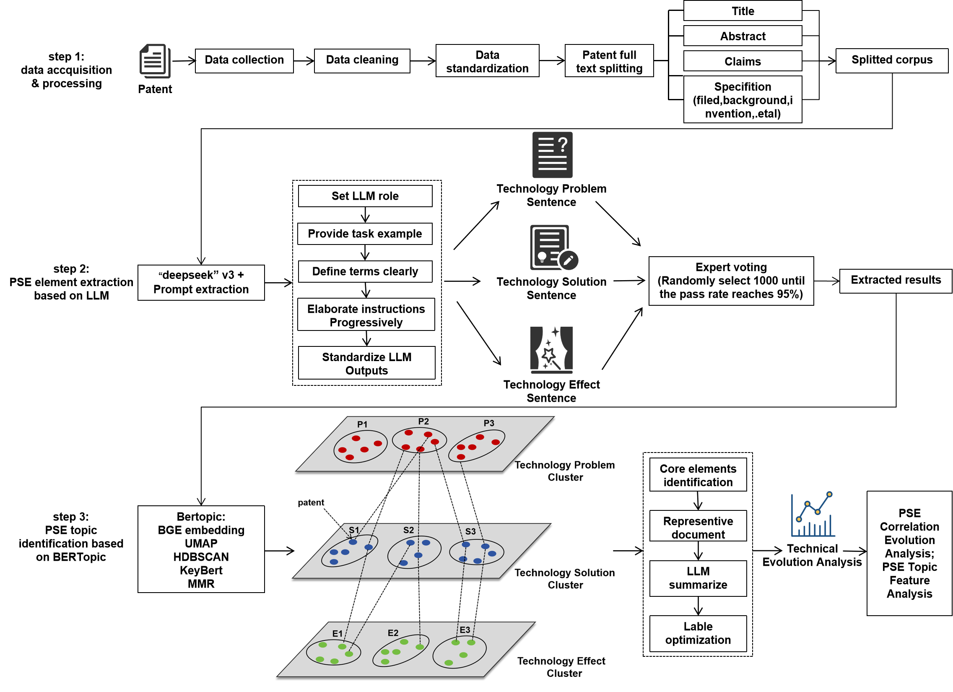
3-2 Technical route
Technical route for Technological Evolution from the Three-dimensional PSE Perspective

Slide 11
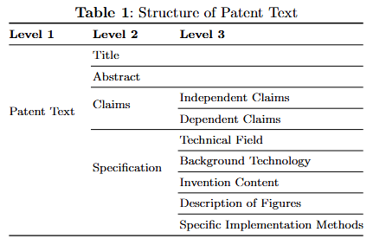
3-2 Technical route
Key Steps:
Step1: Data accquisition & processing
Domain patent data reterieval and fulltext download.
Chinese and English consistency processing.
Text segmentation: segment patent texts into titles, abstracts, background technology, invention content, independent claims, and other components.

Slide 12
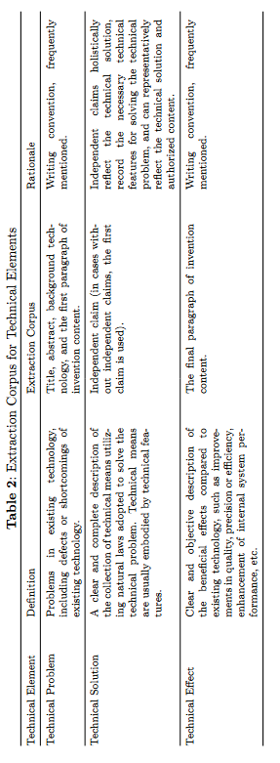
3-2 Technical route
Key Steps:
Step2: PSE element extraction based on LLM
Corpus selection: locates target extraction paragraphs to ensure the accuracy of extraction results.
Prompt engineering construction: setting LLM roles, providing task examples, clarifying terminology definitions, elaborating instructions step by step, and standardizing LLM outputs.

Slide 13
3-2 Technical route
Key Steps:
Step3: PSE Topic Identification Based on the BERTopic Model
Text vectorization: ZhiYuan Basic GloVe Embedding model.
Dimensionality reduction: UMAP (Uniform Manifold Approximation and Projection) algorithm.
Similar groups Clustering to extract core topics: HDBSCAN (Hierarchical Density-Based Spatial Clustering of Applications with Noise) algorithm.`
Optimization of keyword extraction results: CountVectorizer and C-TF-IDF, KeyBert and MMR (Maximal Marginal Relevance) algorithm.
Optimization of the topic labels for each cluster: Combine insights from LLM and domain experts in AI (one senior intellectual property expert and one patent.
Topic Identification Steps Based on the BERTopic Model

Slide 14
3-3 Analysis dimension
PSE Correlation Evolution Analysis
Each patent corresponds to a PSE topic, with each topic encompassing multiple patents.
The publication number serves as the unique ID for a patent, PSE topics are interconnected through it
Analyse the trends of PSE combination pathways.
PSE Topic Feature Analysis
Refer to the technical evolution metrics and classification criteria of existing studies, utilize technical evolution metrics to analyze the dynamic features of PSE combination pathways.
Metrics | Formula | Calculation | Explanation
Importance |  | The importance of topic i is reflected by the average number of patents for this topic across the entire time window. | Qi represents the number of patents for topic i, and T represents the number of time windows.
Novelty |  | The novelty of topic i is reflected by the average application year of patents for this topic. | ti represents the application year of patent i under this topic, and Q represents the total number of patents under this topic.
Growth |  | The growth rate of topic i is reflected by the rate of increase in the number of patents for this topic across the entire time window. | NL represents the number of patents in the most recent time period, and NE represents the number of patents in the earliest time period.
Persistance |  | The persistence of topic i is reflected by the number of patents not less than α and the number of years they cover throughout the entire time window. | |{i|tQi > α}| represents the number of years in which the patent count for this topic exceeds the threshold α, where α ∈ R+ (positive real numbers), and T represents the total number of time windows.

Slide 15
04
Research results and explanations
A case study: Pre-trained Large Model patent data

Slide 16
4-1 Data Acquisition and Preprocessing
Data Retrieval:
Database: incoPat, Derwent Innovation
Retrieval strategy: keywords(text, image, audio, video, and multimodal LLMs), classification numbers (G06N, G06F, G06K...), applications(Google, Microsoft, Tencent...)
Retrieval result: merge the results of the two databases and patent application numbers, remove null (title and abstract) data, 28761.
Retrieval date: March 20th, 2024.
Data Parsing
Html
Regularization
Title, abstract, independent claim, specification(background technology, invention content..)
Technical route for Technological Evolution from the Three-dimensional PSE Perspective

Slide 17
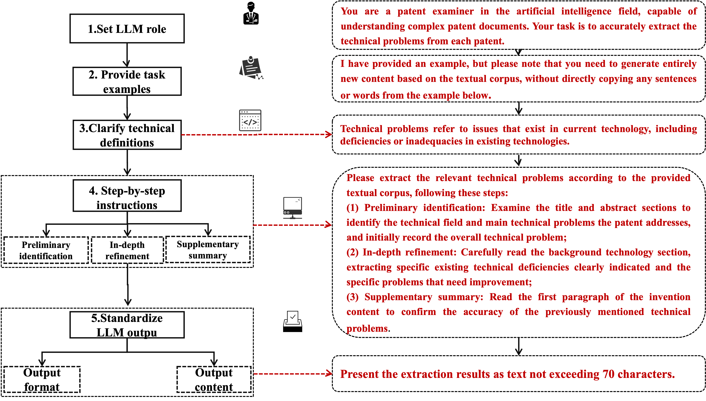
4-2 PSE Element Extraction Based on Large Language Model
Prompt Engineering Construction Steps: deepseek
set a LLM role, provide task examples, clarify the definitions of professional terms and thinking steps of LLM(chain of thought), standardize the content and format of LLM outputs.
Prompt Engineering Construction Steps (Using Technical Problems as an Example)

Slide 18
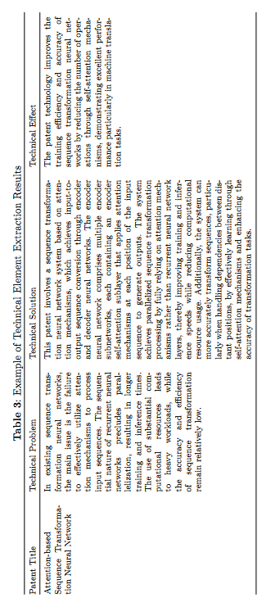
4-2 PSE Element Extraction Based on Large Language Model
Extraction results verification
Invite the aforementioned experts to make a judgment: randomly select 100 samples and adjust the prompt statements until the experts consider them fully accurate(√).
Example of PSE extraction results
Google's transformer technology Chinese family patent (CN110192206A).

Slide 19
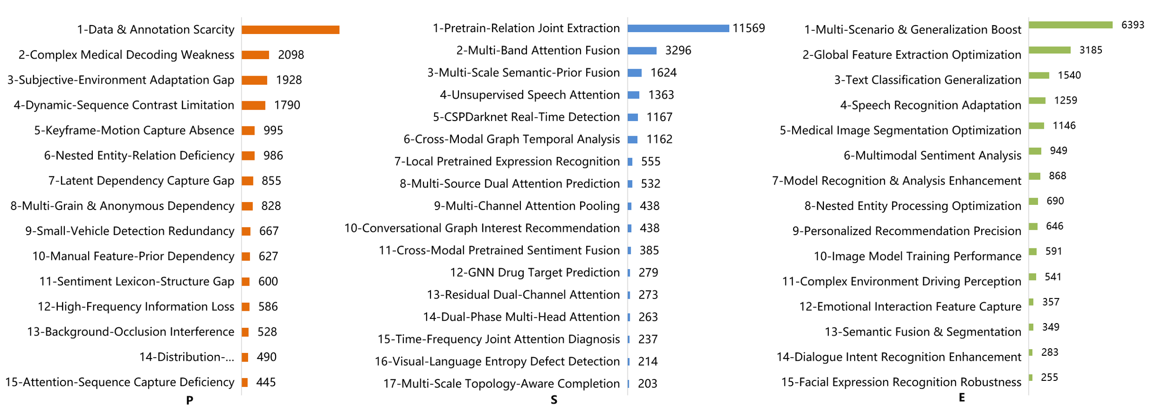
4-3 PSE Topic Identification Based on BERTopic Model
Medical image recognition, entity recognition, vehicle recognition, face recognition, video recognition, audio recognition, and personalized recommendation are the main application areas of large models.
Identification result
Lable optimization: LLM and expert.
P(15), S(17), E(15).
Main areas: medical image recognition, entity recognition, vehicle recognition, face recognition, video recognition, audio recognition, and personalized recommendation.
Core Topic Identification Results of PSE

Slide 20
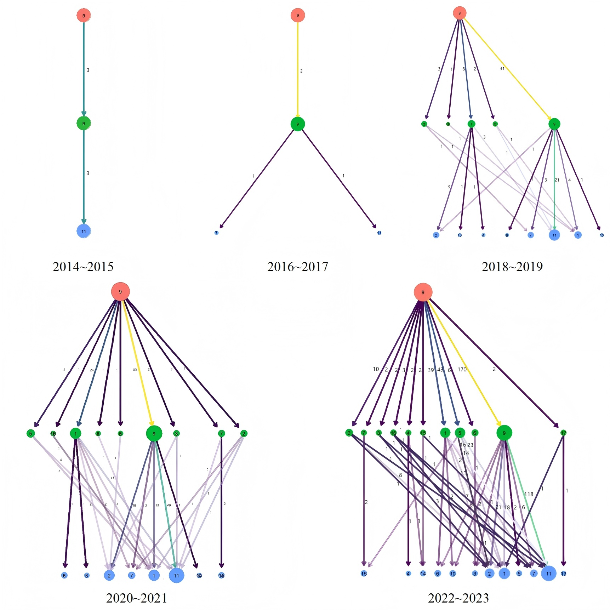
4-4 Technology Evolution Analysis Based on the PSE Perspective
PSE Correlation Evolution Analysis
PSE(952), P9, Clustree settings
A decade, time interval: 2 years.
Three-layer node: PSE.
Node size and lines: patents numbers, Colour: from purple to yellow to indicate growth in patent quantity.
Key conclusion
2014~2015: 3 patents, single attention mechnism, limited to basic target recognition.
2016~2017: 2 patents, deep learning technology, accuracy were improved through limited data training.
2018~2019: 45 patents, combining the attention mechanism and lightweight mode.
2020~2021: 126 patents, attention mechanism was deepened, robustness and real-time performance were improved.
2022~2023: 281 patents, advanced attention mechanisms, adaptive optimization and generative AI.
The S for P9 are advancing toward deeper integration of attention mechanisms and multimodal data fusion, while the E are optimized for improved accuracy, real-time performance, robustness, and enhanced generalization across multiple scenarios.
Evolution trend of the P9 combination path over the past 10 years

Slide 21
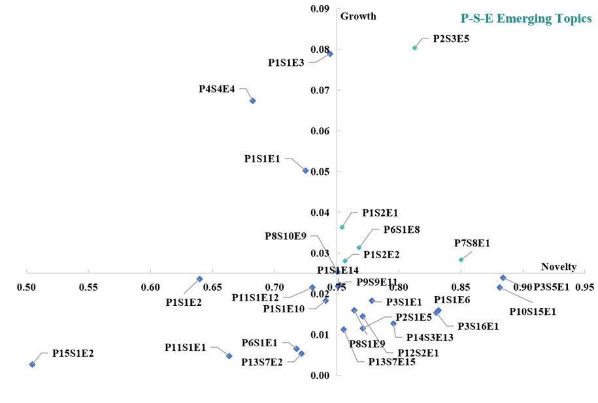
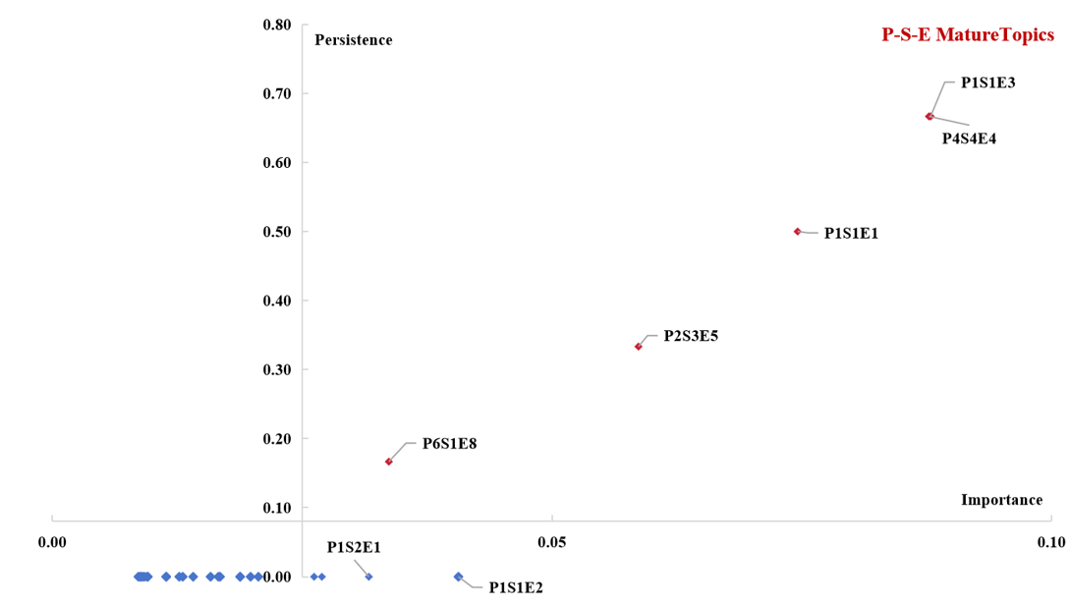
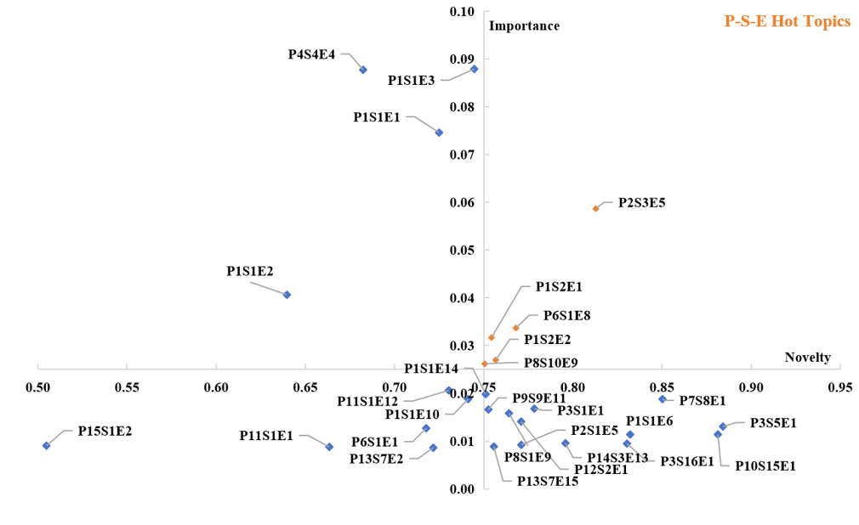
4-4 Technology Evolution Analysis Based on the PSE Perspective
PSE Topic Feature Analysis
Emerging topics: 5, P2S3E5(Complex Medical Decoding Weakness-MultiScale Semantic-Prior Fusion-Medical Image Segmentation Optimization), P1S2E1, P6S1E8, P1S2E2, P7S8E1.
Hot topics: 5, P2S3E5, P1S2E1, , P6S1E8, P1S2E2, P8S10E9.
Mature topics: 5, P1S1E3(highest PSE patents number, Data Annotation Scarcity-Pretrained-Relation Joint Extraction-text classification generalization), P4S4E4(Dynamic-Sequence Contrast Limitation-Unsupervised Speech Attention-Speech Recognition Adaptatio), P1S1E1, P2S3E5, P6S1E8.
PSE Topic Classification Based on Technical Evaluation Indicators

Slide 22
05
Conclusions and Outlooks

Slide 23
5-1 Conclusions and innovations
Conclusions
This method successfully identifies 952 PSE pathways (consisting of 28761 patents, 15 technical problems, 17 technical solutions and 15 technical effects) in the ”pre-trained large model” field, and takes P9 as an example to demonstrate the logic of technical evolution. Indicators such as importance, novelty, growth, and persistence are introduced to identify that P2S3E5 is the most emerging and hottest PSE pathway, P1S1E3 and P4S4E4 are the most mature PSE pathway. The above results are indirectly verified by the conclusions of the authoritative industry report.
Innovations
From the practical significance of patents, the technology is decomposed into the three-dimensional elements of PSE, presenting the content of technological inventions in a more granular way.
Combining large model technology and topic model methods to achieve automatic extraction and topic identification of PSE three-dimensional elements, significantly improving efficiency and accuracy.
From the PSE three-dimensional perspective, analyze the technological evolution trend, combine the time series to reveal ”which technical solution solves which technical problem and achieves which technical effect”, and use technical evolution indicators to screen important pathways, providing comprehensive decision support for technology layout.

Slide 24
5-2 Shortcomings and Outlooks
01
Data source is singular, and the coverage of technological elements is not yet comprehensive.
Integrate multiple source data (such as scientific research papers, technical reports, market data, etc.), refining the classification dimensions of PSE (such as by device, material, structure, etc.), and enhancing the comprehensiveness and accuracy of element extraction.
02
Differences in writing habits between Chinese and English patents may affect the accuracy of technological element positioning strategies
Design differentiated positioning strategies for Chinese and English patents to improve the accuracy of technological element extraction.
03
Correlations between topics and differences in quantity distribution may lead to bias in dynamic indicator analysis
Explore more optimal topic modeling methods, design targeted indicators for different technical elements, enhance the scientific nature of the analysis indicators, and verify the applicability of this method in fields such as high-end manufacturing and key materials. And take more into account the attribute of patents as a commercialization strategy.

Slide 25
06
References

Slide 26
[1] Dongsheng, Z., Liang, Z., Guoqiang, L., Kai, Z.: Identifying technological evolution paths with graph embedding and path analysis. Data Analysis and Knowledge Discovery 9(02), 120–133 (2025)
[2] Chen, C.-M., Ho, S.-Y., Chang, C.: A hierarchical topic analysis tool to facilitate digital humanities research. Aslib Journal of Information Management 75(1), 1–19 (2023)
[3] Zhu, Y., Lu, X., Hong, J., Wang, F.: Joint dynamic topic model for recognition of lead-lag relationship in two text corpora. Data Mining and Knowledge Discovery 36(6), 2272–2298 (2022)
[4] Rieger, J., Lange, K.-R., Flossdorf, J., Jentsch, C.: Dynamic change detection in topics based on rolling ldas. In: Text2Story@ ECIR, pp. 5–13 (2022)
[5] Kai, S., Yue, C.: A new method for dynamic evolution analysis of technicalthemes: The dpl-bmm model. Journal of the China Society for Scientific and Technical Information 43(01), 25–33 (2024)
[6] Huifang, Y., Xiwen, L., Jie, L., Baoyan, W., Xun, L., Kun, D.: Research on technology opportunity discovery based on problem-solution (p-s). Library and Information Service 67(17), 102–117 (2023) https://doi.org/10.13266/j.issn.0252-3116.2023.17.009
[7] Jinzhu, Z., Yi, Z.: Identification of technological topic evolution paths based on patent entity semantic representation. Journal of Intelligence 43(11), 117–128 (2024)
[8] Adhav, H., Singh, V.: Modeling topic evolution to steer interactive information search. In: International Conference on Pattern Recognition and Machine Intelligence, pp. 586–596 (2021). Springer
[9] Wu, H., Yi, H., Li, C.: An integrated approach for detecting and quantifying the topic evolutions of patent technology: A case study on graphene field.Scientometrics 126, 6301–6321 (2021)
[10] Guo, J., Cao, L., Gong, Z.: Recurrent coupled topic modeling over sequential documents. ACM Transactions on Knowledge Discovery from Data (TKDD) 16(1), 1–32 (2021)
[11] Liu, P., Zhou, W., Feng, L., Wang, J., Lin, K.-Y., Wu, X., Zhang, D.: Mapping and comparing the technology evolution paths of scientific papers and patents:an integrated approach for forecasting technology trends. Scientometrics 129(4),
1975–2005 (2024)
[12] Lijie, F., Wei, Z., Jinfeng, W., Ke, Z., Shibin, Z.: Examining multi-dimensional technology evolution path and technology innovation opportunity identification based on sao semantic analysis. Journal of the China Society for Scientific and Technical Information 41(11), 1149–1160 (2022)
[13] Deligiannis, P., Vergoulis, T., Chatzopoulos, S., Tryfonopoulos, C.: Visualising scientific topic evolution. In: Companion Proceedings of the Web Conference 2021,pp. 468–472 (2021)
[14] Lin, L., Yu, J., Hong, F., Lai, C., Chen, S., Yuan, X.: Graphinterpreter: a visual analytics approach for dynamic networks evolution exploration via topic models.Journal of Visualization 27(5), 909–924 (2024)

Slide 27
[15] Dang, T., Nguyen, H.N., Pham, V., Johansson, J., Sadlo, F., Marai, G.: Wordstream: Interactive visualization for topic evolution. In: EuroVis (Short Papers),pp. 103–107 (2019)
[16] Liu, N.F., Lin, K., Hewitt, J., Paranjape, A., Bevilacqua, M., Petroni, F., Liang,P.: Lost in the middle: How language models use long contexts. Transactions of the Association for Computational Linguistics 12, 157–173 (2024)
[17] National Intellectual Property Administration: Patent Examination Guidelines (2023). Online (2023). https://www.cnipa.gov.cn/art/2023/12/21/art 526189193.html?xxgkhide=1
[18] White, J., Fu, Q., Hays, S., Sandborn, M., Olea, C., Gilbert, H., Elnashar, A.,Spencer-Smith, J., Schmidt, D.C.: A prompt pattern catalog to enhance prompt engineering with chatgpt. arXiv preprint arXiv:2302.11382 (2023)
[19] Wei, J., Wang, X., Schuurmans, D., Bosma, M., Xia, F., Chi, E., Le, Q.V., Zhou,D., et al.: Chain-of-thought prompting elicits reasoning in large language models. Advances in neural information processing systems 35, 24824–24837 (2022)
[20] Kai, Z., Lucheng, L., Tao, H., Yajuan, Z.: Research on emerging technology identification from the perspective of “ paper-patent” correlation. Information studies: Theory Application 47(09), 183–191 (2024) https://doi.org/10.16353/j.cnki.1000-7490.2024.09.019
[21] Lucheng, L., Jian, Z., Xuezhao, W., Xiwen, L.: Technology evolution analysis framework based on two-layer topic model and application. Data Analysis and Knowledge Discovery 6(Z1), 18–32 (2022)
[22] Lingling, Z., Yu’e, Z., Li, D., Shiting, L., Qing, L., Mengxia, Y.: Research on the collaborative direction and characteristics of basic research and technological innovation —taking the field of new electronic components as an example.
Library and Information Service 65(13), 55–65 (2021) https://doi.org/10.13266/j.issn.0252-3116.2021.13.006
[23] Kai, S., Yanjun, Z.: Patent frontier technology topic identification and trend prediction: A case analysis of artificial intelligence. Journal of Intelligence 40(01),33–38 (2021)
[24] Liu, X., Porter, A.L.: A 3-dimensional analysis for evaluating technology emergence indicators. Scientometrics 124(1), 27–55 (2020)
[25] Xu, S., Hao, L., Yang, G., Lu, K., An, X.: A topic models based framework for detecting and forecasting emerging technologies. Technological Forecasting and Social Change 162, 120366 (2021)
[26] John, I.: The art of asking chatgpt for high-quality answers. Nzunda Technologies Ltd (2023)
[27] China Society for Automotive Engineering: Top 10 technological trends in china’s automobile industry in 2025. Research report, China Society for Automotive Engineering (2024)
[28] China Academy of Information and Communications Technology: Artificial intelligence development report (2024). Research report, China Academy of Information and Communications Technology (2024)
[29] Stanford Institute for Human-Centered Artificial Intelligence: The 2025 AI Index Report. https://hai.stanford.edu/ai-index/2025-ai-index-report (2025)

Slide 28
Thank you for watching!
Reporter: Zhanyi Zhao
zhaozhanyi@mail.las.ac.cn

