Slide 1
Measuring Technology Diffusion Dynamics Using Patent Full-Text Data and Machine Learning
Joint Workshop of the 5th AI + Informetrics (AII) and the 6th Extraction and Evaluation of Knowledge Entities from Scientific Documents (EEKE)
at ISSI2025, Yerevan, Armenia
Alex J. Yang1*, Star X. Zhao2, Yi Bu3, and Sanhong Deng1
1 School of Information Management, Nanjing University, China.
2 National Institute of Intelligent Evaluation and Governance, Fudan University, China.
3 Department of Information Management, Peking University, China.

Slide 2
01
Abstract
Measuring Technology Diffusion Dynamics Using Patent Full-Text Data and Machine Learning
1.2倍
Abstract:
Understanding the dynamics of technology diffusion is critical for tracking innovation and its impact across industries. This study leverages full-text patent data and advanced machine learning to develop a novel framework for quantifying technology diffusion. Using the PatentsView dataset from the U.S. Patent and Trademark Office, we analyze 6,913,074 utility patents’ full texts with a Doc2Vec model to map semantic relationships in a high-dimensional knowledge space. We propose a dynamic measurement framework based on knowledge distances and temporal evolution, validated through case studies of disruptive patents, including Google’s PageRank. Our results reveal patterns of cross-disciplinary diffusion, with metrics like the 5-Year Average Diffusion Index and Diffusion Trend Index offering robust tools for comparative analysis. This approach provides a scalable, data-driven method to study technology diffusion’s complex dynamics.

Slide 3
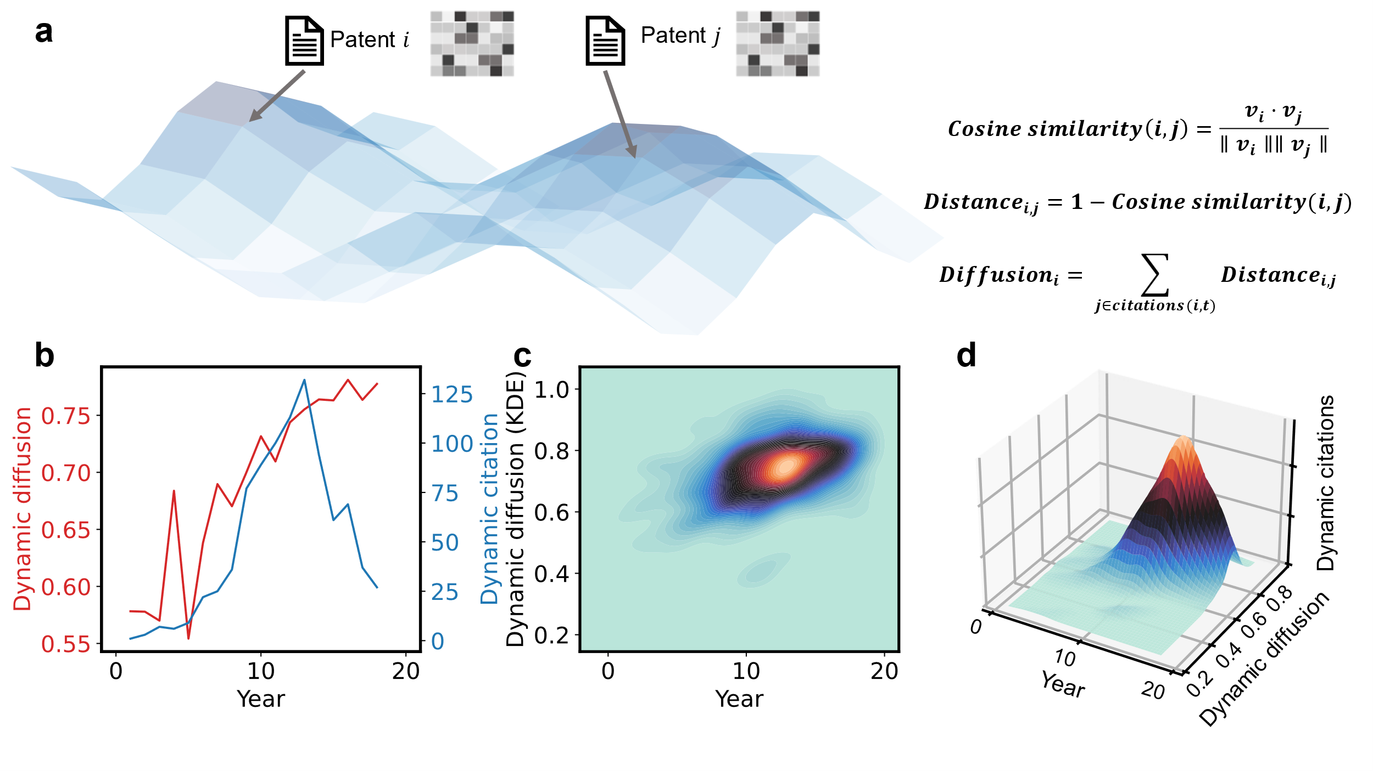
01
Technology Diffusion Measurement Framework
1.2倍

Slide 4
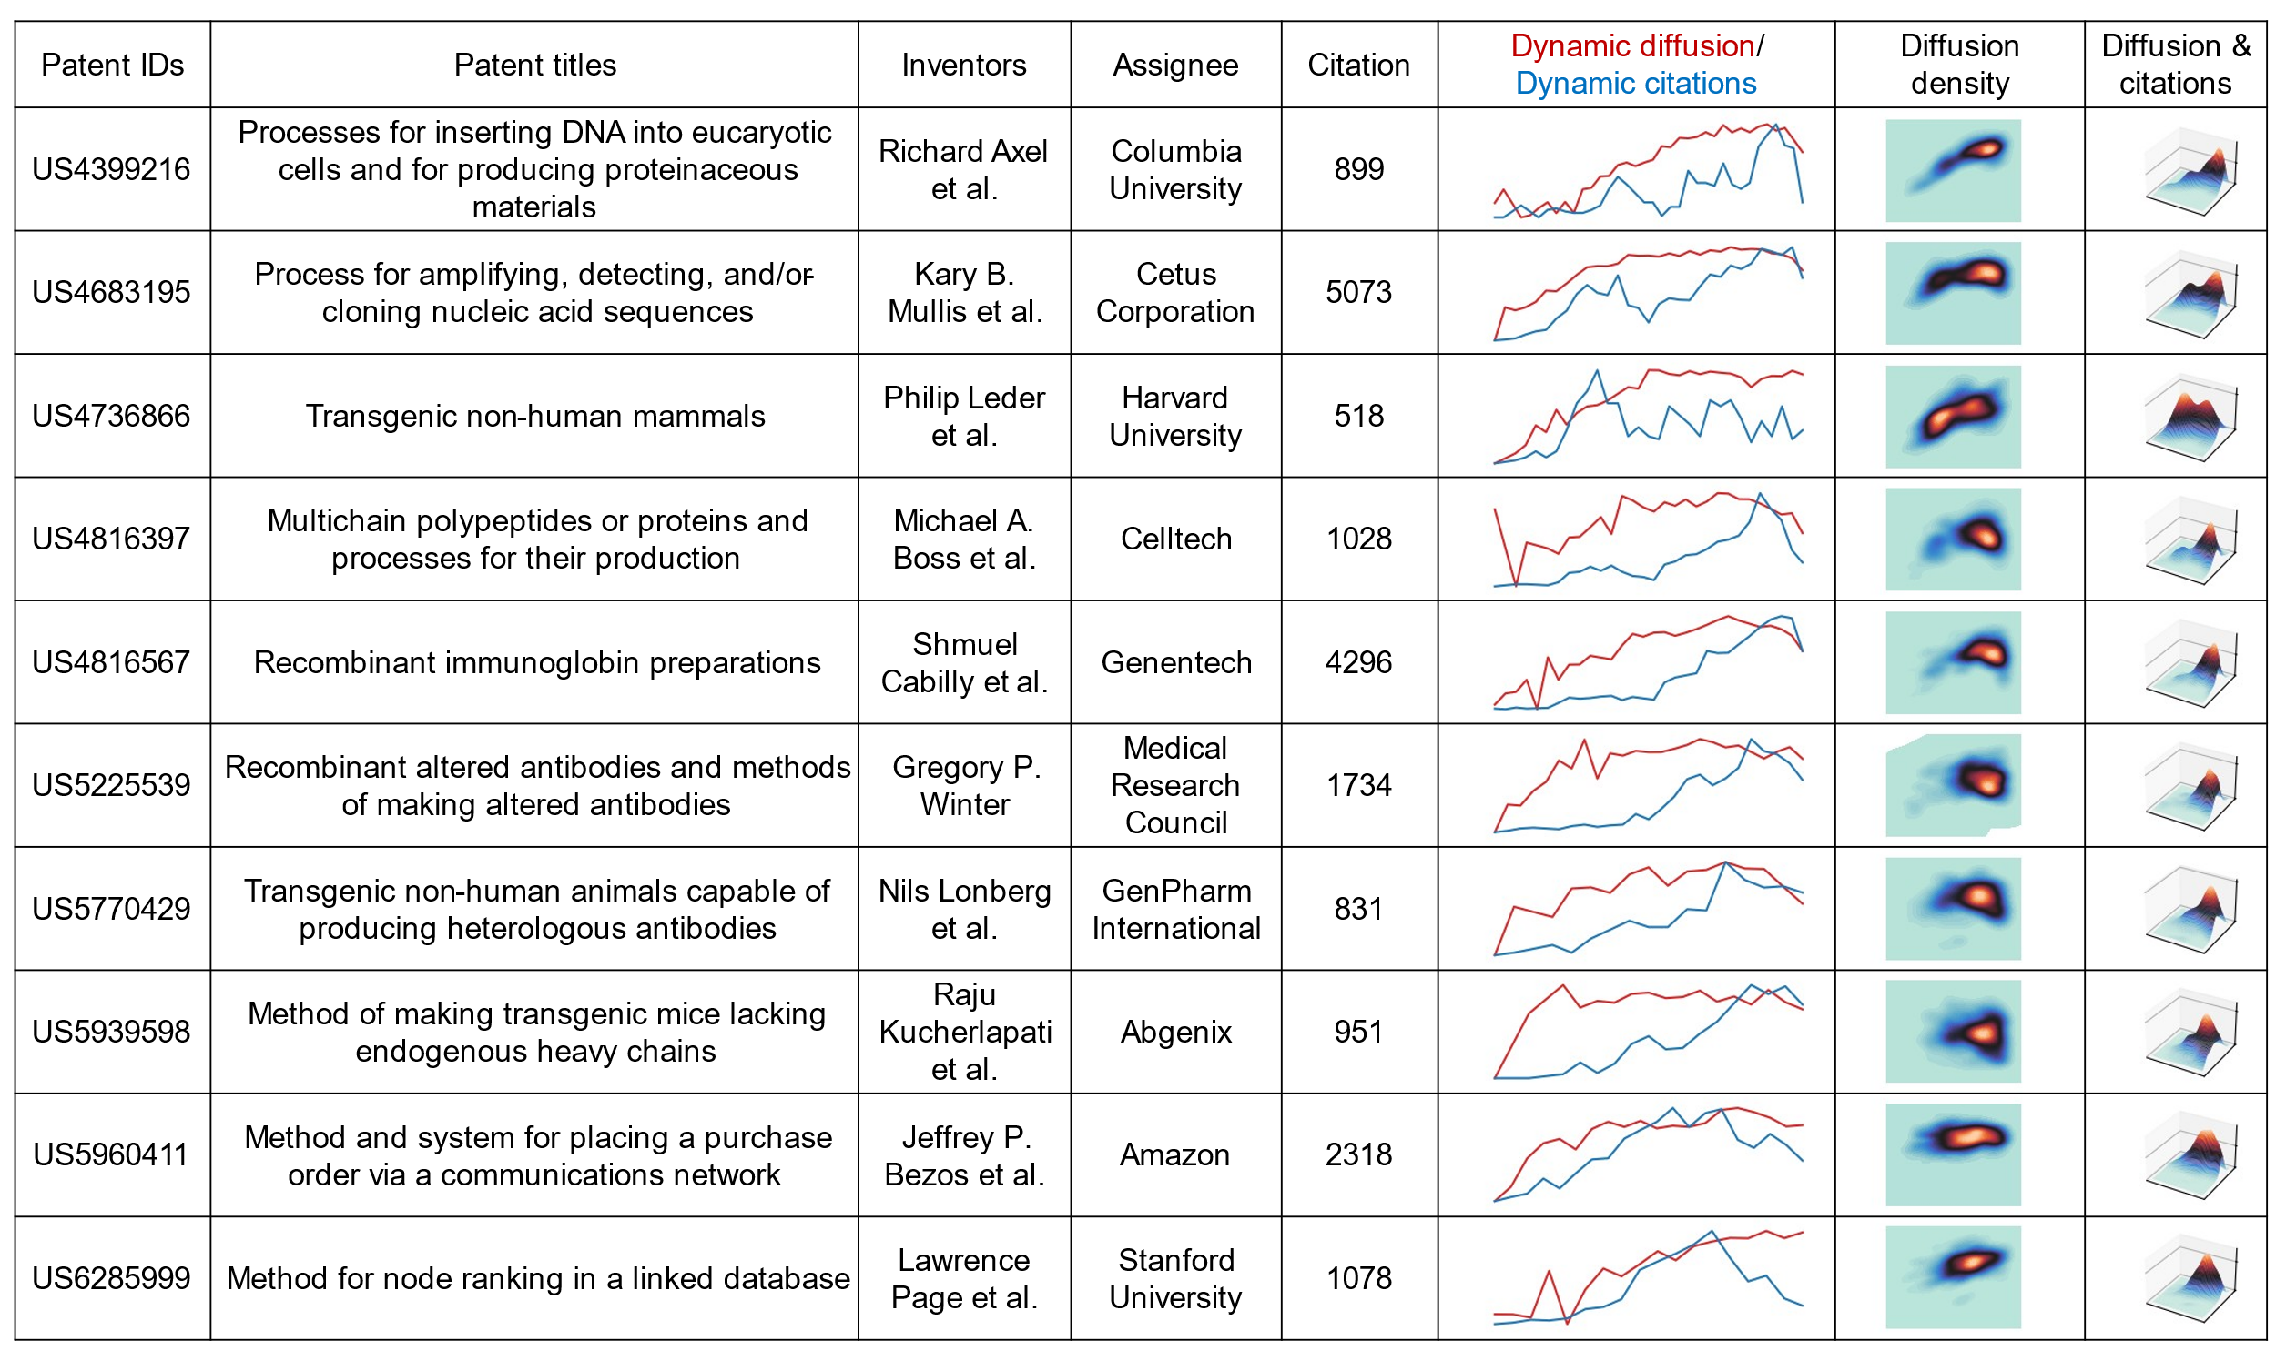
02
Technology Diffusion of Several Disruptive Patents
1.2倍

Slide 5
03
Higher-Order Diffusion Metrics & Related measures
5-Year Average Diffusion Index: ${Diffusion}_{5}(i,t)=\frac{1}{5}\sum_{k=0}^{4}{\text{Diffusion}(i,t+k)}$,
5-Year Diffusion Trend Index: ${Diffusion trend}_{5}(i,t)=\frac{\sum_{k=0}^{4}{\left(\text{Diffusion}(i,t+k)−\bar{D}\right)}\left(k−\bar{T}\right)}{\sqrt{\sum_{k=0}^{4}{{\left(\text{Diffusion}(i,t+k)−\bar{D}\right)}^{2}}}\sqrt{\sum_{k=0}^{4}{{\left(k−\bar{T}\right)}^{2}}}}$,
1.2倍
Number of References
(1) $Disruption=p_{D}−p_{C}=\frac{n_{i}−n_{j}}{n_{i}+n_{j}+n_{k}}$，
(3) $\text{HH}{\text{I}}_{i}=\sum_{c∈\text{CP}{\text{C}}_{i}}{{\left(\frac{\text{References} \text{in} \text{Class} c}{\text{Reference}{\text{s}}_{i}}\right)}^{2}}$，
(4) Original Technology Category
(5) 5-Year Citation Count
(6) Nominal and Real Market Value: T$ξ_{j}=(1−\overline{π})\frac{M_{j}}{N_{j}}E\left[V_{j}|R_{j}\right]$，
$E\left[V_{j}|R_{j}\right]=δ_{ft}R_{j}+\sqrt{δ_{ft}}σ\frac{φ(\frac{−R_{j}\sqrt{δ_{ft}}}{σ})}{1−Φ(\frac{−R_{j}\sqrt{δ_{ft}}}{σ})}$。
(1)Team Size
(2)$\text{GIN}{\text{I}}_{\text{Age},i}=\frac{\sum_{a=1}^{N_{i}}{\sum_{b=1}^{N_{i}}{|}}\text{Technical} \text{Ag}{\text{e}}_{a,y}−\text{Technical} \text{Ag}{\text{e}}_{b,y}|}{2N_{i}^{2}{\bar{A}}_{i}}$，
(3) $\text{GIN}{\text{I}}_{\text{h}\text{−}\text{index},i}=\frac{\sum_{a=1}^{N_{i}}{\sum_{b=1}^{N_{i}}{|}}h_{a,y}−h_{b,y}|}{2N_{i}^{2}{\bar{h}}_{i}}$，
(4) $\text{Entrop}{\text{y}}_{\text{Gender},i}=−\left(p_{i,\text{female}}\log_{2}p_{i,\text{female}}+p_{i,\text{male}}\log_{2}p_{i,\text{male}}\right),$
(5) $\text{Disciplinary} \text{Richnes}{\text{s}}_{i}=\ln{(}\text{Unique} \text{Major} \text{Field}{\text{s}}_{i}+1)$。
(6) $\text{Geographic} \text{Diversit}{\text{y}}_{i}=\ln{(}\text{Unique} \text{Location}{\text{s}}_{i}+1)$。
(7) $\text{Collaboration} \text{Distanc}{\text{e}}_{i}=\frac{1}{\left(\begin{aligned}N_{i} \\ 2\end{aligned}\right)}\sum_{a<b}{d}(\text{Locatio}{\text{n}}_{a},\text{Locatio}{\text{n}}_{b})$。

Slide 6
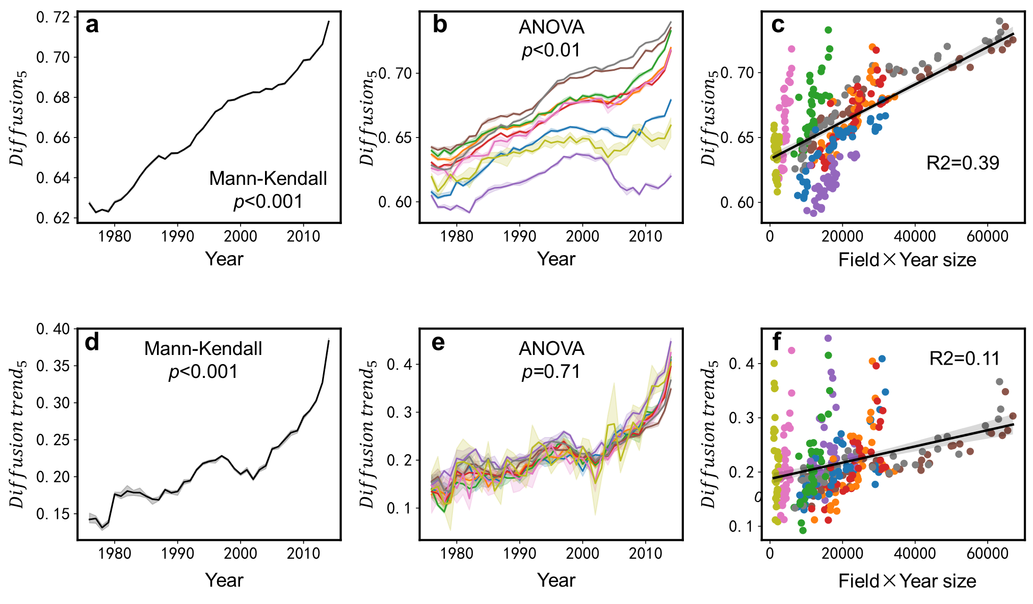
04
Time Trends and Field Heterogeneity of Higher-Order Diffusion Metrics
1.2倍

Slide 7
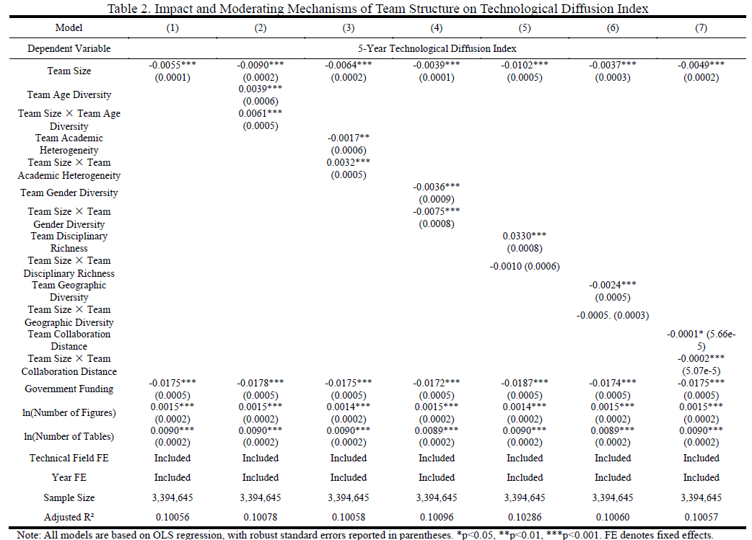
05
Impact and Moderating Mechanisms of Technological Innovation on Diffusion
1.2倍
$${Diff}_{i}=$$
$$α+$$
$$β_{1}\left({Team size}_{i}\right)$$
$$+β_{2}\left({Team structure}_{i}\right)$$
$$+β_{3}\left({Team size}_{i}×{Team structure}_{i}\right)$$
$$+\sum_{k=4}^{K}{β_{k}\left({Control}_{k,i}\right)}$$
$$+γ_{t}Y_{t}$$
$$+δ_{f}F_{f}$$
$$+ε_{i}$$

Slide 8
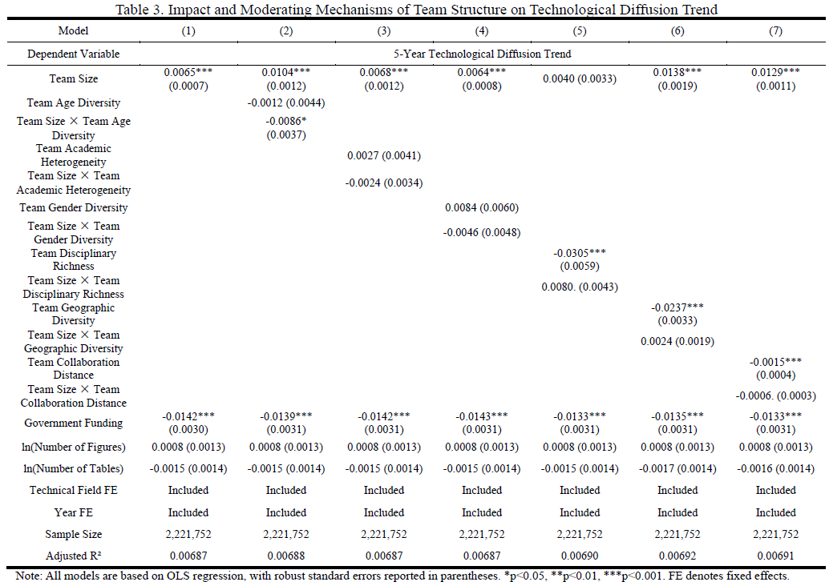
06
Impact and Moderating Mechanisms of Technological Innovation on Diffusion Trend
1.2倍
$${Diff}_{i}=$$
$$α+$$
$$β_{1}\left({Team size}_{i}\right)$$
$$+β_{2}\left({Team structure}_{i}\right)$$
$$+β_{3}\left({Team size}_{i}×{Team structure}_{i}\right)$$
$$+\sum_{k=4}^{K}{β_{k}\left({Control}_{k,i}\right)}$$
$$+γ_{t}Y_{t}$$
$$+δ_{f}F_{f}$$
$$+ε_{i}$$

Slide 9
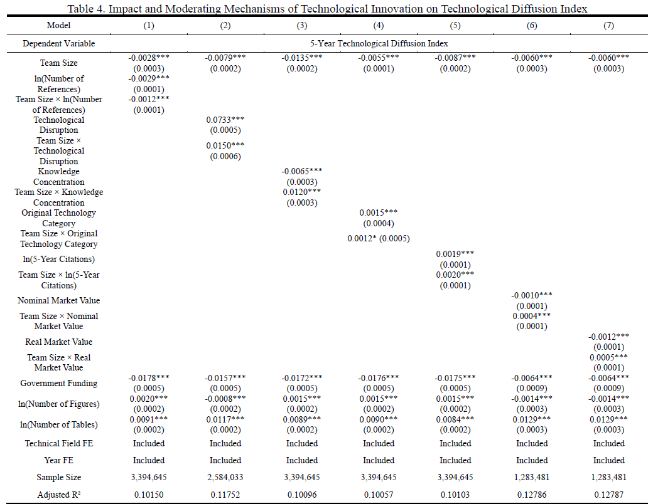
07
Impact and Moderating Mechanisms of Team Structure on Diffusion
1.2倍
$${Diff}_{i}=α$$
$$+β_{1}\left({Team size}_{i}\right)$$
$$+β_{2}\left({Innovation}_{i}\right)$$
$$+β_{3}\left(\begin{aligned}{Team size}_{i} \\ ×{Innovation}_{i}\end{aligned}\right)$$
$$+\sum_{k=4}^{K}{β_{k}\left({Control}_{k,i}\right)}$$
$$+γ_{t}Y_{t}$$
$$+δ_{f}F_{f}$$
$$+ε_{i}$$

Slide 10
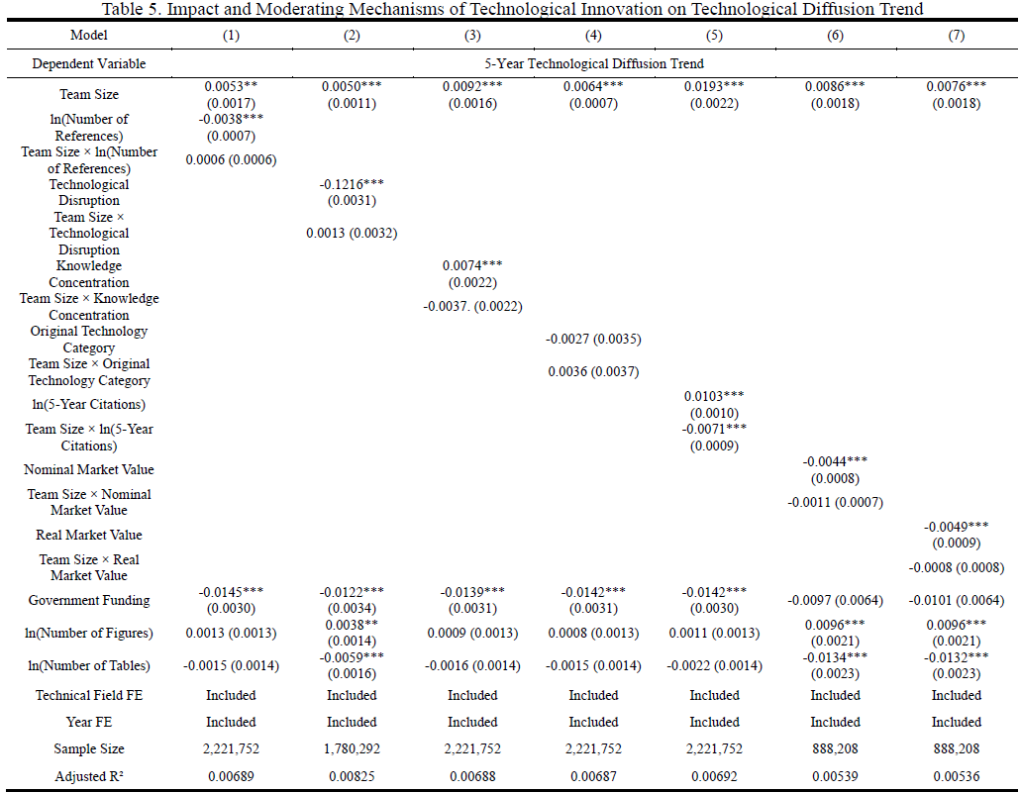
08
Impact and Moderating Mechanisms of Team Structure on Diffusion Trend
1.2倍
$${Diff}_{i}=α$$
$$+β_{1}\left({Team size}_{i}\right)$$
$$+β_{2}\left({Innovation}_{i}\right)$$
$$+β_{3}\left(\begin{aligned}{Team size}_{i} \\ ×{Innovation}_{i}\end{aligned}\right)$$
$$+\sum_{k=4}^{K}{β_{k}\left({Control}_{k,i}\right)}$$
$$+γ_{t}Y_{t}$$
$$+δ_{f}F_{f}$$
$$+ε_{i}$$

Slide 11
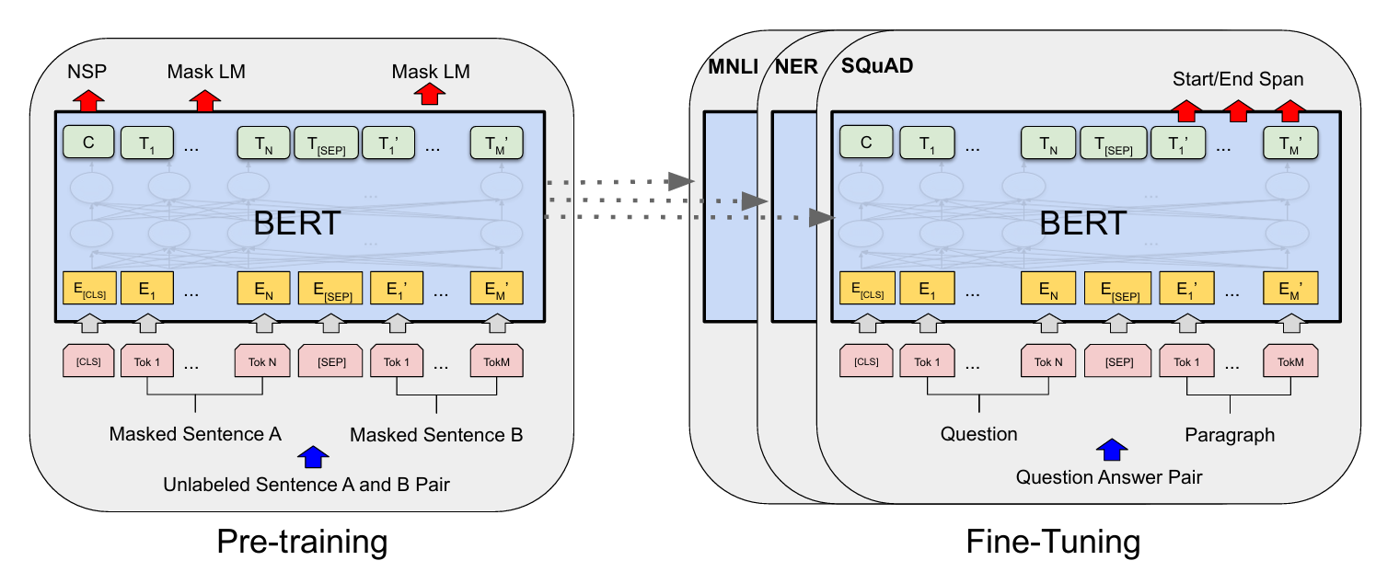
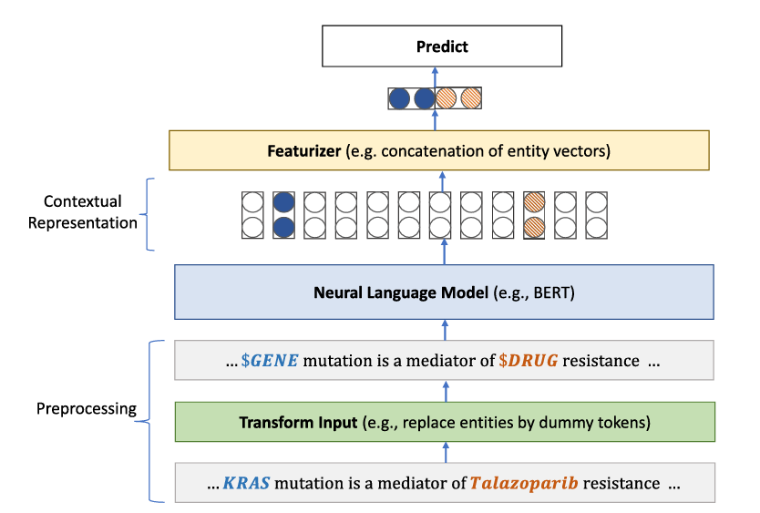
09
On going projects: analyzing PubMed papers
1.2倍
Cosine distance
Embedding space of all papers in PubMed
PubMed BERT

Slide 12
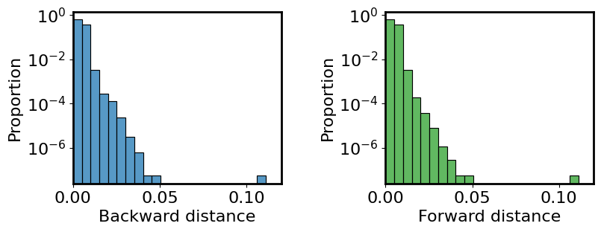
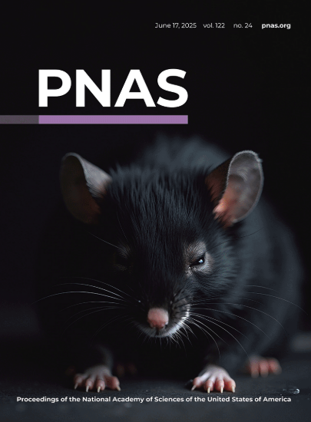
10
Knowledge distance within journals
Papers published in the same journal
Focal paper
1.2倍
t-3
t
t+3
Time
Forward distance
Backward distance

Slide 13
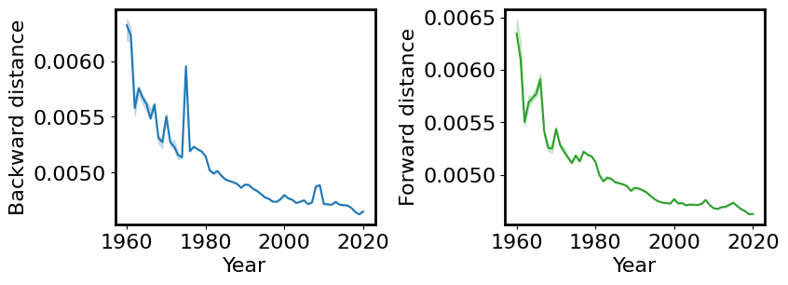
11
Decreased knowledge distance
1.2倍

Slide 14
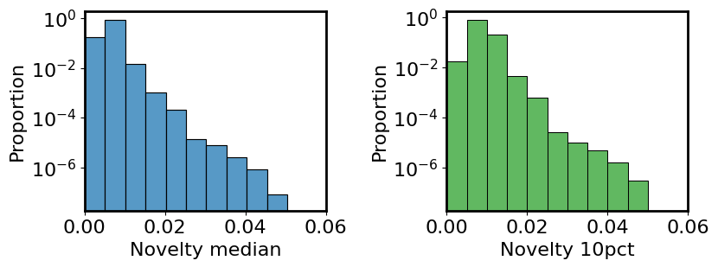
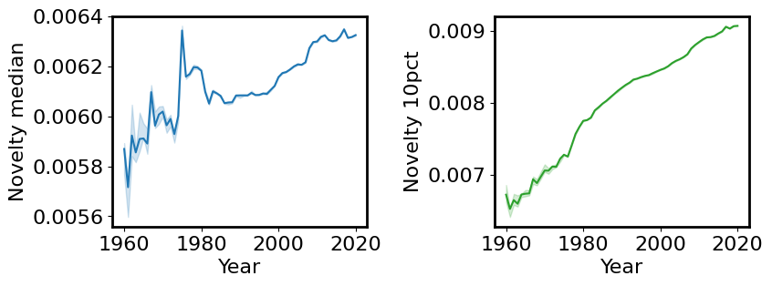
12
Combine citation network and embedding space
References
Citations
1.2倍
FP
Year
Novelty
Interdicsiplinarity
Impact / knowledge diffusion

Slide 15
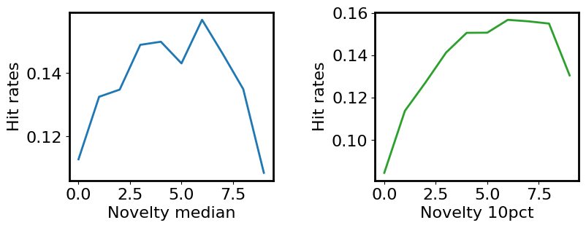
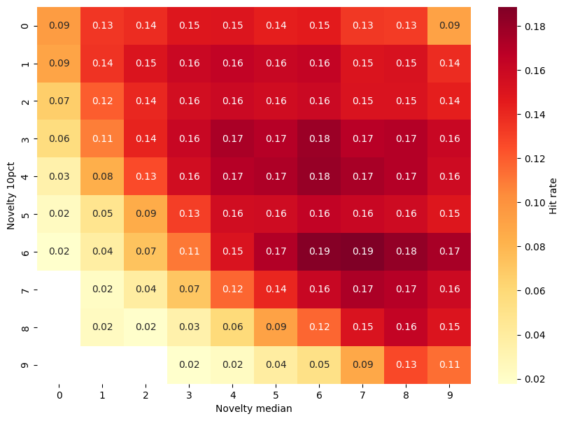
13
Combine citation network and embedding space
1.2倍

Slide 16
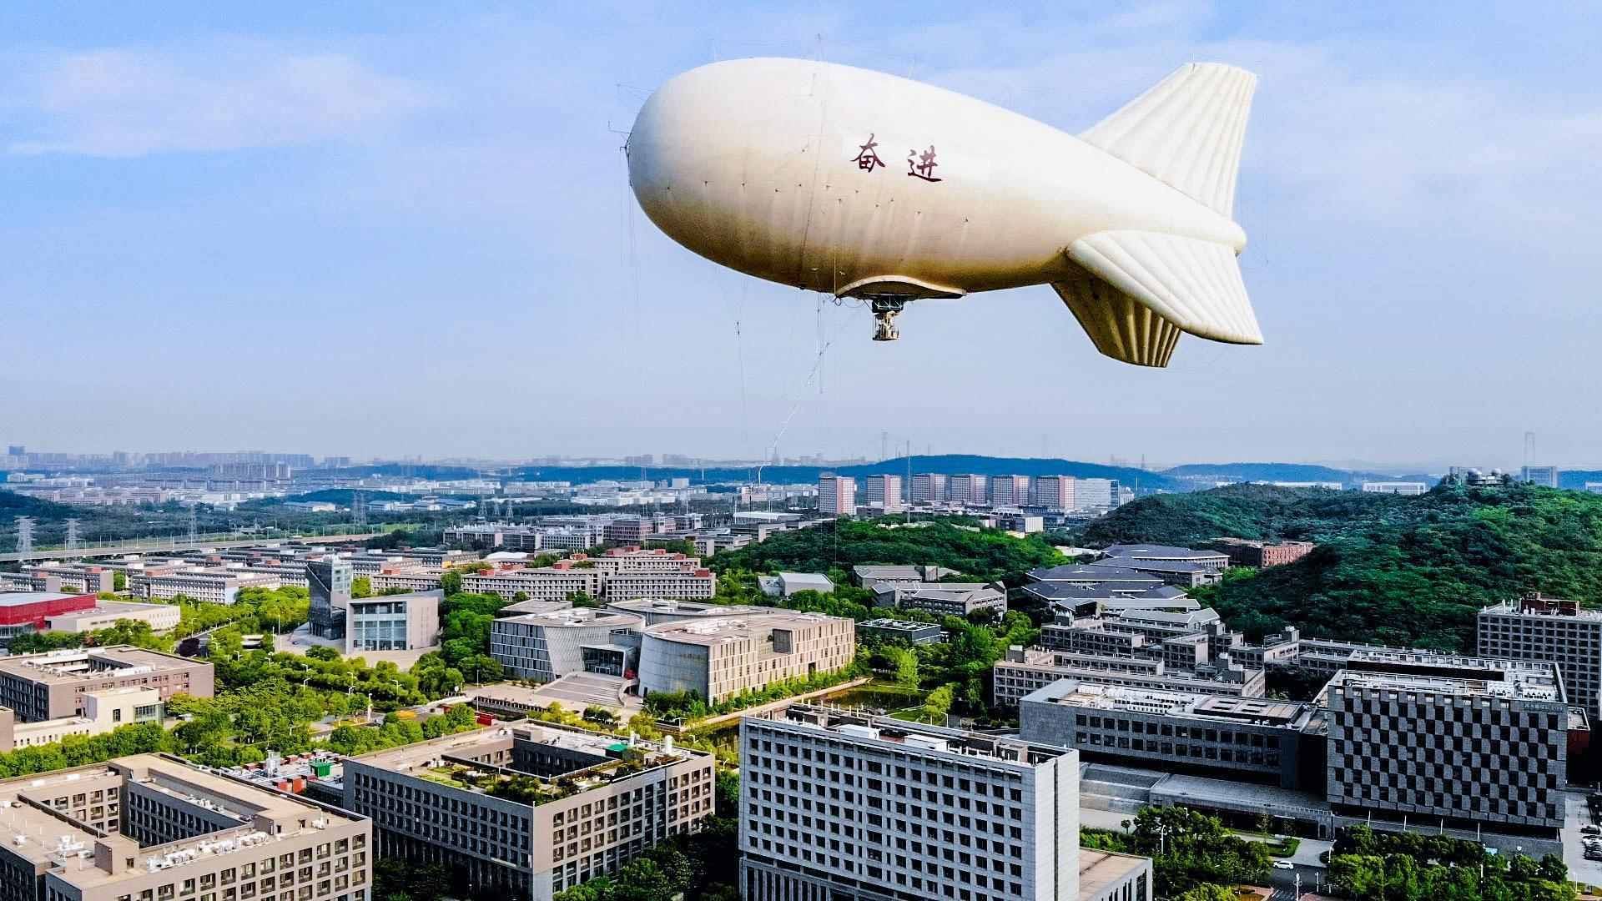
Many thanks！

