Slide 1
LLM-based Approaches to Canonical Reference Extraction in Academic Texts: Initial Results
Joint Workshop of the 5th AI + Informetrics and the 6th Extraction and Evaluation of Knowledge Entities from Scientific Documents, AII-EEKE 2025
Yerevan, Armenia, 23 June, 2025
Luisa Ripoll-Alberola, Manuel Burghardt
MSCA Doctoral Networks 2022,
Grant Agreement No. 101120349.

Slide 2
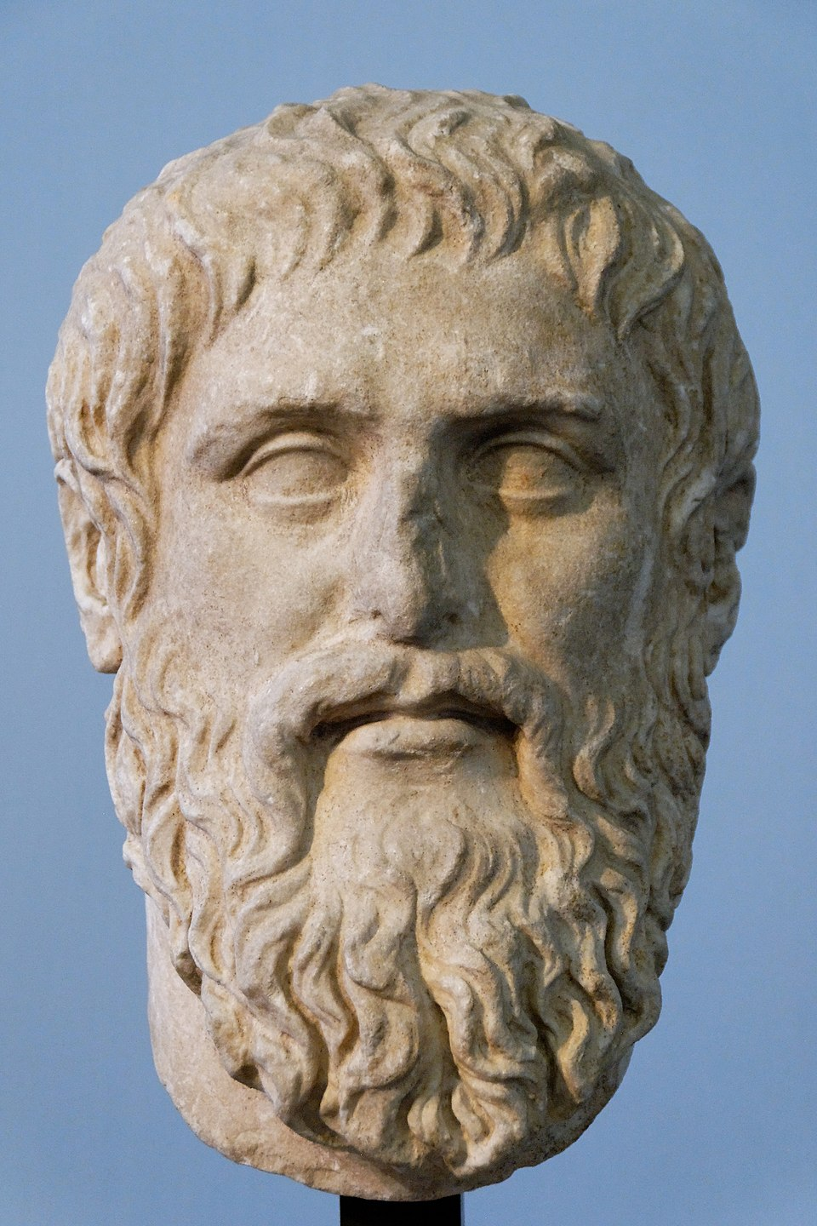
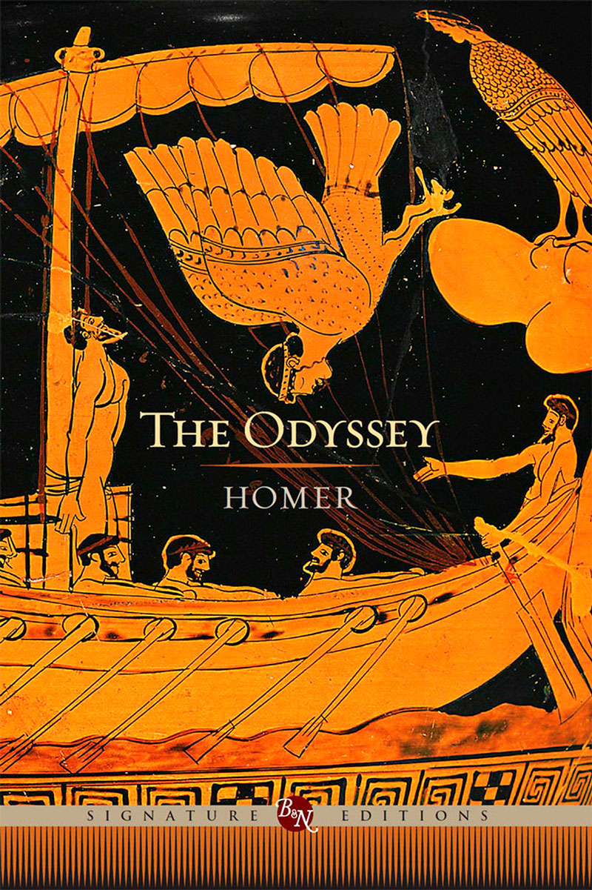
introduction
What is a canonical author from Antiquity?
Initial goal: identifying in-text references, NER.
Important entities: “Ancient Author Name” and “Ancient Work Title”.
Potentially expanding it to “Other Person” (e.g., classical scholars, non-Ancient authors) and “Mythological Character”.
Research question: Which computational approaches are most effective for extracting Ancient canonical references in English across diverse academic disciplines?
Notes:
As we are dealing with ancient authors in the academic discourse in general, in our task we will deal with different density of entities.

Slide 3
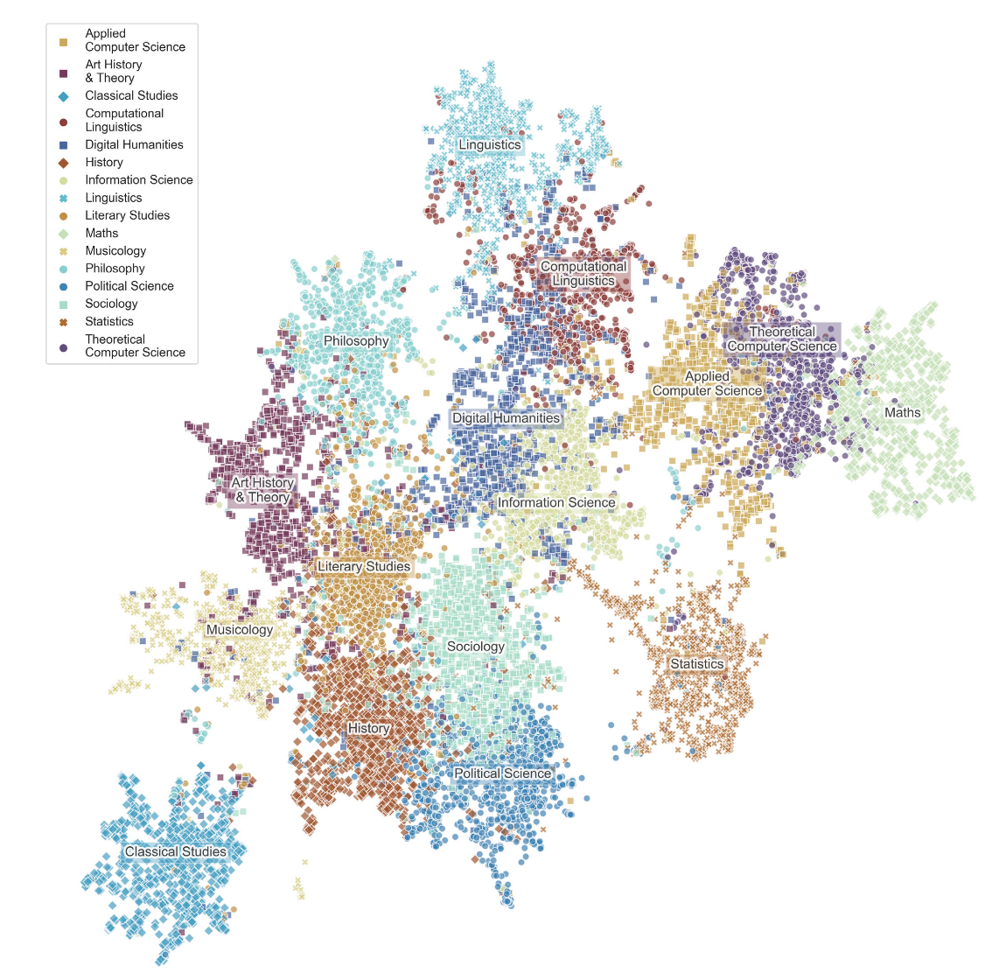
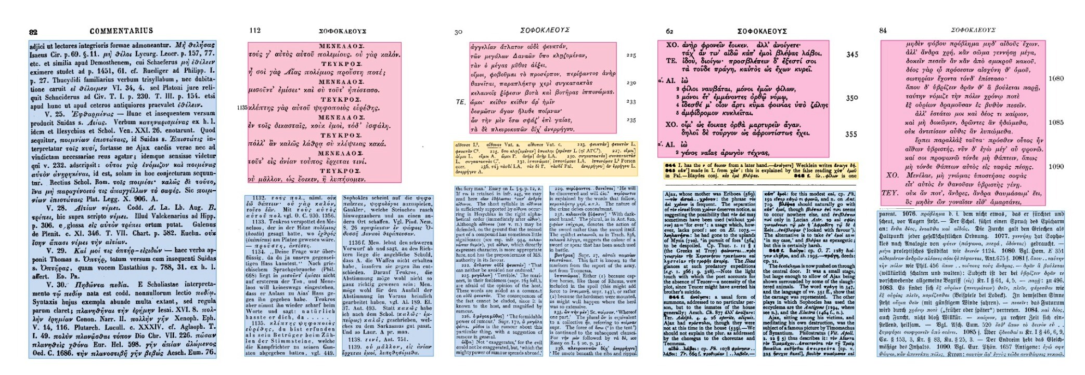
CORPORA
JSTOR vs AjMC
Luhmann & Burghardt, 2020.
General corpus including different disciplines.
Not annotated.
Romanello & Najem-Meyer, 2024.
Domain-specific corpus of Classical studies texts.
Annotated (gold standard).
Notes:
Our preliminary idea was to use the AjMC as a gold standard, and work on the transferrability from one corpus to the other, to try to avoid annotating

Slide 4
heuristic approach
DICTIONARY SEARCH
Method developed in Ripoll-Alberola et al., 2025.
Tested against AjMC:
F1-Score of 0.7917 for ancient author names.
Idea: exploring SOTA models, leveraging language understanding and zero-shot capabilities of LLMs.
Models to check: 1 domain-specific, fine-tuned model (XLM-RoBERTa for Classics) and 3 generative models (Llama-3.1-8B, and two adaptations of genAI to NER: GLiNER and GoLLIE).

Slide 5
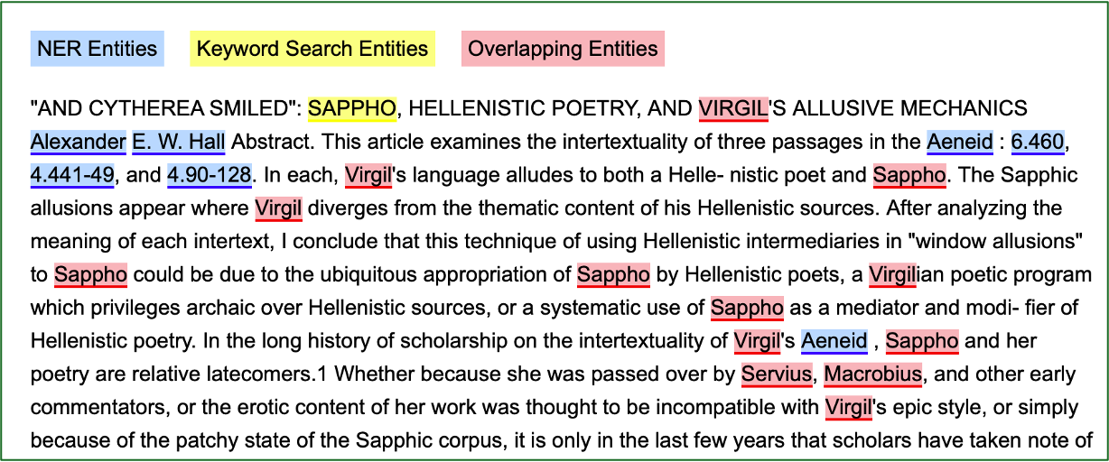
XLM-RoBERTa FOR CLASSICS
DOMAIN-SPECIFIC MODEL
Model from Hugging Face, documented in Najem-Meyer et al., 2025.
Capable of retrieving work titles.
Capable of retrieving quotations to specific passages.
Generates false positives in disciplines outside Classical studies.
Notes:
This method was already tested quantitatively against AjMC in the Najem-Meyer et al paper, getting a F1-score of around 0.8 in English language for all entities. We tried it in the JSTOR corpus and got the following results.

Slide 6
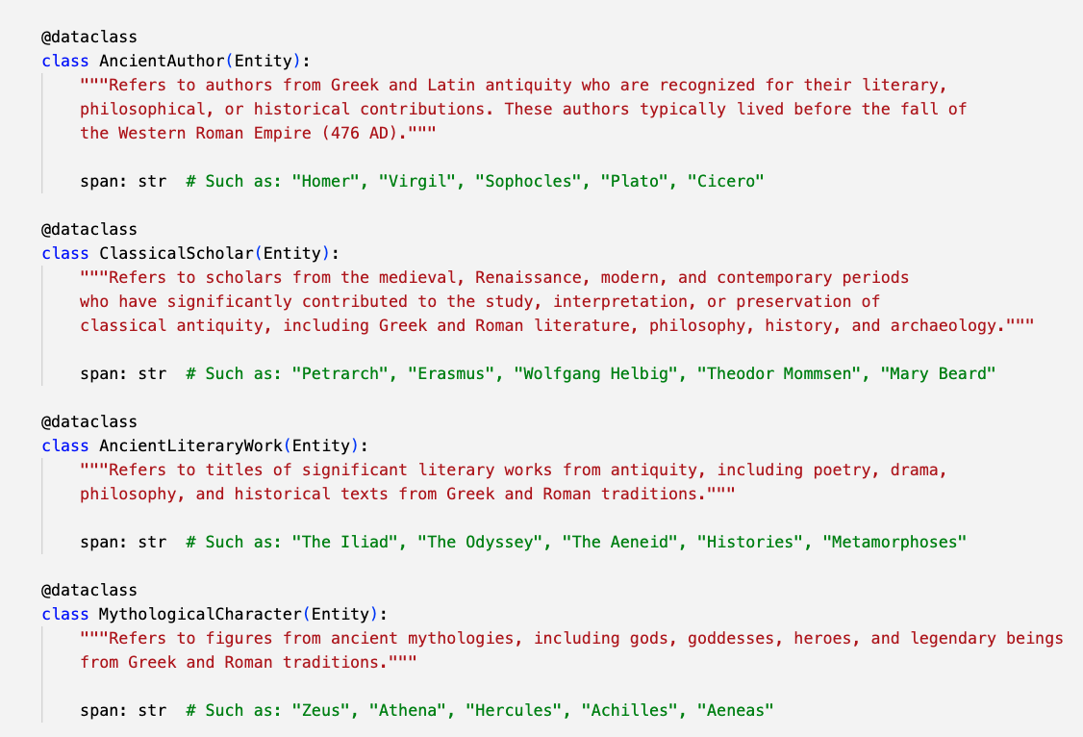
GoLLIE
GUIDELINE-FOLLOWING PARADIGM
Poorest results.
Ancient Greek quotes trigger hallucination.
Difficulty distilling historical knowledge from guidelines.
Less famous authors or scholars might be poorly represented in the LLM training data.

Slide 7
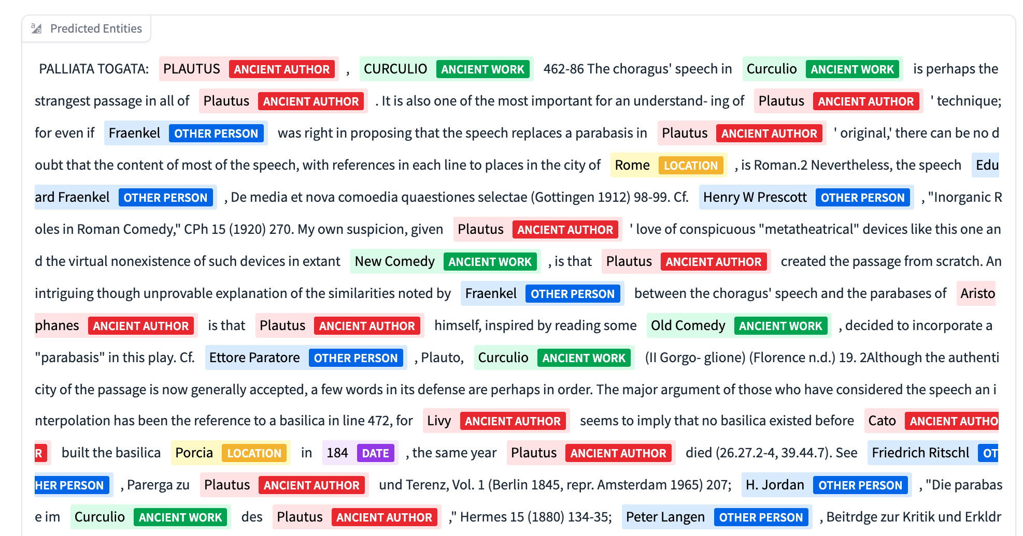
GLiNER
ZERO-SHOT MODEL
Deviation from the AjMC schema:
Not interested in fragments.
Adapting the tags is not good practice.
Labeling definition:
“Ancient Author” vs “Other People”.
Overlapp between “Ancient Work” and “Mythological Character”.
No hallucination in disciplines with low entity density.

Slide 8
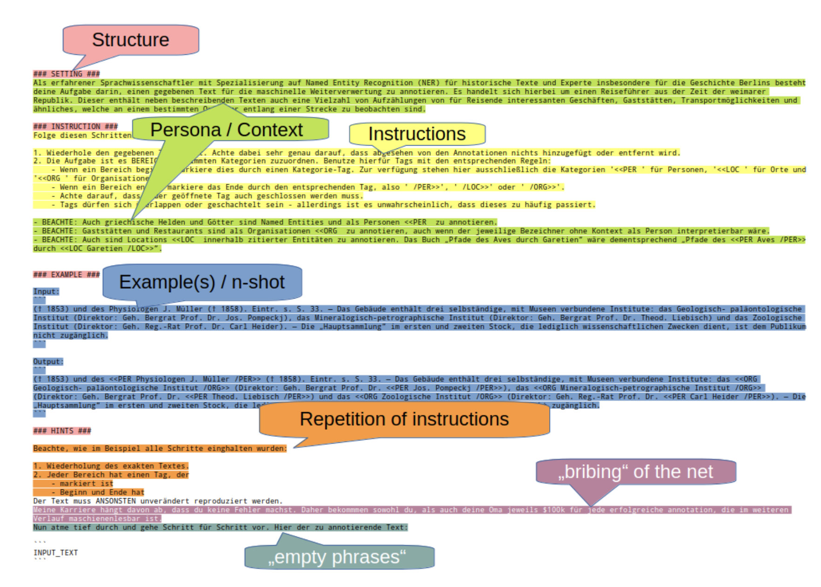
LLAMA MODELS
7-8B PARAMETERS
Prompt strategy: Task Description + ICL (10+ examples) + Input.
Different output formats: entity strings and GPT-NER style (Wang et al., 2023).
Critical factors:
Content length.
Prompting strategy (Tran et al., 2024 vs Hiltmann et al., 2025).
Hallucination.
Notes:
To convert NER in a generative approach, we ask the model to repeat the input strings adding special characters around the entities.

Slide 9
CONCLUSIONS
AjMC conclusions cannot be generalised to JSTOR
Baseline F1-score ~0.80 with dictionary search.
Domain-specific models are not suitable.
Among zero-shot models, GoLLIE is discarded.
GLiNER achieves good results, Llama models would need refinement.

Slide 10
QUESTIONS
Vielen Dank!
Luisa Ripoll-Alberola
ripoll_alberola@informatik.uni-leipzig.de
ORCID 0009-0001-4611-448X
Manuel Burghardt
burghardt@informatik.uni-leipzig.de
ORCID 0000-0003-1354-9089
What is the best practice to annotate my JSTOR corpus for this task?
Are there other models I should evaluate for this task?
Notes:
The corpus has more than 50,000 papers, so annotating 10% of this is not really an option. We are thinking about annotating fragments carrying high-information. Annotating full articles may not have so much sense because in a same article the authors/works appearing may be redundant. We could adapt Active Learning for this task. Once we have annotations, we can measure the model performance quantitatively on it.

Slide 11
REFERENCES
T. Hiltmann, M. Dröge, N. Dresselhaus, T. Grallert, M. Althage, P. Bayer, S. Eckenstaler, K. Mendi, J. M. Schmitz, P. Schneider, W. Sczeponik, A. Skibba, NER4all or Context is All You Need: Using LLMs for low-effort, high-performance NER on historical texts. a humanities informed approach, 2025. URL: https://arxiv.org/abs/2502.04351. arXiv:2502.04351.
J. Luhmann, M. Burghardt, Digital humanities—A discipline in its own right? An analysis of the role and position of digital humanities in the academic landscape, Journal of the Association for Information Science and Technology 73 (2022) 148–171. doi:10.1002/asi.24533.
S. Najem-Meyer, F. Kaplan, M. Romanello, Don’t stop pretraining! efficiently building specialised language models in resource-constrained settings., in: A. Kazantseva, S. Szpakowicz, S. Degaetano-Ortlieb, Y. Bizzoni, J. Pagel (Eds.), Proceedings of the 9th Joint SIGHUM Workshop on Computational Linguistics for Cultural Heritage, Social Sciences, Humanities and Literature (LaTeCH-CLfL 2025), Association for Computational Linguistics, Albuquerque, New Mexico, 2025, pp. 252–260. doi:10.18653/ v1/2025.latechclfl-1.22.
L. Ripoll-Alberola, L. D’Addario, M. Burghardt, M. Berti, M. Depauw, Tracing antiquity: References to Greco-Roman authors in modern academic discourse, in: Digital Humanities: Book of Abstracts, 2025. [forthcoming].
M. Romanello, S. Najem-Meyer, A named entity-annotated corpus of 19th century classical commentaries, Journal of Open Humanities Data (2024). doi:10.5334/johd.150.
H. T. H. Tran, C.-E. González-Gallardo, J. Delaunay, A. Doucet, S. Pollak, Is Prompting What Term Extraction Needs?, volume 15048 of Lecture Notes in Computer Science, Springer Nature Switzerland, Cham, 2024, p. 17–29. URL: https://link. springer.com/10.1007/978-3-031-70563-2_2. doi:10. 1007/978-3-031-70563-2_2.
S. Wang, X. Sun, X. Li, R. Ouyang, F. Wu, T. Zhang, J. Li, G. Wang, GPT-NER: Named Entity Recognition via Large Language Models, 2023. URL: https:// arxiv.org/abs/2304.10428. doi:10.48550/arXiv.2304. 10428. arXiv:2304.10428.

