Slide 1
Using large language models in literature screening for bibliometrics and reviews: a case study on health communication gap
Author：Ni Cheng, Heng Dong, Xuan Han, Beibei Tan, Shuzhen Zhu
Speaker：Heng Dong
Joint Workshop of the 5th AI + Informetrics (AII) and the 6th Extraction and Evaluation of Knowledge Entities from Scientific Documents (EEKE): AII-EEKE 2025

Slide 2
01 . Research Background
02 . Research Question
03 . Dataset
OUTLINE
04 . Method
05 . Results and Discussions
06 . Summary
Notes:
I’ll show you our research in six parts

Slide 3
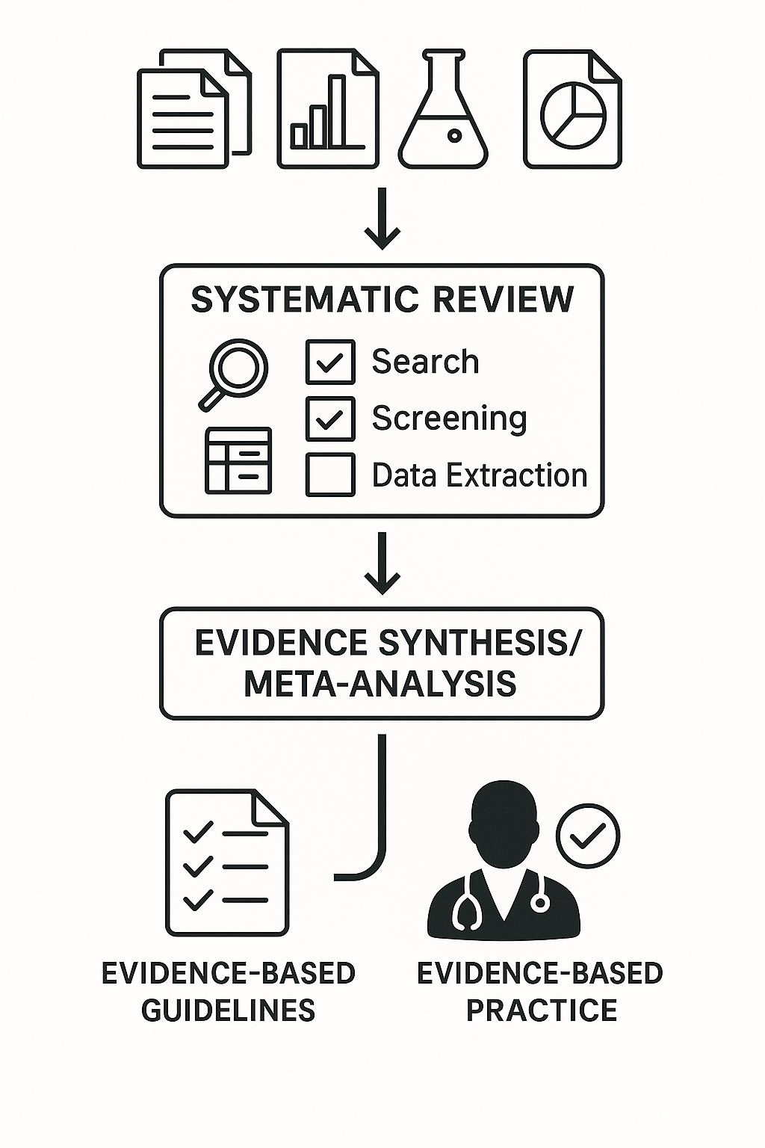
1.1 Research Background
Research Background
Research Question
Systematic review: Key element of evidence-based research and its quality largely depends on literature screening
Dataset
Framing questions for a review
Method
Identifying relevant work
Results and Discussions
Summary
Assessing the quality of studies
Summarizing the evidence
Interpreting the findings
Khan, K. S., Kunz, R., Kleijnen, J., & Antes, G. (2003). Five steps to conducting a systematic review. Journal of the Royal Society of Medicine, 96(3), 118–121.
Notes:
At the beginning, As all we know, Systematic reviews and meta-analyses are a key element of evidence-based research and its quality largely depends on whether researchers can screen out studies related to the review topic from a series of studies, that is literature screening.

Slide 4
1.1 Research Background
Research Background
Research Question
Traditional screening faces challenges
LLM may offer solutions
Dataset
Cognitive bias and inconsistent decisions
Difficulty handling vast and rapidly expanding scientific literature
Labor-intensive
Automated text comprehension
Scalability and consistency improvements
Method
Results and Discussions
Summary
Notes:
Literature screening is critical but labor-intensive and subjective
Traditionally, researchers have to manually sift through thousands of articles, reading titles and abstracts to decide if they are relevant. This manual process is prone to subjectivity and inconsistencies. Different reviewers might include or exclude different studies because of personal interpretation, which introduces bias. And as scientific literature keeps, it becomes harder to ensure we catch all relevant studies. Given these challenges, there's a growing interest in tools to help automate literature screening.

Slide 5
1.2 Literature Review
Research Background
Research Question
Dataset
Method
Results and Discussions
Summary
Since medical reviews are generally accurate and objective, the effectiveness of LLM-based literature screening tools has been well demonstrated.
Notes:
Recently, large language models (LLMs) have shown remarkable abilities in understanding and processing natural language. Before the era of large language models, people tried using machine learning for screening. For example, classifiers based on traditional algorithms or earlier deep learning models like BERT. Those had some success, but they often required a lot of labeled training data and still struggled with understanding context or abstract concepts; they needed retraining for each new topic. Large Language Models, by contrast, come pre-trained on vast text corpora and can understand language more deeply. They can potentially identify relevant studies by grasping context and meaning, not just by keyword matches. Especially, Since medical reviews are generally accurate and objective, the effectiveness of LLM-based literature screening tools has been well demonstrated.

Slide 6
1.2 Literature Review
Research Background
Research Question
Dataset
Method
Fig 1.Accuracy of LLM–Assisted Citation Screening in the Primary Analysis(Used results of the included publications)
Results and Discussions
Summary
Fig 2. Post Hoc Analysis for the Primary Analysis Using the Modified Prompt(Adopted a modified prompt based on false-negative studies)
Oami T, Okada Y, Nakada T. Performance of a Large Language Model in Screening Citations. JAMA Netw Open. 2024;7(7):e2420496. doi:10.1001/jamanetworkopen.2024.20496
Notes:
Here I post two studies in the field of clinical medicine or basic medicine that use large models for literature screening. One is from jama and the other is from jmir. Both have achieved very good results

Slide 7
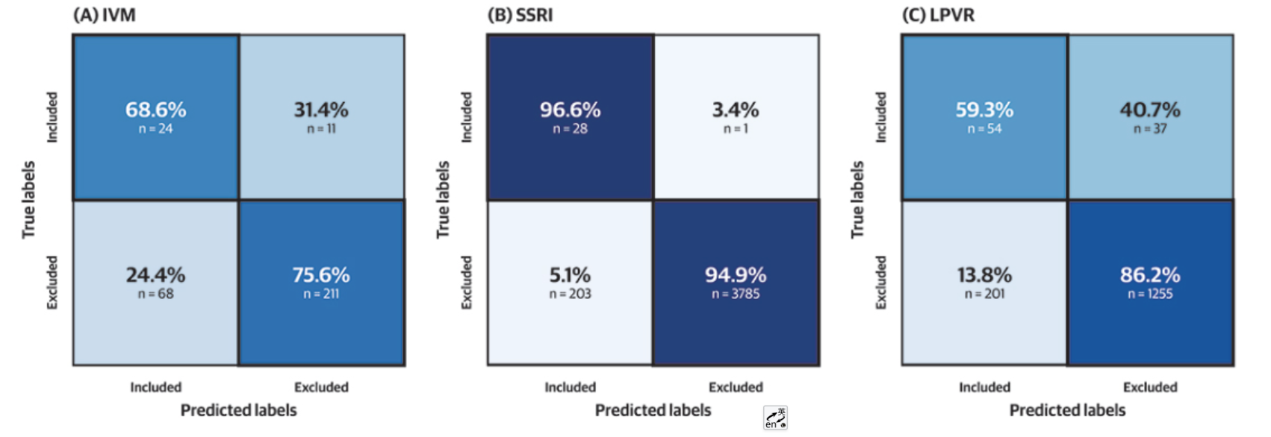
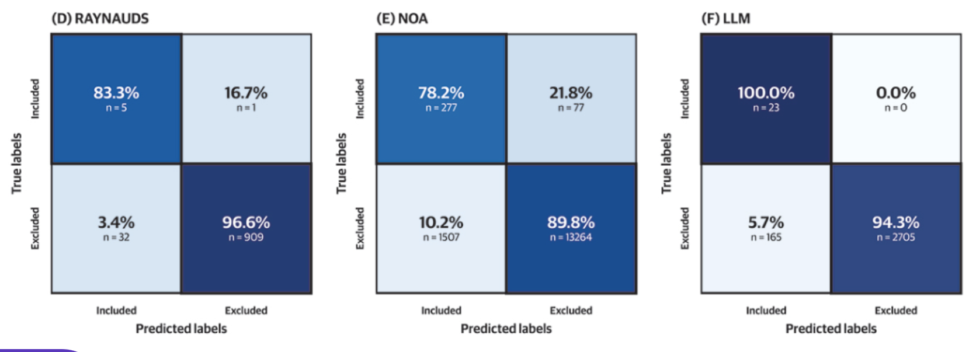
1.2 Literature Review
Research Background
Research Question
Confusion matrices for the included and excluded papers for all data.
IVM: ivermectin;
LLM: large language model;
LPVR: lopinavir-ritonavir;
NOA: nonopioid analgesia;
RAYNAUDS: Raynaud’s syndrome;
SSRI: selective serotonin reuptake inhibitor.
Dataset
Method
Results and Discussions
Summary
Guo E, Gupta M, Deng J, Park YJ, Paget M, Naugler C. Automated Paper Screening for Clinical Reviews Using Large Language Models: Data Analysis Study. J Med Internet Res 2024;26:e48996

Slide 8
2.1 Research Objective
Research Background
Research Question
Research Case: "How does the online health-knowledge gap emerge and evolve?"
Research Question
Dataset
When the research topic is interdisciplinary and abstract, can the LLM still effectively reduce the workload of literature screening
Method
Simulate the literature review scenario of interdisciplinary and abstract topics
Results and Discussions
Purpose
Summary
Evaluate the practical effectiveness of the LLM based literature screening workflow in interdisciplinary and abstract topics.
Developing an LLM workflow for literature screening of abstract topics
Identify the sources of errors.
Build the dataset
Test the LLM workflow’s effectiveness, Identify the sources of errors.
Notes:
So we want to figure out, What if the review topic is abstract and interdisciplinary(ˌɪntədɪsəˈplɪnəri)—less question like “Does drug X lower blood pressure?” and more question like “How does the online health-knowledge gap emerge and evolve?” The test dataset was “How does the online health-knowledge gap emerge and evolve?”. “

Slide 9
3.1 Dataset Obtain
Research Background
Keywords | Retrieve strategy
#1Knowledge Gap | (TS=( ("knowledge gap*" OR "gap*" OR "information inequalit*" OR "health disparity" OR "digital divide" OR “barrier” OR “difference” OR "information poverty" OR "health literacy gap*" OR "information access disparity" ) NEAR/5 (health* OR medical OR "patient education") )) NOT (SILOID==("PPRN")) Result: 114,892
#2 Social Impact Factor | (TS=( (socioeconomic OR "education level" OR "income disparity" OR "digital literacy" OR ageism OR "racial disparity" OR "geographic barrier*" OR "language barrier*") ) NOT (SILOID==("PPRN"))) Result: 599,290
#3 Online Environment | (TS=( ("online communit*" OR "social media" OR "health forum*" OR "eHealth platform*" OR "virtual support group*" OR "mHealth" OR "telemedicine" OR "web-based interaction*" OR "digital health space*" OR "peer-to-peer network*") )) NOT (SILOID==("PPRN")) Result: 340,869
#4 Health Information Communication | (TS=(("health information exchange" OR "health communication" OR "information sharing behavior*" OR "interactive health communication" OR "discussion*" OR "patient-provider communication" OR "peer-to-peer health advice" OR "collaborative health sensemaking" OR "health knowledge co-construction" OR "communicat*") ))NOT (SILOID==("PPRN")) Result: 8,666,738
#5 Merged | (((#1 OR #2)) AND #3) AND #4 and Preprint Citation Index (Exclude – Database) Result: 3,638
Search time: 2025.02.21 19:20
Research Question
Dataset
Method
Results and Discussions
Summary
Notes:
Health-knowledge communication gap” is a concept whose borders bleed into “digital divide,” “information inequality,” and half a dozen other literatures, so simple keyword filters are noisy. We retrieved it on WOS, After deduplication we had exactly 3,638 records.

Slide 10
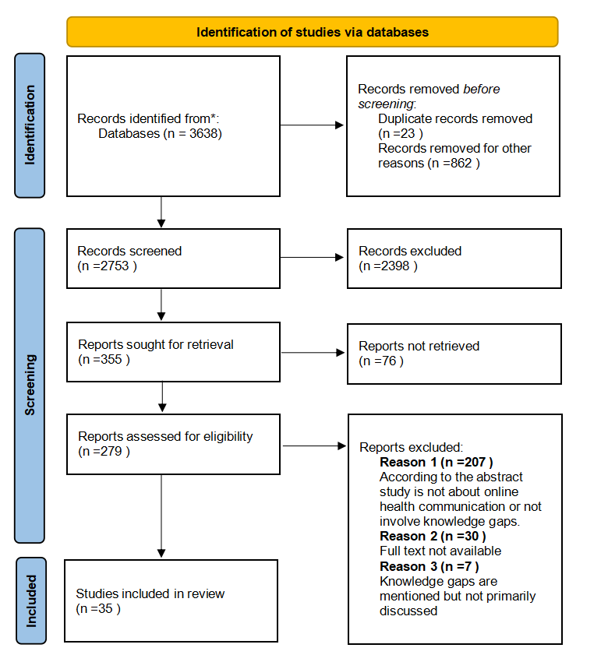
3.2 Dataset Obtain
Research Background
Research Question
Dataset
Method
Results and Discussions
Final inclusion: 35 relevant studies identified by two reviewers.
Summary
Notes:
Finally there are 35 relevant studies identified by two reviewers.

Slide 11
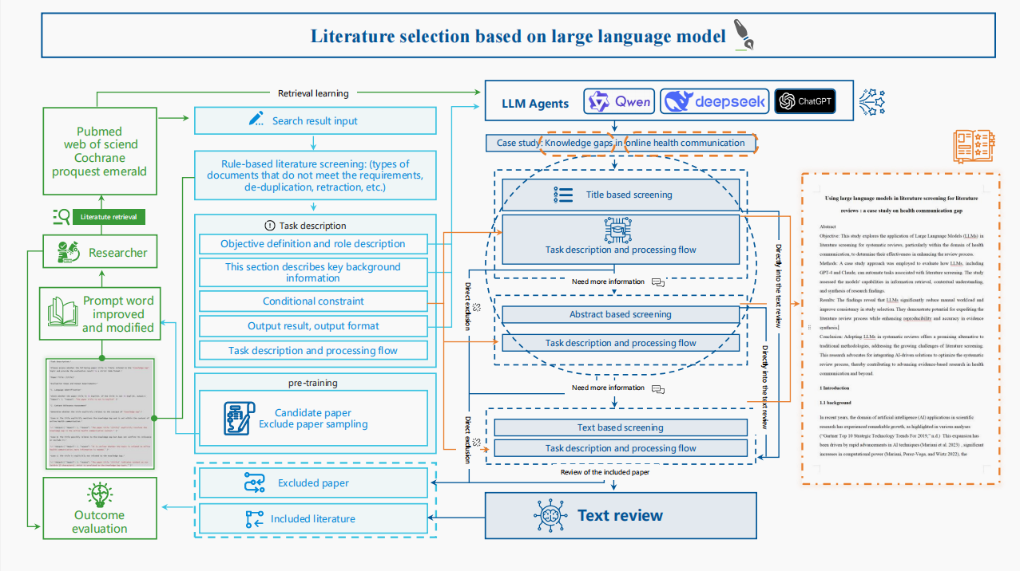
4.1 Workflow Construction
Research Background
Research Question
Dataset
Method
Results and Discussions
Summary
Notes:
We used a lightweight API platform around the DeepSeek-R1 open-source LLM. The workflow has four layers.

Slide 12
4.1 Workflow Construction
Research Background
Research Question
(i)Rule‑based Pre‑Filter: Regular expressions excluded records with missing abstracts, conference editorials.
(ii)Title Pass: Model rated each title on a 3‑point relevance scale. Only items rated ≥ 2 advanced.
(iii)Abstract Pass: Abstracts of retained items were re‑ranked on a 5‑point scale, threshold ≥ 3 will be retained.
(iv)Full‑Text Pass: Where OA PDFs were available, if the pdf does not exceed 50 pages, the model will read the full text.
Dataset
Method
Results and Discussions
Summary
The workflow follows the PRISMA process to achieve better speed and lower cost
Notes:
First, a rule-based pre-filter threw away items with no abstracts or obvious editorial content. Next, the model rated every remaining title on a three-point scale of relevance; anything scoring two or higher survived into the second pass. In that pass the abstract was scored on a five-point scale; only scores of three or above advanced. Finally, where an open-access PDF was available and shorter than fifty pages, the model skimmed the full text.

Slide 13
4.1 Workflow Construction
Research Background
Research Question
Task Description(Title Screening):
Determine whether the title explicitly relates to the concept of "Knowledge Gap":
3*: The title explicitly mentions the Knowledge Gap and is set within the context of online health communication.
2*: The title possibly relates to the Knowledge Gap but does not confirm its relevance or exclude it.
1*: The title is explicitly not related to the Knowledge Gap.
Dataset
Method
Results and Discussions
Summary
Notes:
At each stage it had to explain its verdict in short sentences so that we could audit its logic. Like this, this is a brief Task Description for title screening in our workflow, we have given different specific meanings to different ratings

Slide 14
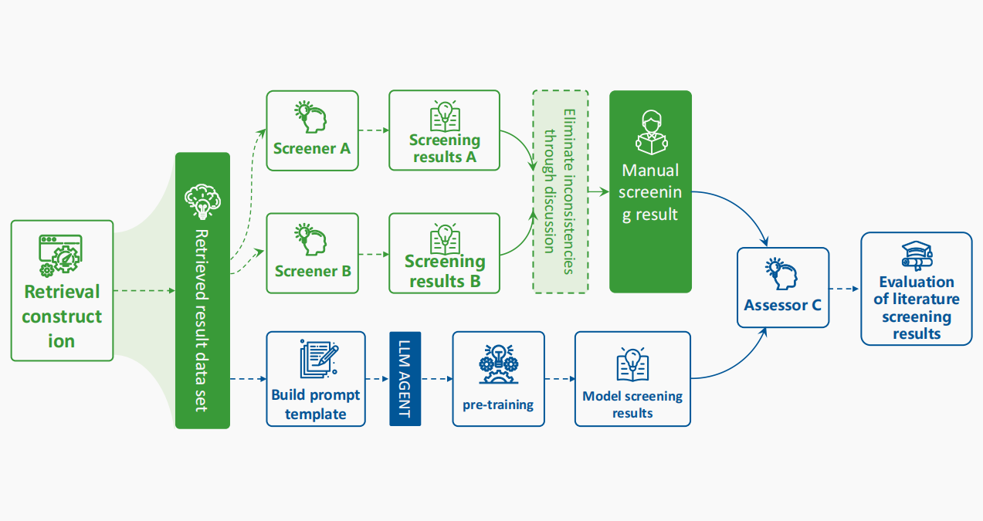
4.2 Outcome Assessment
Research Background
Research Question
Dataset
Method
Results and Discussions
Summary
Notes:
Disagreements between the model and a human reviewer were flagged, and a third accessor issued the final call, giving us not only a decision but also try to figure out the why inconsist happened.

Slide 15
5.1 Result
Research Background
Research Question
Model | Accuracy | Precision | Recall | F1-Score | Cohen’s Kappa
Deepseek-R1* | 0.947 | 0.914 | 0.145 | 0.530 | 0.237
Research Workflow | 0.994 | 0.771 | 0.675 | 0.723 | 0.408
Research Model (After Adjusted) | 0.994 | 0.840 | 0.525 | 0.683 | 0.383
Dataset
Method
Results and Discussions
Summary
*Only offered the task objective
Notes:
As our results. In its baseline the workflow reached a precision of 0.77 and a recall of 0.68, a Cohen’s kappa of 0.38 against expert consensus. After unifying the inconsistent results between the model and the evaluator, the model’s precision climbed to 0.84, although it’s recall declined to 0.53 . By the way, the model identified three studies that both human reviewers had missed .

Slide 16
5.2 Comparison of inconsistent results in literature screening (partial)
Research Background
Research Question
Article title | Included/Excluded Reason(LLM) | Included/Excluded Reason(Reviewer)
Framing Public Opinion on Physician-Patient Conflicts on Microblog: A Comparative Content Analysis | Excluded: The paper's title, 'Framing Public Opinion on Physician-Patient Conflicts on Microblog: A Comparative Content Analysis,' shows that the content is irrelevant to the knowledge gap topic. | Included: Knowledge gaps are reflected by differences in opinion among doctors, the public, and the media.
Online health consultation: Examining uses of an interactive cancer communication tool by low-income women with breast cancer | Included: The effects of online health counseling for low-income patients involve knowledge gaps in online health communication scenarios. | Excluded: To investigate how psychosocial variables predict the use of online health counseling services by low-income breast cancer patients and how the use of the service affects these same psychosocial outcomes.
Dataset
Method
Results and Discussions
Summary
Limitations and Recommendations:
LLMs require expert oversight, particularly for nuanced cases.
Ongoing risk management for biases and hallucinations.
Notes:
Why, then, does recall still lag? Our error analysis showed two repeating patterns. False positives were articles that talked about the “digital divide” or “health disparities” but never actually framed a knowledge gap in communication terms; the model latched onto surface cues. False negatives were like mirror images—papers where authors hinted at gaps in research without actually saying the word 'gap.' Basically, the model is great at spotting obvious keywords but struggles with hidden meanings, especially when social science authors get creative with their wording. Prompt engineering helps a little, but the real solution is clear: keep a human reviewer in the loop and focus their attention where the model is unsure

Slide 17
6.1 Summary
Research Background
Research Question
Key Findings
LLM-based workflow completed literature screening (3,638 studies) in approximately 90 minutes. Substantially reduces reviewer burden.
LLM identified 3 eligible studies initially overlooked by human reviewers.
LLM performs high-volume triage; humans handle edge cases.
Difficulty capturing implicit relevance.
Difficulty distinguishing thematic centrality from incidental mentions.
Limitations
Single, small positive set within one interdisciplinary domain.
Evaluated only one open-source model (DeepSeek-R1).
More indicators should be considered
Dataset
Method
Results and Discussions
Summary
Notes:
To summary our finding. First, yes, LLMs really can reduce the seventy or eighty percent of citation screening while raising precision above many human-only pipelines. Second, they cannot yet be trusted completely without supervision—but a mixture design in which people adjudicate(əˈdʒuːdɪkeɪt) low-confidence cases can already improve eiffiency but also may help you to find missed evidences.
Of course, the work has limitations. We tested only one open-source model and only one data. There is no specific calculation in the statistics of time and money costs. We now have grants to replicate across domains—from oncology trials to agricultural economics—and to compare GPT-4o, Phi-3, and several RAG-style hybrids.

Slide 18
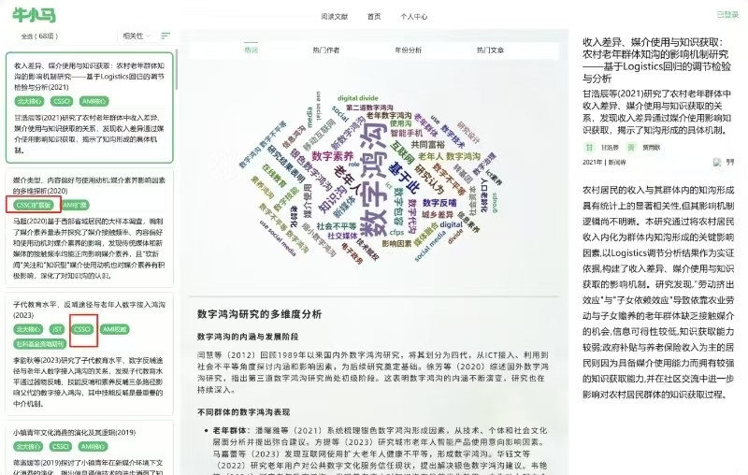
6.2 Additional
Research Background
Research Question
The current progress of our research
We are building specific agents for each domain and use multi-agent scoring for interdisciplinary topics.
We aim for a universal screening system that needs no extra tailored prompts.
We reduce costs by optimizing algorithms and expanding llm models and datasets to test our workflow
Dataset
Method
Results and Discussions
Summary
Our demo2.0 is now be testing

Slide 19
6.2 Additional
Research Background
Research Question
Our demo2.0 is now be testing
Dataset
Method
Results and Discussions
Summary

Slide 20
Thank you for listening
Using large language models in literature screening for bibliometrics and reviews: a case study on health communication gap
Author：Ni Cheng, Heng Dong, Xuan Han, Beibei Tan, Shuzhen Zhu
Speaker：Heng Dong
M202375953@hust.edu.cn

